Slide 1
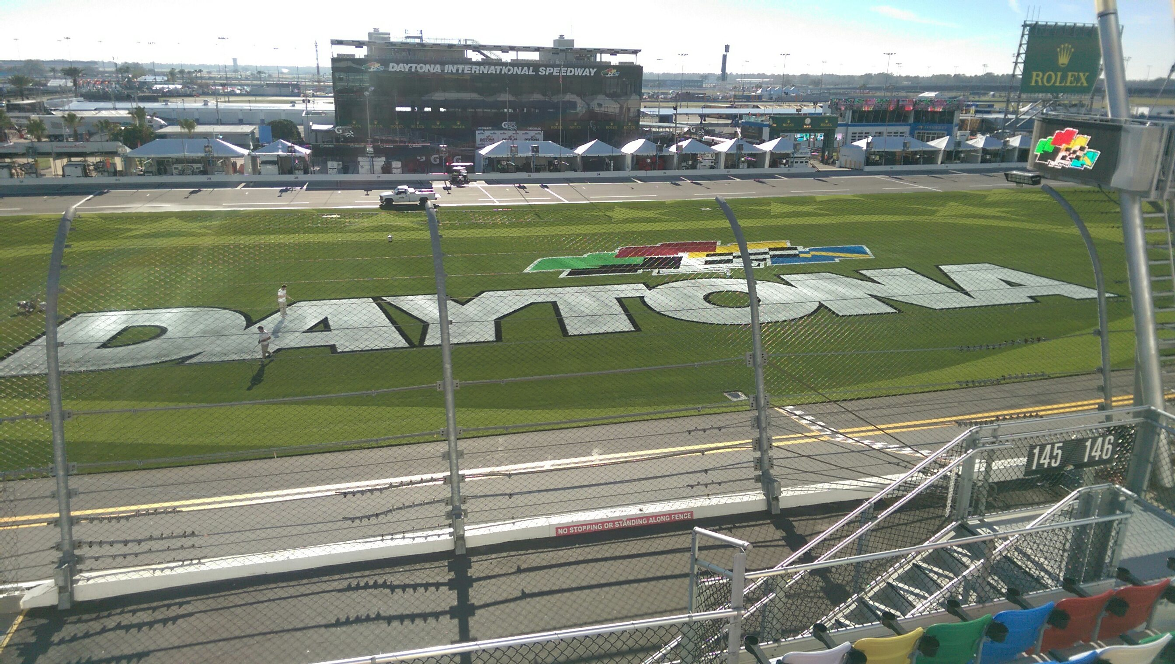
2017 Daytona 500 was last Sunday, February 26

Slide 2
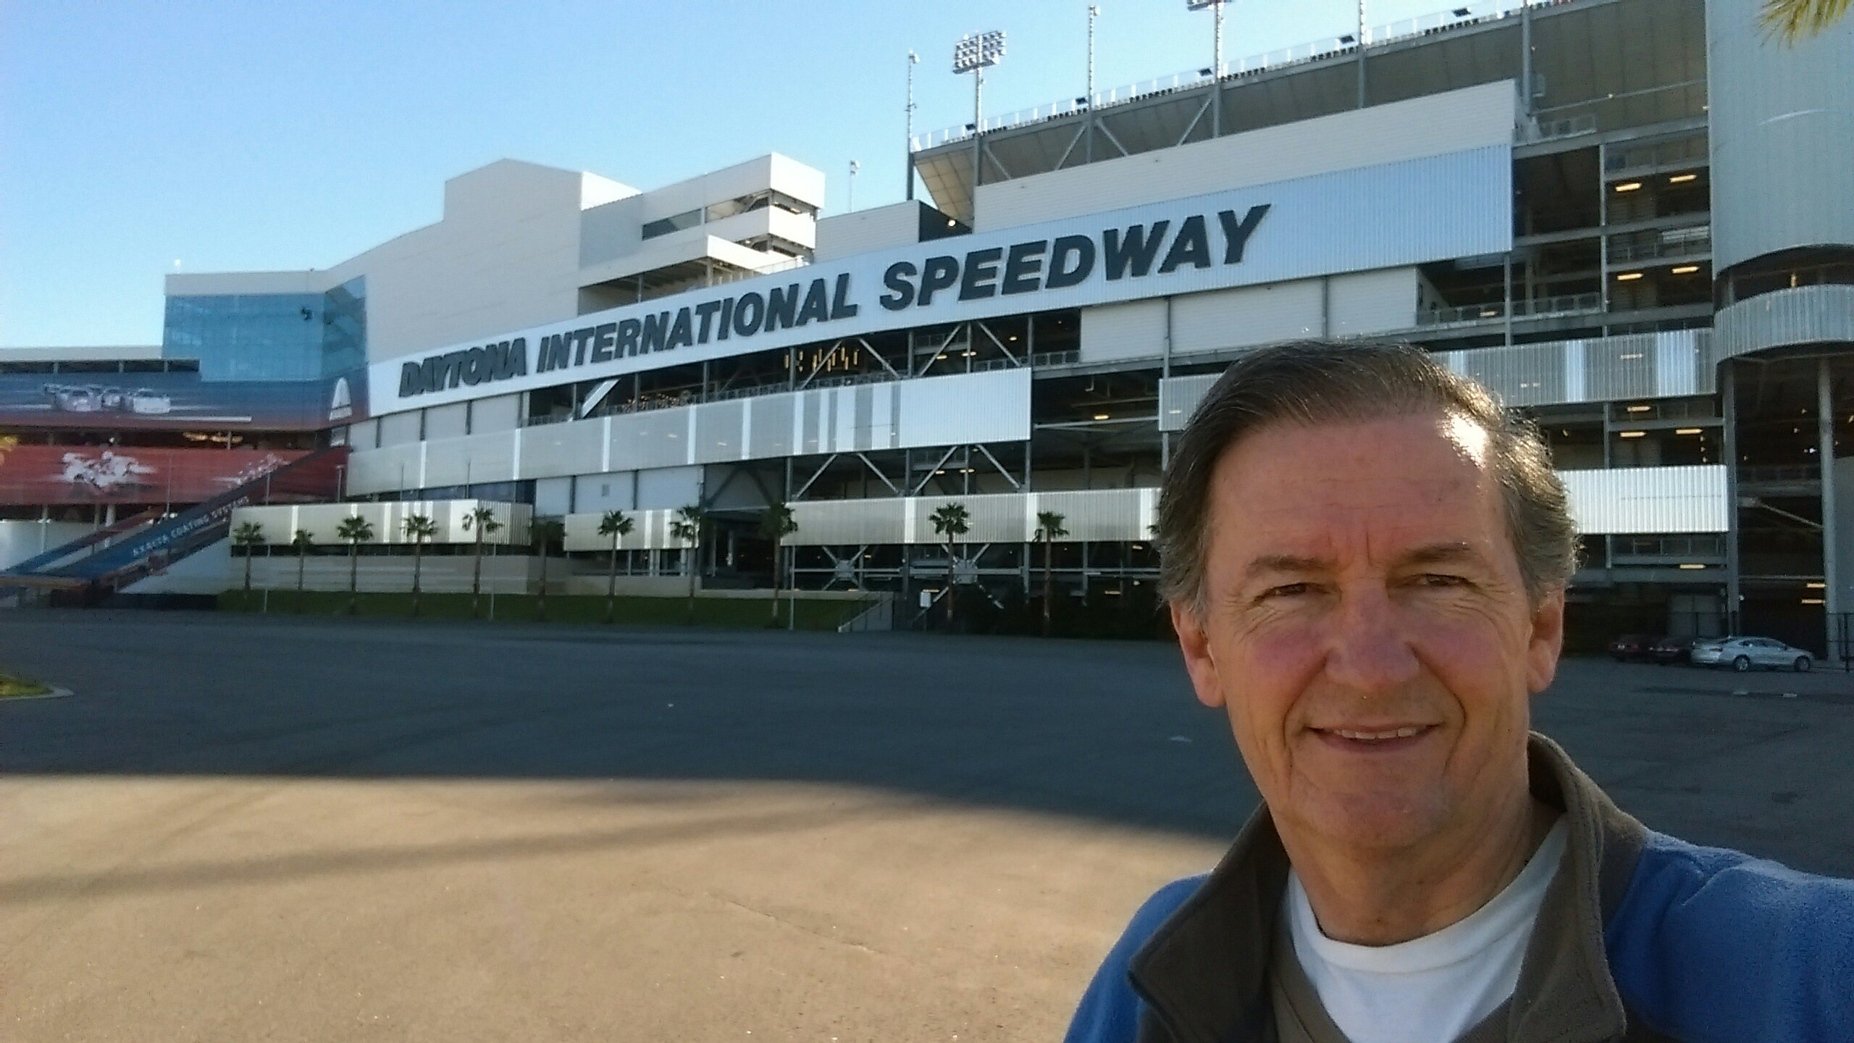

Slide 3
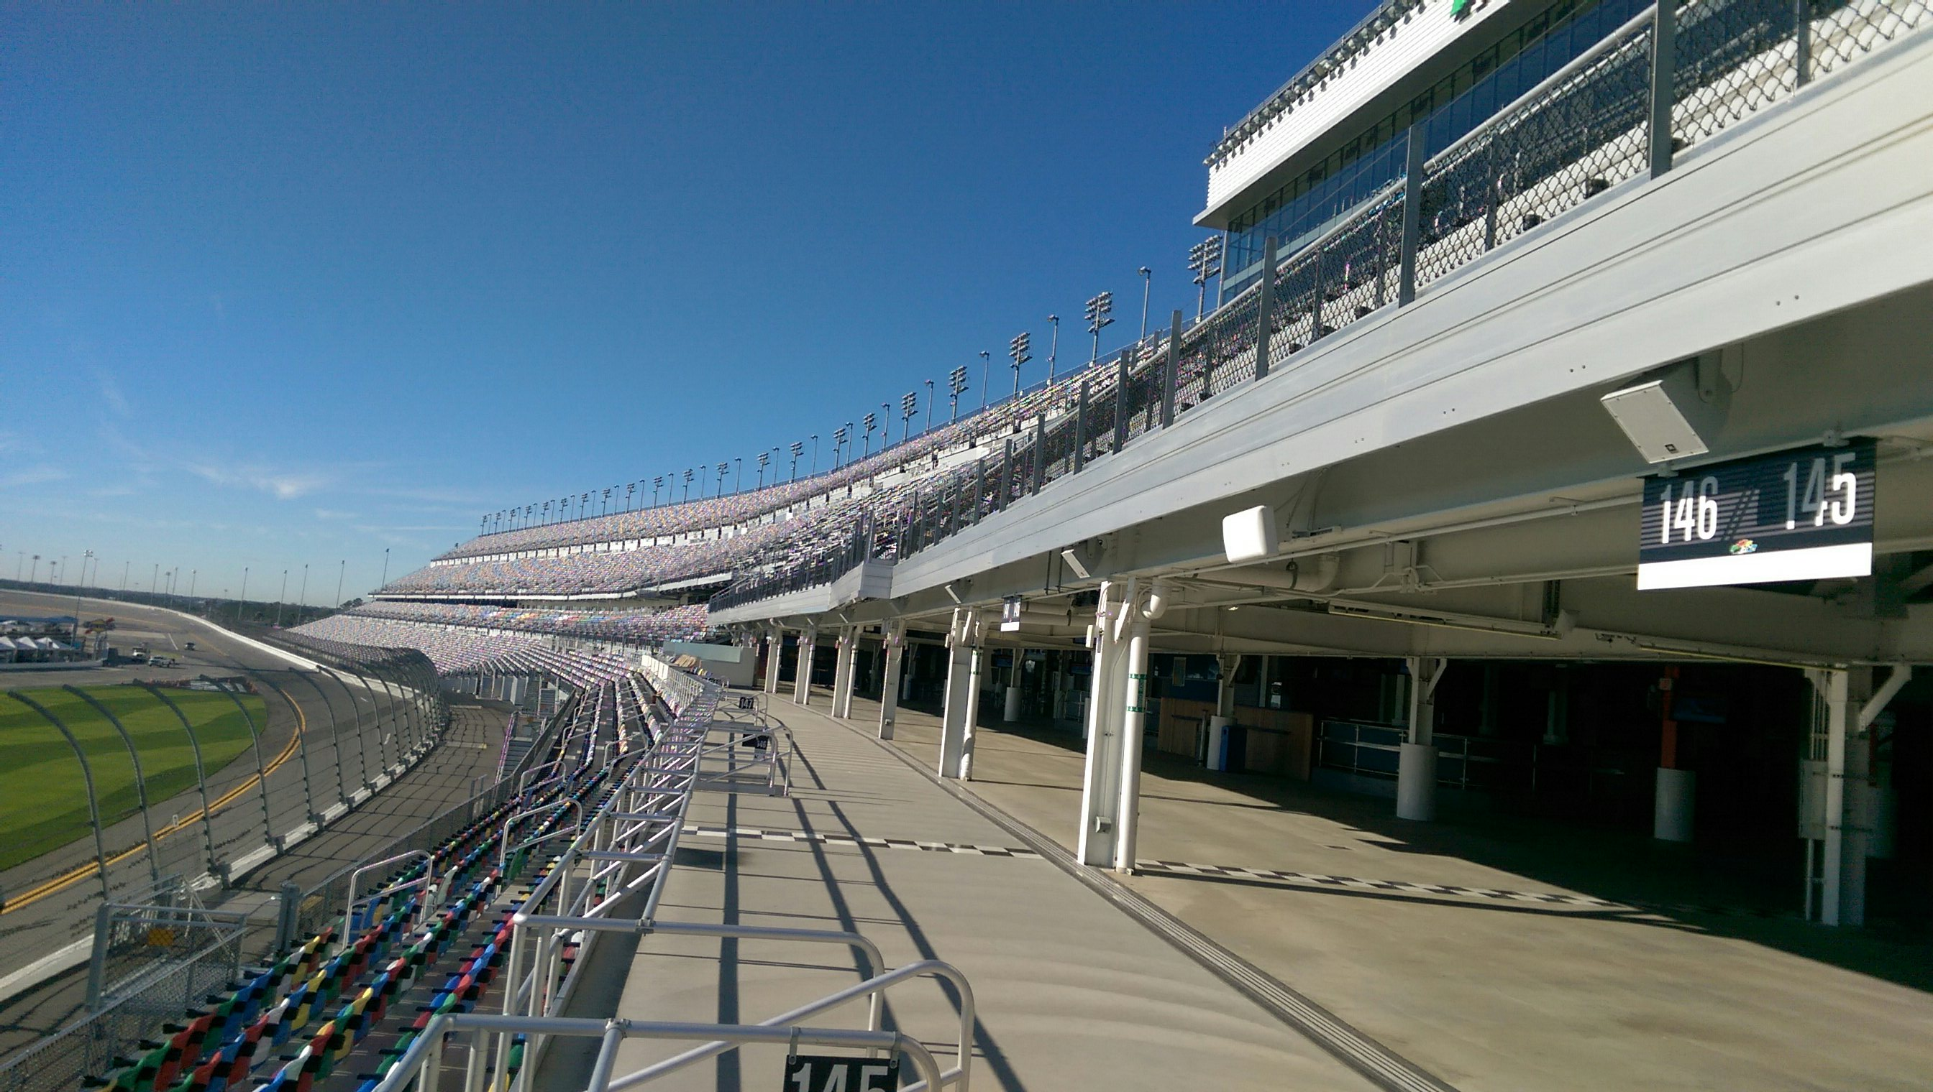
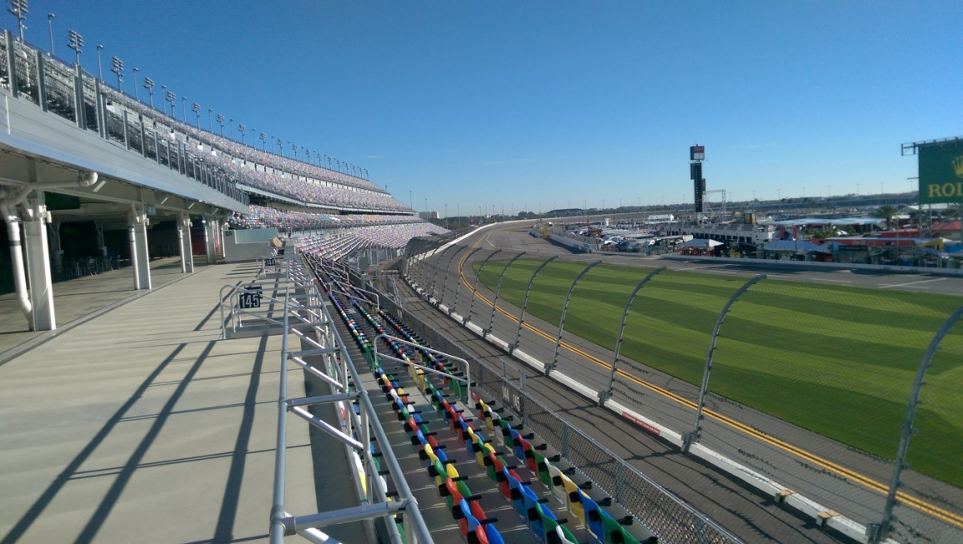
101500 Seats

Slide 4
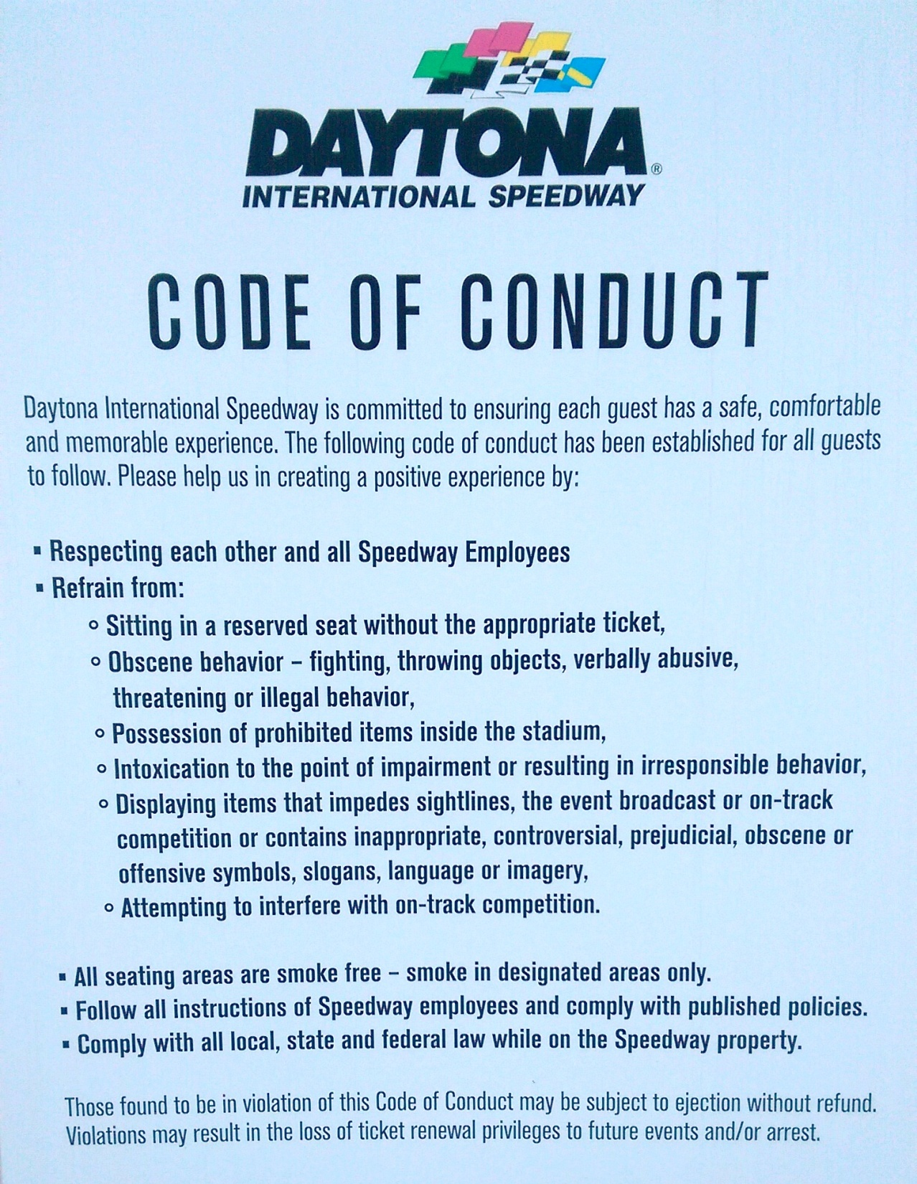

Slide 5
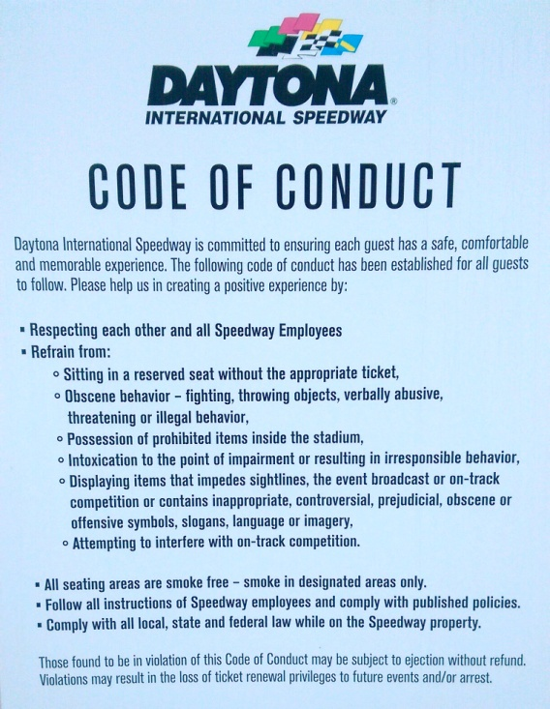
“Code of Conduct”
Titus 2:11-15
Some Conduct is Unacceptable
Tit.2:12, Col.3:5-9, Eph.4:25-31, Gal.5:19-21, 1Cor.5:1ff, etc.
Some Conduct Should to be Expected
Tit.2:12-15, Col.3:10-17, Gal.5:22-25, Matt.28:20, etc.
Failures In the Code of Conduct, Leads to Discipline
1 Cor.5:1-8, 2 Thess.3:6-14. etc.

Slide 6
The Plan of Salvation
Hear the Gospel of Christ, Acts 18:8
Believe in Jesus Christ, Acts 2:36
Repent and Turn to God, Acts 2:38
Confess Jesus Before Men, Acts 8:37
Be Baptized for Forgiveness, Ac.22:16
-----------------------
Be Thou Faithful Unto Death, Rev.2:10
If Err From The Faith: Repent and Pray God Acts 8:22

