Slide 1
There were Problems & Troubles in the 1st Century Churches
Acts 6:1
Acts 15:1-2
1 Cor.1:11, 3:3, 5:1, 11:17-19, 15:12
Gal.1:6, 2:3-4, 2:12-13, 5:7
Rev.2:4-5, 14-15, 20, 3:1-3, 15-17

Slide 2
That Shouldn’t Be So!
Seek Human Wisdom, Human Solutions? Ps.55:6, Lk.8:13, Pr.14:12
Seeking Biblical Solutions
Acts 6:2-5
Acts 15:6 ff
1 Cor.1:10, 14:37
Gal.5:14-17
Rev.2:7, 11, 17, 29, 3:6, 13, 22

Slide 3
Jesus is the Solution
Hear the Gospel of Christ, Acts 2:22
Believe in Jesus Christ, Acts 16:31
Repent and Turn to God, Acts 17:30
Confess Jesus Before Men, Acts 8:37
Baptized Into Christ, I Pet.3:21
---------------------------------------------
Grow And Be Faithful, 1 Pet.2:2
If Err as a Christian: Repent and Pray God 1 Jn.1:9

Slide 4
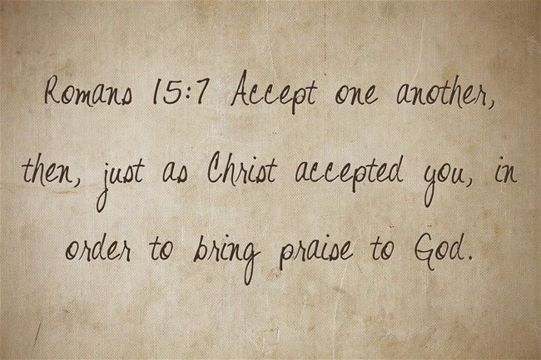
Thanks For Coming

