Slide 1
Repent or Perish
Luke 13:1-9

Slide 2
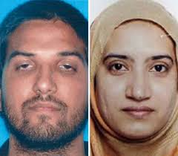
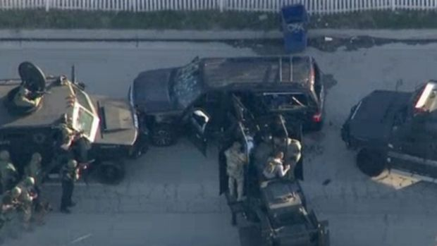
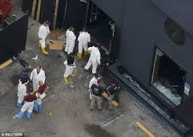
Think These are Worse Sinners? Vs.1, 2, 4

Slide 3
Repentance is Not…
Remorse for sin, regret, Matt.27:3
Getting Scared, Acts 24:25 (Felix)
Penitence
Merely Reporting Sin
Merely Saying I am Sorry
Making Excuses for Sin

Slide 4
What is Repentance?
Definition of the Word:
metanoeō From G3326 and G3539; to think differently or afterwards, that is, reconsider (morally to feel compunction): - repent.
To change one’s mind, i.e. to repent. To change one’s mind for better, heartily to amend with abhorrence of one’s past sins
Turning From Sin, Turning to God
180 degree - U-Turn

Slide 5
What is Involved in Repentance?
Conviction of Sin, John 16:8, Acts 2:37
Godly Sorrow, 2 Cor.7:8-10
Fear of the Lord, 2 Cor.5:10
God’s Goodness, Rom.2:4
Change of Mind – Luke 15:17
Fruits of Repentance, Acts 26:18-20, Acts 19:18-20, Luke 3:7-14

Slide 6
Repentance is Essential to Salvation Absolutely Necessary
Luke 13:3, 5
Luke 24:47
Acts 2:38
Acts 3:19
Acts 8:22
Acts 11:18
Acts 17:30-31

Slide 7
A Parable About Repentance
Luke 13:6-9
God is Patiently waiting for us to Repent.
2 Peter 3:9, 14-15
God is showing Longsuffering to us, for us to Repent

Slide 8
You Can Repent and Come to Jesus
Hear the gospel of Christ, Acts 18:8
Believe in Jesus Christ, Jn.3:16
Repent and Turn to God, Acts 17:30
Confess Jesus Before Men, Acts 8:37
Be Baptized For Forgiveness, Acts 22:16
---------------------------------------
Cleave Unto The Lord, Acts 11:23
If Err From The Truth: Repent and Pray God Acts 8:22

