Slide 1
A Powerful Text
Heb.4:12
Gen.1:26-28

Slide 2
God Made, God Created, God Formed
Affirmed in Gen.1:26, 27; 2:7
Know from What, Gen.2:7, Dust & Water (60-70%)
(Through the squeezing into shape); to mould into a form; especially as a potter
Formed Spirit Also, Zech 12:1
Not The General Theory of Evolution
Special Evolution - Limited Change - Yes
Chemical Evolution, Spontaneous Generation
Go From One Species to Another
Theistic Evolution

Slide 3
Let Us, In Our Image, Our Likeness
Our, Us, Plural Pronouns
3 Persons in One Godhead, Deut.6:4
Gen.1:1-2, Jn.1:1-3: Father, Jesus, Holy Spirit
1 Cor.13:5, Essence of love: “Seeketh not her own”
Errors about God
Jesus Only Doctrine
Jesus Created First, Jr. God, Mighty God Is.9:6, “A god”
No God But Allah

Slide 4
Male and Female
Definition of the Original Marriage
Gen.2:18-25, language shows permanence
Jesus cites these texts, Matt.19:3-9
Errors Abound Today
Homosexual Marriage, Lesbian Marriage, Same Sex Marriage
Practice of Polygamy
Concubines, Paramours
Female Sex Slaves – History of Islam

Slide 5
He Created them Male and Female
God Made them Male and Female
Similarities yet Differences
Compliment each other, Balance each other
Who are we to question God?
Do we expect our creations to change purposes?
Error we See Today
Transgenderism
Work hard to Change outward body…
Why Not work hard to change inward Attitude, Viewpoint, Mindset?

Slide 6
He Made Male 1st and Female 2nd
God Made Man First and Female Second
Gen.2:18-25, The order of creation described
1 Cor.11:3, 1 Tim.2:11-15
Functional Subordination: Family & in the Church
Equality in Relationship in Christ, Gal.3:28
Error We See Today
No Distinction – “Equal Rights Amendment”
Women Preachers, Pastors, Bishops
Women Exercising Authority over Men in Church
Women Wearing “Pants” in the Family

Slide 7
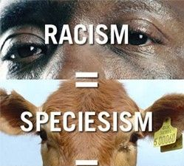
We Are Made in the Image & Likeness of God
We Look Like God
Intelligence, Emotions
Free Will, Volition, Power of Choice
Why it is Wrong to Murder Humans, Gen.9:6
We are Accountable before God – Judgment Day
Error People Believe today
There is No God and No Moral Standard
Product of Evolution
Equal with our Fellow Animals
Speciesism is Like Racism

Slide 8
Let Them Have Dominion Over…
Where God Placed Man & Woman in Creation, vs.26, 28
Beasts of Burden
Animals for Food, Gen.9:3, 1 Tim.4:3-5
The Just and Animals, Prov.12:10, Matt.6:26
Error in Minds of Some
We are all Fellow-animals in this World
No Difference in Killing a Chicken and Killing a Person (Yet Believes in Abortion)
Graphics to show not making this stuff up . . .

Slide 9
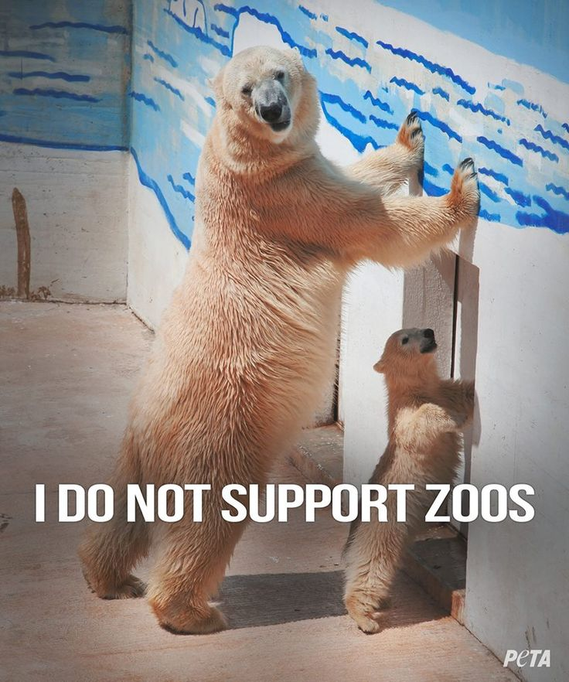
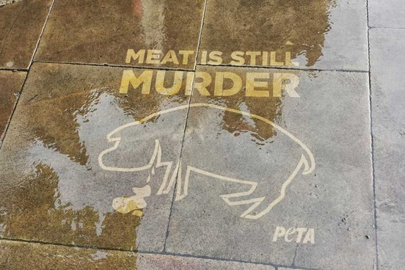
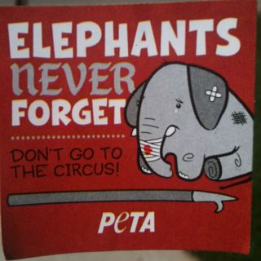

Slide 10
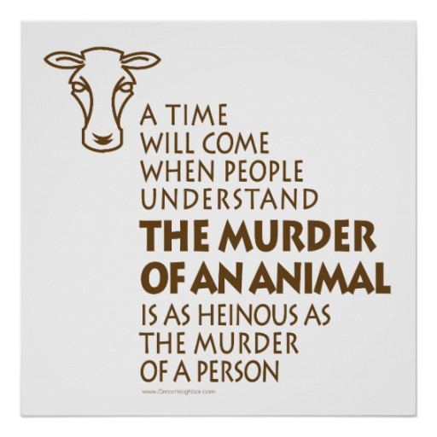
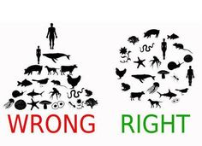

Slide 11
Let Them Replenish & Subdue the Earth
Man’s Relationship to the Planet, vs.28
Multiply & Replenish, fill the earth
Subdue: A primitive root; to tread down; to conquer, subjugate. Bring into bondage, force, keep under, subdue, bring into subjection.
Tame Rivers - Dams, Manage Forests, Cut Mountains and fill valleys, Use Natural Resources
Errors Today
“Overpopulation”
Tree Huggers, Don’t cut any trees
Tear Down all Dams
Leave Amazon Forrest Alone

Slide 12
We Are Accountable Creatures
Hear the Gospel of Christ, Rom.10:17
Believe in Jesus Christ, Jn.8:24
Repent and Turn to God, Luke 13:5
Confess Jesus Before Men, Acts 8:37
Be Baptized for the Remission of Sins, Ac.2:38
---------------------------
Be Thou Faithful Unto Death, Rev.2:10
If Err as a Christian: Repent & Confess, Acts 19:18

