Slide 1
What Do You Want to See in Heaven?
A Family Feud Game Show Question

Slide 2
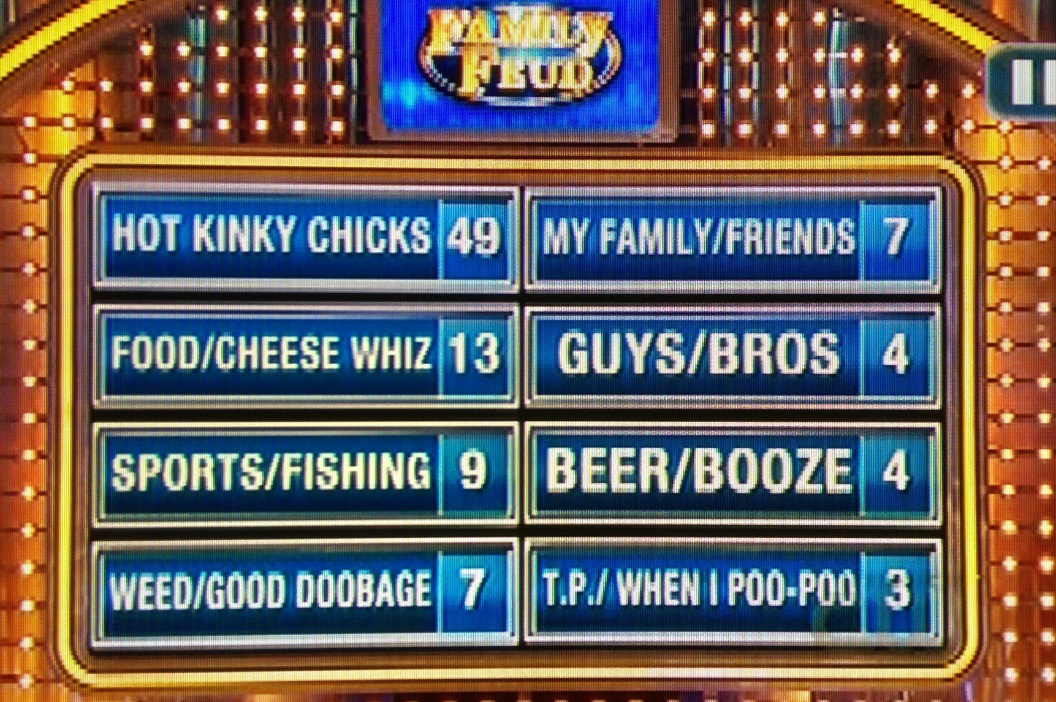
100 Men Surveyed…
What Do You Want to See in Heaven?
Carnality – Rom.8:5-8
Heaven Would Be Torment

Slide 3
What Do You Want to See in Heaven?
The Godhead: The Father, Jesus, Holy Spirit, Is.6:1 ff, Ezek.1:4 ff; Rev.4
Angels, Living Creatures, Seraphims
Heaven, The Abode of God, Mansions, Mt.6:9, Jn.14:1-3
Faithful of the Old Testament & New Testament, Heb.11
The Faithful of My Time, 2 Tim.4:8
The Glorified, Immortal Body, 1 Jn.3:2, 1Cor.15:42-44, Rev.21:4
When We Gather to Worship Our God, Rev.5:11-14

Slide 4
You Can Go To Heaven – Spiritually Minded
Hear the gospel of Christ, Acts 18:8
Believe in Jesus Christ, Rom.5:1
Repent and Turn to God, Acts 17:30
Confess Jesus Before Men, Matt.10:32
Be Baptized for the Remission of Sins, Ac.2:38
--------------------------
Be Thou Faithful Unto Death, Rev.2:10
If Err From The Faith: Repent and Pray God 1Jn.1:9

