Slide 1
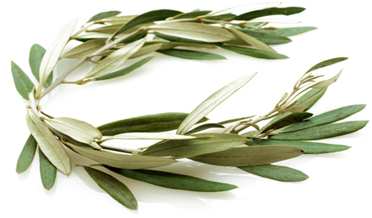
The Crown
1 Cor.9:25 BBE
“And every man who takes part in the sports has self-control in all things. Now they do it to get a crown which is of this world, but we for an eternal crown.”

Slide 2
2 Types of Crowns in N.T.
Rev.19:12, 1) a diadem. 1a) a blue band marked with white which Persian kings used to bind on the turban or tiara. 1b) the kingly ornament for the head, the crown
Stephanos - The wreath or garland which was given as a prize to victors in public games. Metaphorically the eternal blessedness which will be given as a prize to the genuine servants of God and Christ: the crown (wreath) which is the reward of the righteousness

Slide 3
Victory is In Jesus
John 16:33
Rom.8:37
1Cor.15:54-57
1John 5:3-5
Rev.3:5
Rev.17:14

Slide 4
The Crown of . . .
Glory, 1 Peter 5:4, 2Cor.3:6-12, 2Cor.4:4-6
Life, James 1:12, Rev.2:10, John 10:10, John 14:6, Col.3:3-4
Righteousness, 2Tim.4:6-8, Rom.1:16-17, 3:21-26, Phil.3:7-14

Slide 5
Will You Strive For The Eternal Crown?
Hear the Gospel of Christ, Acts 18:8
Believe in Jesus Christ, Rom.5:1
Repent and Turn to God, Luke 24:47
Confess Jesus Before Men, Matt.10:32
Baptized Into Christ, Gal.3:26-27
-----------------------------
Grow And Be Faithful, 2 Pet.3:18
If An Erring Christian: Repent and Pray God, I Jn.1:9

