Slide 1
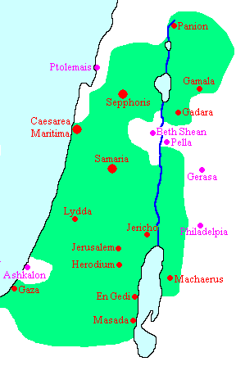
Luke 3:16-20
Machaerus
Ma-Key-Rus
Ma-Care-Rus

Slide 2
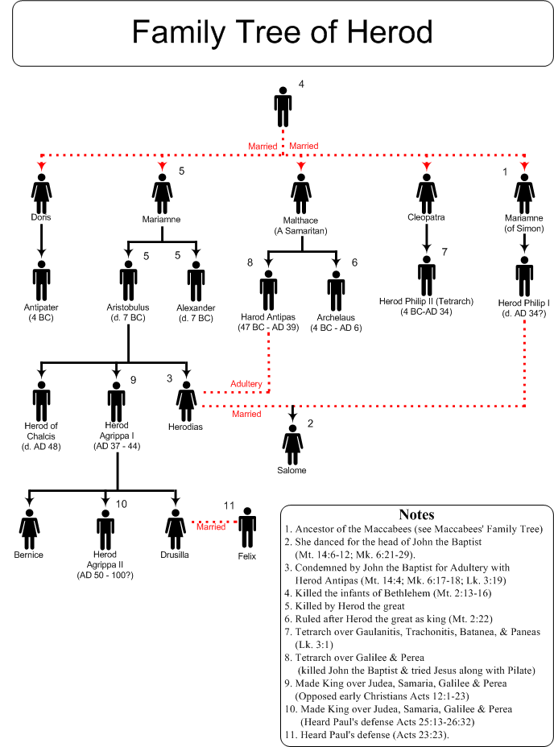
Matt. 14:1-12
Mark 6:14-29

Slide 3
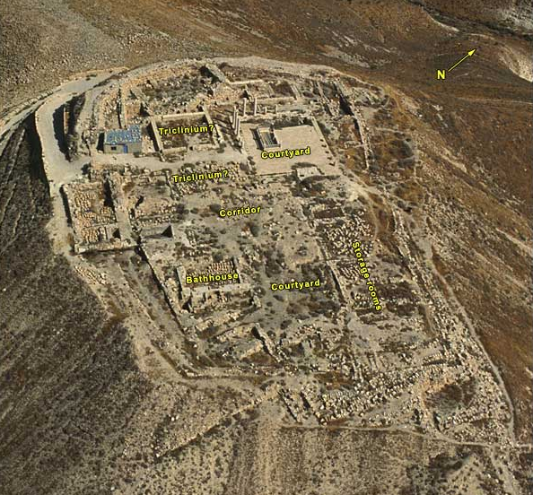
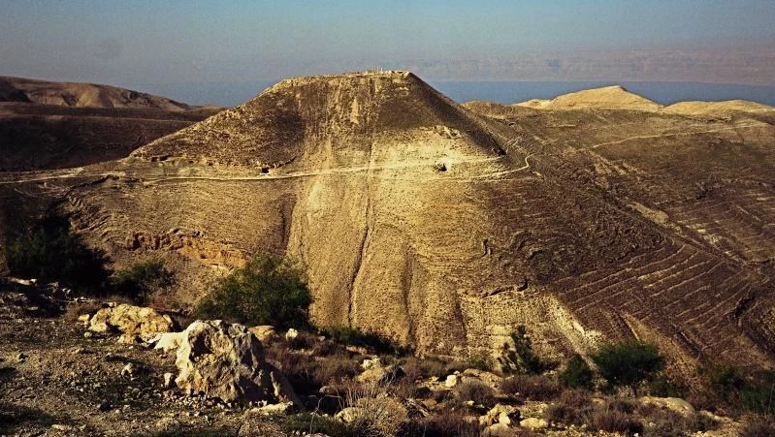
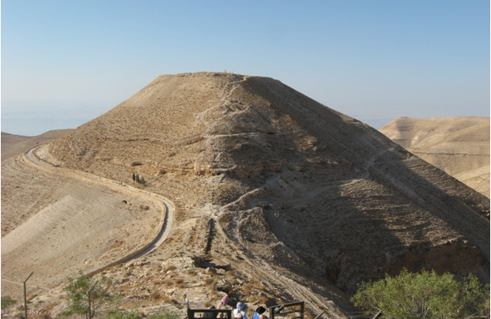
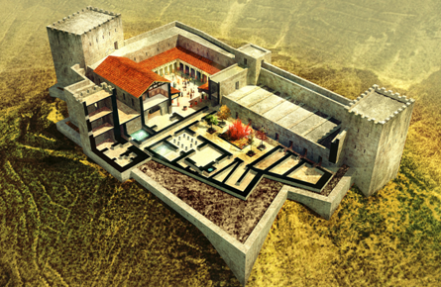
Machaerus
Always Been Wicked People
Truth is the Truth
Courage to Say The Truth
Persecution Can Come
Can’t Kill The Soul
Compassion of the Saints

Slide 4
The Plan of Salvation
Hear the Gospel of Christ, Acts 18:8
Believe in Jesus Christ, Acts 16:31
Repent and Turn to God, Acts 17:30
Confess Jesus Before Men, Acts 8:37
Be Baptized For Forgiveness, Acts 2:38
---------------------------------
Cleave Unto The Lord, Acts 11:23
If Err From The Truth: Repent & Pray God Acts 8:22

