Slide 1
“A Living Sacrifice”
Acts 21:6
“And when we had taken our leave one of another, we took ship; and they returned home again.”
Rom.12:1-2

Slide 2
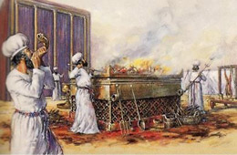
A Living Sacrifice
Conclusion Drawn
Compassions of God
Present… It is the technical term for presenting the Levitical victims and offerings.
Your Bodies, 1 Cor.6:20, Phil.1:20
Living Sacrifice. The Problem?
Holy, Sanctified, 1 Pet.1:15-16
Acceptable, Well Pleasing, 2 Cor.5:9
Reasonable Service, spiritual service, spiritual worship, Matt.4:10

Slide 3
A Living Sacrifice
Not Be Conformed. To fashion alike, that is, conform to the same pattern
This World, Age, 1 Jn.2:15-17
Transformed, “Metamorphosis”
Renewing of Your Mind, Eph.4:17-23
That Ye may Prove, to Test. Not assume, guess, take it for granted
Good, and Acceptable, and Perfect
Will of God, Authority, 2 Tim.3:16-17

Slide 4
The Plan of Salvation
Hear the Gospel of Christ, Acts 18:8
Believe in Jesus Christ, Rom.5:1
Repent and Turn to God, Luke 24:47
Confess Jesus Before Men, Acts 8:37
Be Baptized for the Remission of Sins, Ac.2:38
---------------------------------
Be Thou Faithful Unto Death, Rev.2:10
If Err From The Faith: Repent and Pray God Acts 8:22

