Slide 1
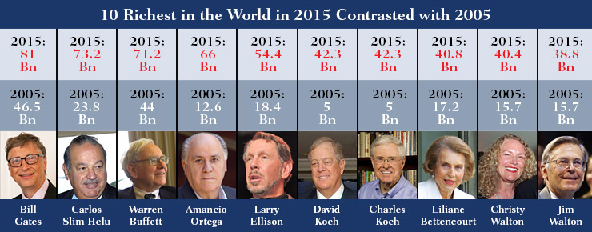
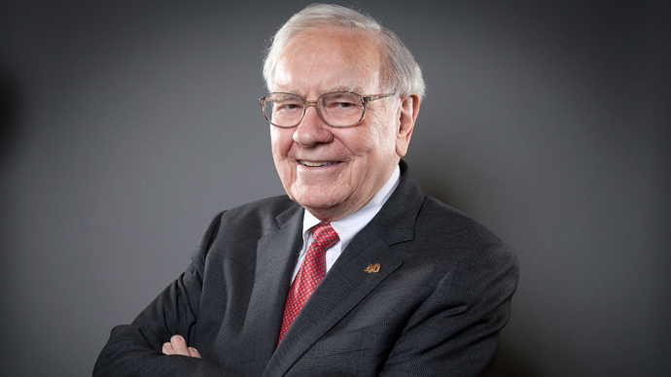
Are You Rich?
$70,000,000,000
$100,000
1917.8 Years

Slide 2
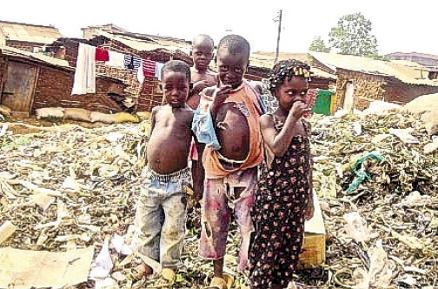
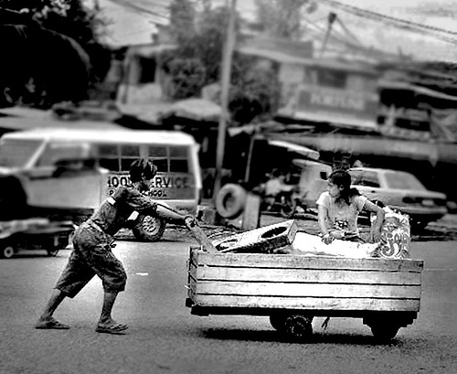
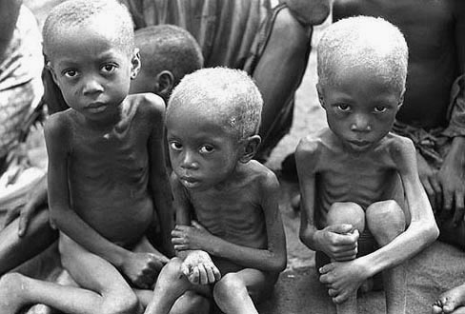
Are You Rich?
Prov.30:8-9

Slide 3
Are You Rich?
Rom.2:4
Rom.11:33-36, Who Could Think of Such a Plan?
Eph.1:3-19
Eph.2:4-8
Eph.3:5-11
Eph.3:14-21
Phil.4:18-20
Col.1:25-29
Col.2:2-3
Heb.11:24-27

Slide 4
The Plan of Salvation
Hear the Gospel of Christ, Acts 2:22
Believe in Jesus Christ, Rom.5:1
Repent and Turn to God, Luke 13:3
Confess Jesus Before Men, Matt.10:32
Baptized Into Christ, I Pet.3:21
-----------------------------
Grow And Be Faithful, 2 Pet.3:18
If Err From The Faith: Repent and Pray God I Jn.1:9

