Slide 1
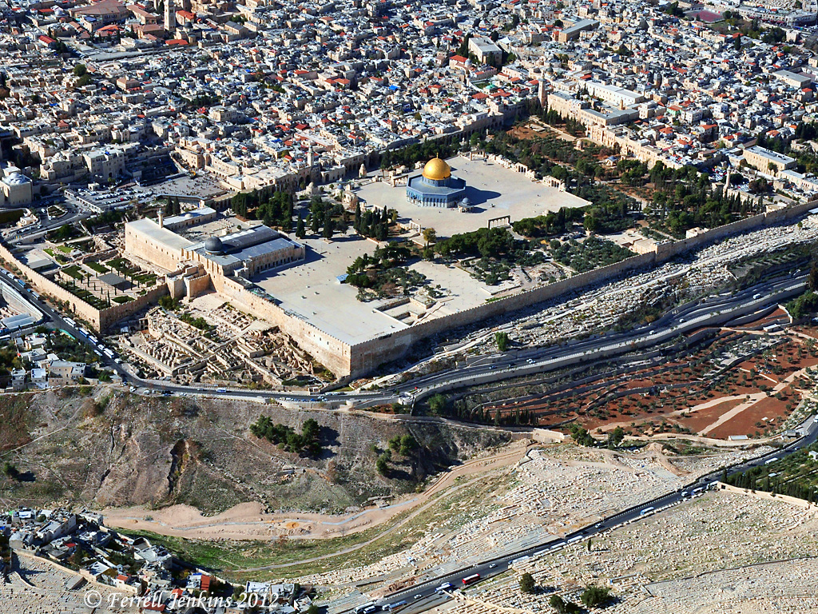
Welcome

Slide 2
The Longsuffering of God
2 Peter 3:9, 15

Slide 3
Defining Longsuffering
To be of a long spirit, not to lose heart. To persevere patiently and bravely in enduring misfortunes and troubles. To be patient in bearing the offenses and injuries of others. To be mild and slow in avenging. To be longsuffering, slow to anger, slow to punish.
To be long spirited, that is, (objectively) forbearing or (subjectively) patient: - bear (suffer) long, be longsuffering, have (long) patience, be patient, patiently endure.
Longanimity, that is, (objectively) forbearance or (subjectively) fortitude: - longsuffering, patience.
Longanimity, patient endurance of hardship, injuries, or offense, forbearance. From longus long + animus mind, soul
Patience, forbearance, longsuffering, slowness in avenging wrongs. (Opposite of “Short Tempered”)

Slide 4
The Longsuffering of God
A Characteristic of God, O.T. Ex.34:5-7, Ps.86:15, N.T. Rom.2:4, 2 Pet.3:9, 15
A Characteristic of Love, 1 Cor.13:4
He Wants us to be Saved, 2 Pet.3:9
The Great Example Seen in the Story of Noah, 1Pet.3:20, Gen.6:1-6
Seen in the Example of Paul, 1 Tim.1:12-16
It Leads to Repentance, Rom.2:4
It Leads to Salvation, 2 Peter 3:15

Slide 5
We Should Mimic His Example
Follow God’s Example, Eph.5:1
Col.3:12; Eph.4:2; Gal.5:22; 2 Cor.6:6
Apply in Suffering, Jam.5:10-11 (To persevere patiently and bravely in enduring misfortunes and troubles)
Forgiving others, Matt.18:21-35
Applications in Many Areas of Life:
Family Relationships. In the Local Church
In the Work Place. At Stores.
In Public Parks. Social Settings and Events
With “Road Rage.” At Schools.
In Neighborhoods. At the Movies.

Slide 6
God’s Longsuffering Awaits You
Hear the Gospel of Christ, Acts 18:8
Believe in Jesus Christ, Acts 16:31
Repent and Turn to God, Acts 17:30
Confess Jesus as Lord, Rom.10:9-10
Be Baptized, Ac.22:16
----------------------------------
Be Thou Faithful Unto Death, Rev.2:10
If Err: Repent and Pray God, Acts 8:22

