Slide 1
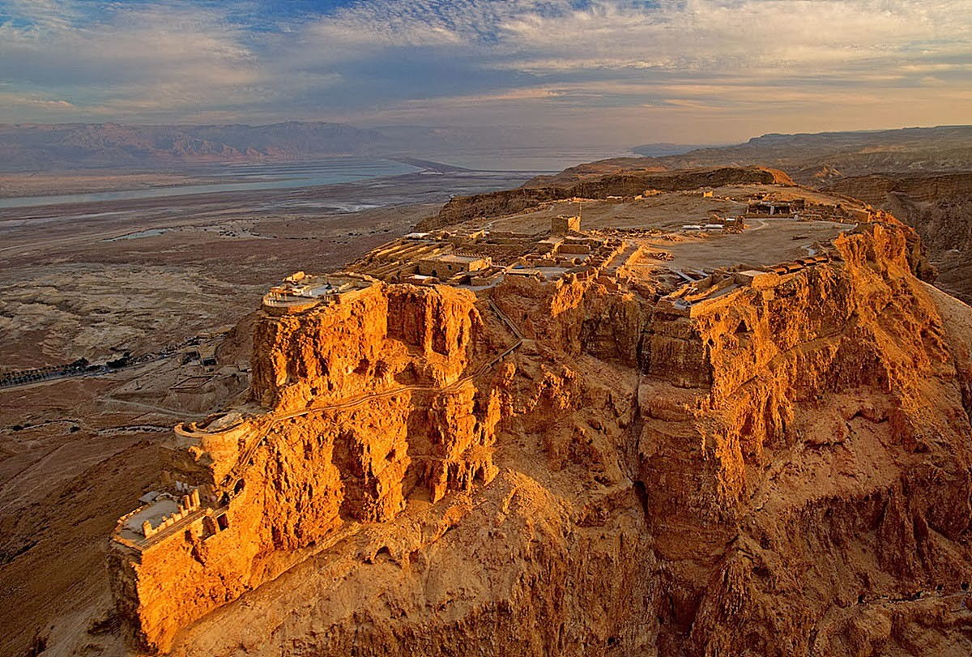
Welcome To Our Services
(Masada)

Slide 2
Our God is Faithful
The Character of God

Slide 3
Define Faithful
Objectively trustworthy; subjectively trustful. Of persons who show themselves faithful in the transaction of business, the execution of commands, or the discharge of official duties. One who kept his plighted faith, worthy of trust. That can be relied on.

Slide 4
Our God is Faithful
Affirmed in O.T.
Deut.7:9
Psalms 89:1-5
Affirmed in N.T.
1 Cor.1:9
Rev.19:11

Slide 5
Evidence That God is Faithful
Promise of God, Gen.8:21-22, 9:13
58 years, 21183 days
Punish for Disobedience, Deut.28-30
Assyrian Captivity, Babylonian Captivity, Destruction of Jerusalem
Messianic Promises, Psalm 89:1-5, 34-37
A Wonderful Poem By John Clifford

Slide 6
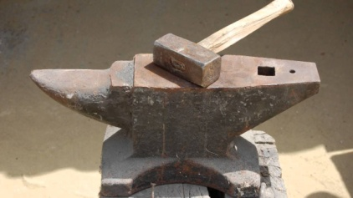
The Hammer & The Anvil
Last eve I passed beside a blacksmith’s door
And heard the anvil ring with vesper chime;
When looking in, I saw upon the floor,
Old hammers worn with beating years of time.
How many anvils have you had, said I
To wear and batter all these hammers so?
Just one, said he, then said with twinkling eye
The anvil wears the hammers out, you know.
And so, I thought, the anvil of God’s word
For ages skeptic’s blows have beat upon
Yet, though the noise of falling blows was heard,
The anvil is unharmed – the hammers are gone.

Slide 7
God is Faithful . . .
When Temptation Comes: 1Cor.10:13, 2 Thes.3:1-3
When We Need Forgiveness: 1 John 1:9-2:2
To Complete the Job: 1 Thes.5:24
To Keep His End of the “Bargain” 2Tim.2:13
To Provide for Us: Matt.6:32-33, Ps.37:25
To Keep His Promises: Heb.10:23
In Being Our High Priest: Heb.2:17, 3:1-2
When We Suffering: 1 Pet.4:19

Slide 8
What His Faithful Does For Us
Gives Us Comfort in Our Hearts
We Can Rest with Assurance
We Can Have Peace of Mind
It Will Take Away Our Worries
Build Confidence in Trusting Him
Helps Our Souls
Take Heed To His Warnings

Slide 9
Have Trusted In God?
Hear the Gospel of Christ, Acts 16:32
Believe in Jesus Christ, Acts 16:31
Repent and Turn to God, Acts 16:33
Confess Jesus Before Men, Acts 8:37
Baptized Into Christ, Acts 16:33
-----------------------------
Grow And Be Faithful, 2 Pet.3:18
If An Erring Christian: Repent and Pray God, I Jn.1:9

