Slide 1
Welcome To Our Services

Slide 2
The Gospel of the Grace of God
Studies On Grace
He Saw the Grace of God

Slide 3
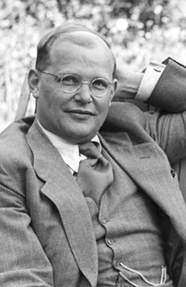
Dietrich Bonhoeffer
Born February 4th, 1906, In Breslau Germany
Died April 9th 1945 in a Nazi Concentration Camp
He was a very religious man. He preached and was a theologian.
He wrote the book called “The Cost of Discipleship”
“Cheap grace is grace without discipleship, grace without the cross, grace without Jesus Christ.“
“Costly grace confronts us as a gracious call to follow Jesus, it comes as a word of forgiveness to the broken spirit and the contrite heart. It is costly because it compels a man to submit to the yoke of Christ and follow him; it is grace because Jesus says: "My yoke is easy and my burden is light." "

Slide 4
Cheap Grace or Costly Grace?
The Demands of Discipleship

Slide 5
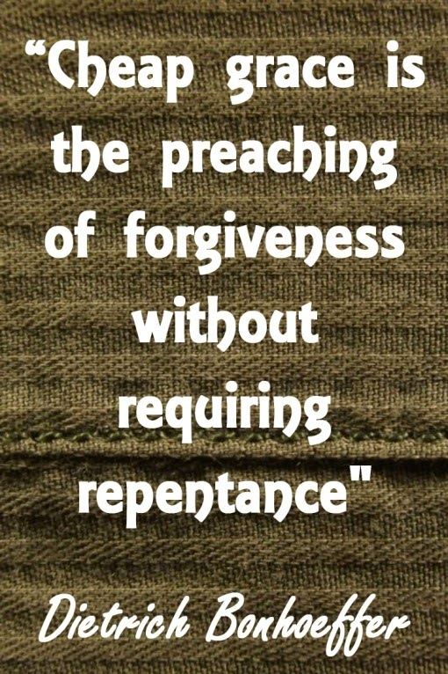
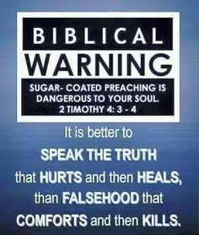
Cheap Grace
2 Tim.4:1-5
Rom.10:1-3

Slide 6
Costly Grace
What it Cost God: Jn.3:16, Mk.14:36, Mt.27:26-35
Paid the Price for the Debt of Sin
Make Disciples, Mt.28:18-20
Discipleship, Lk.14:25-33
High Cost, Mt.13:44-46
Give Ourselves to God, Gal.2:20, Phil.1:21, 3:7-12, Col.3:4, 2Cor.8:1-5
Love God With All Our Hearts, Mt.22:36-40, 2 Cor.5:14-15
Godly Lives, Micah 6:6-8, Tit.2:11-14

Slide 7
Will You Give Yourself to Jesus
Hear the Gospel of Christ, Acts 2:22
Believe in Jesus Christ, Acts 2:36
Repent and Turn to God, Acts 2:38
Confess Jesus Before Men, Acts 8:37
Baptized Into Christ, Acts 2:38
-----------------------------
Grow And Be Faithful, Matt.25:21
If Err As A Christian: Repent and Pray God, Acts 8:22

