Slide 1
The Story of Joseph
A Great Lesson on Divine Providence

Slide 2
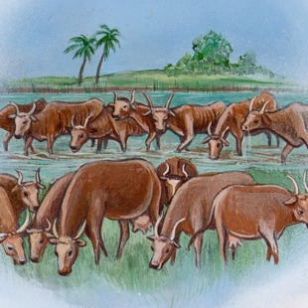
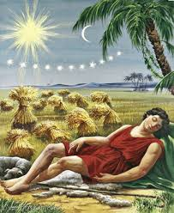
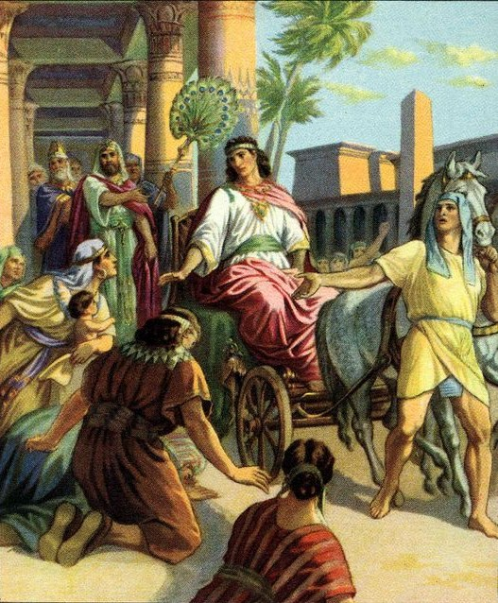
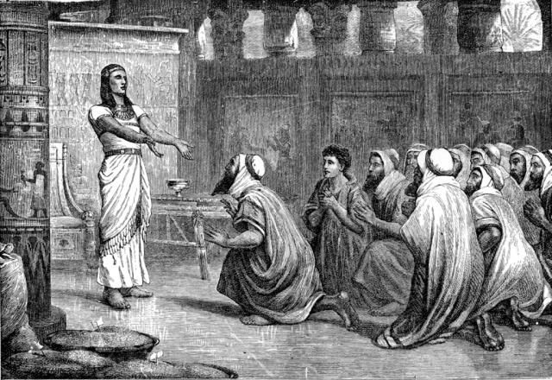
The Story of Joseph
Ch.40, Dreams of the Cupbearer and Baker
Ch.41, Pharaoh's Dreams
Ch.42, 10 Brothers Come
Ch.43, Come 2ND Time
Ch.44, Plan For Benjamin
Ch.45, Reveals Himself

Slide 3
The Plan of Salvation
Hear the Gospel of Christ, Acts 18:8
Believe in Jesus Christ Acts 16:31
Repent and Turn to God, Acts 2:38
Confess Jesus Before Men, Acts 8:37
Be Baptized for Forgiveness, Acts 22:16
-------------------------
Be Thou Faithful Unto Death, Rev.2:10
If Err From The Faith: Repent and Pray God, Acts 19:18

