Slide 1
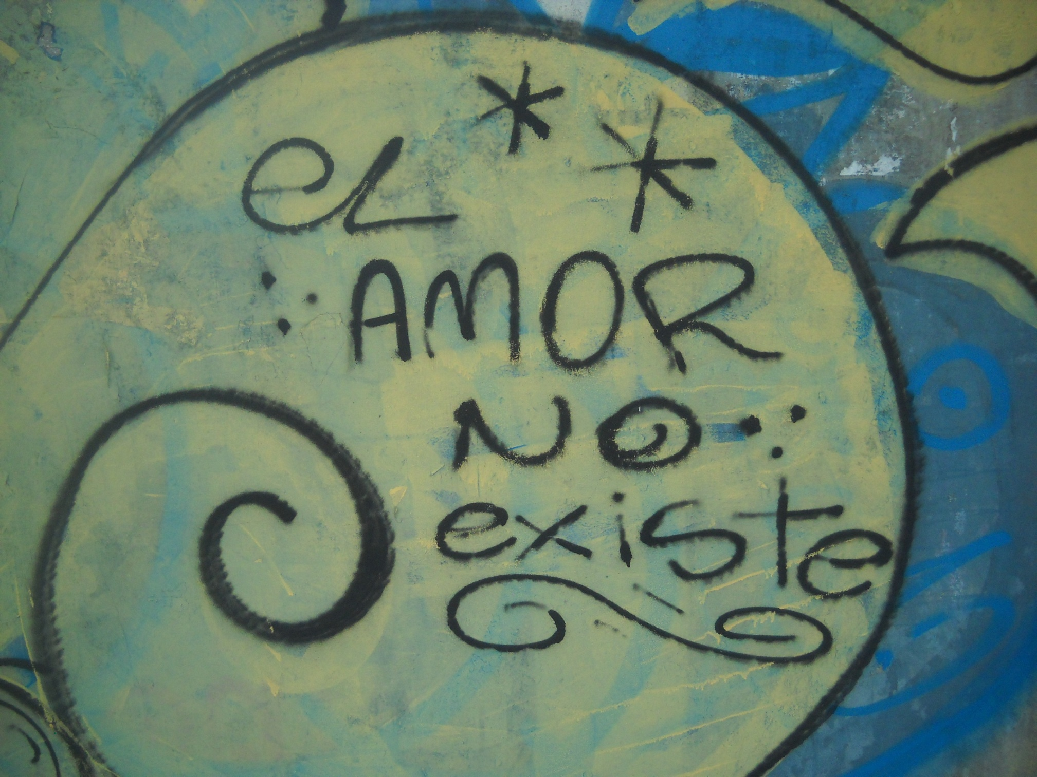
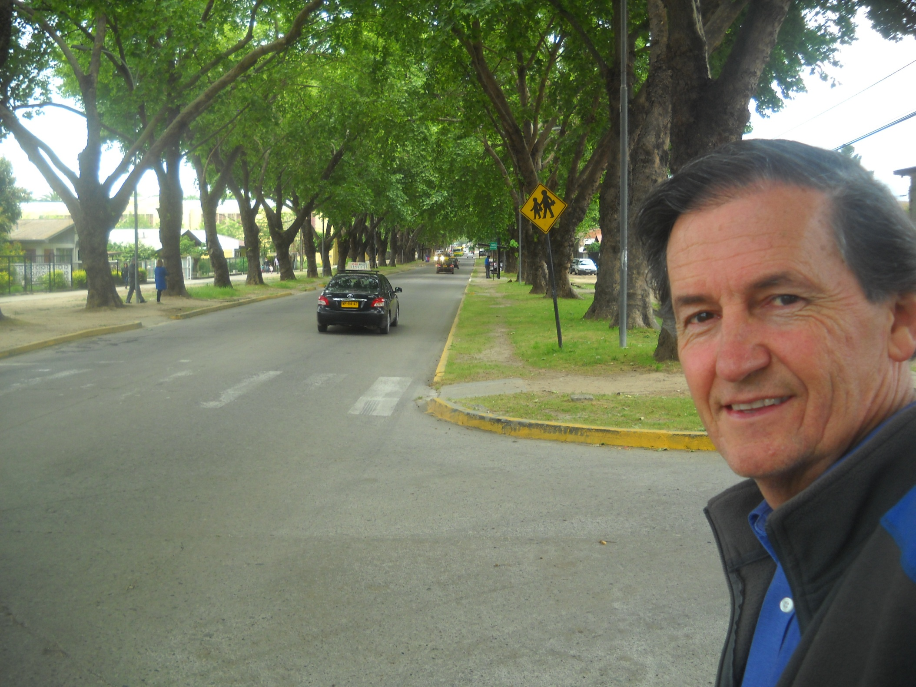
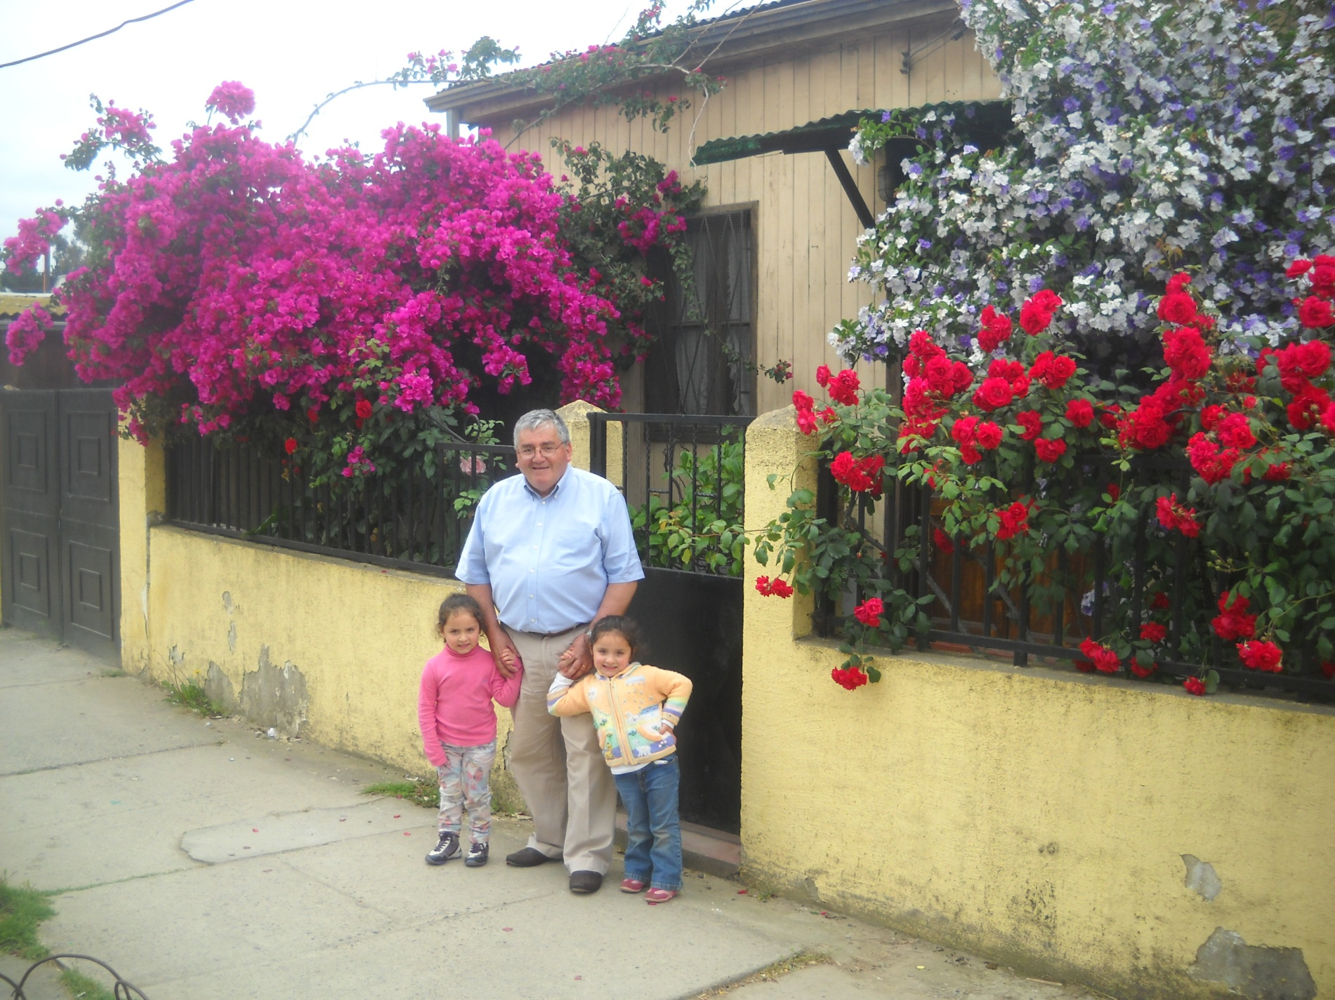
“Love Does Not Exist”

Slide 2
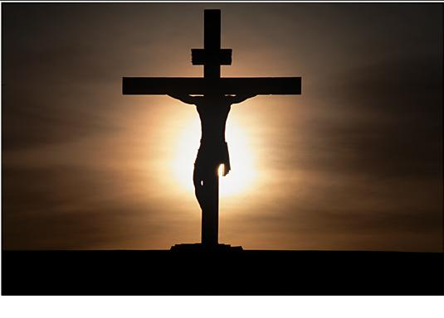
“Love Does Not Exist”
Why Would Someone Write This?
Probably Young Person
Not Many In Nursing Home – Graffiti-Art
Someone Hurt Bad, Abused, Rejected, Bitter, Rom.1:31, 2 Tim.3:1-3
Evidence That Love Exists:
Parents for Children, 1 Thes.2:7-8, 1Kg.3:16-28
Devoted Spouses, Eph.5:22-33, Tit.2:3-4
Good Samaritans, Lk.10:25-37
Brotherly Love, 1 Jn.3:16-18, Ac.4:32-37, 5:4
God’s Love For Mankind, Jn.3:16, Rom.5:6-8, Matt.26:51-54; 27:26-35

Slide 3
The Love of Jesus Calls You to Come
Hear the Gospel of Christ, Acts 18:8
Believe in Jesus Christ, Rom.5:1
Repent and Turn to God, Luke 24:47
Confess Jesus Before Men, Matt.10:32
Baptized Into Christ, Gal.3:26-27
-----------------------------
Grow And Be Faithful, 2 Pet.3:18
If An Erring Christian: Repent and Pray God, I Jn.1:9

Slide 4
The Lord’s Supper
And he took the cup, and gave thanks, and said, Take this, and divide it among yourselves:
For I say unto you, I will not drink of the fruit of the vine, until the kingdom of God shall come.
And he took bread, and gave thanks, and brake it, and gave unto them, saying, This is my body which is given for you: this do in remembrance of me.
Likewise also the cup after supper, saying, This cup is the new testament in my blood, which is shed for you. Luke 22:17-20

Slide 5
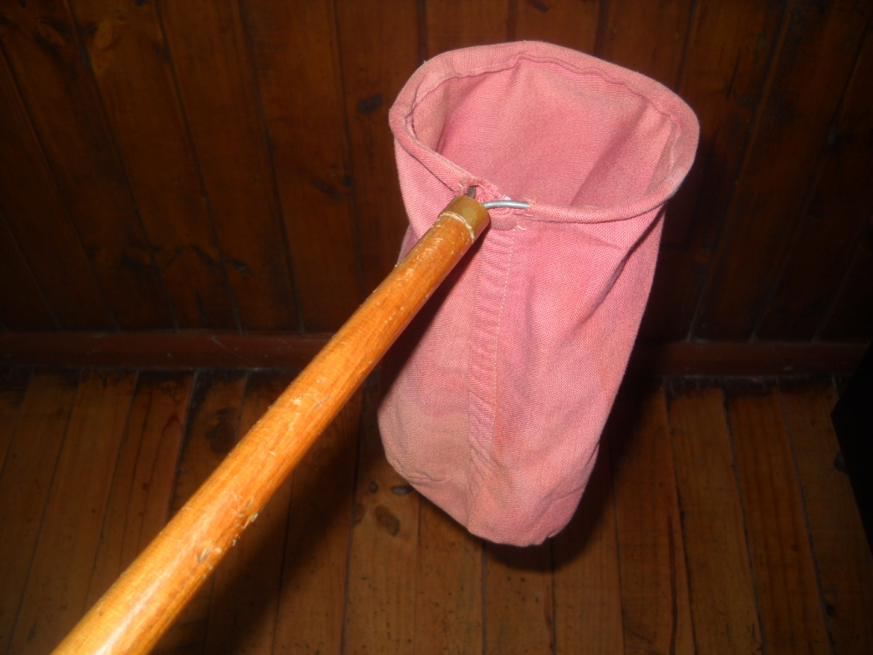
The Collection
“Every man according as he purposeth in his heart, so let him give; not grudgingly, or of necessity: for God loveth a cheerful giver.” 2 Cor.9:7

