Slide 1
The Church Jesus Built
Matt.16:13-19

Slide 2
The Church Jesus Built
The Promise of Jesus, Mt.16:13-19
Has a Set Pattern, Heb.8:1-5
Respects the Headship of Jesus, Eph.1:20-23, Col.1:18
Work of the Church: Evangelism, Phil.1:5, 4:14f, Edification, Eph.4:13-16, Benevolence, Rom.15:25f
Worship of the Church, 1 Cor.11:23f, 14:15-19, 16:1-2
Organization of the Local Church, Phil.1:1, Ac.20:28
Scriptural Name, Rom.16:16, 1 Cor.1:2, Ac.11:26
Complete Guide, 2 Tim.3:16-17, 2 Pet.1:3

Slide 3
The Plan of Salvation
Hear the Gospel of Christ, Rom.10:17
Believe in Jesus Christ, Acts 16:31
Repent and Turn to God, Luke 13:5
Confess Jesus Before Men, Acts 8:37
Be Baptized for the Remission of Sins, Ac.2:38
---------------------------
Be Thou Faithful Unto Death, Rev.2:10
If Err as a Christian: Repent & Confess, Acts 19:18

Slide 4
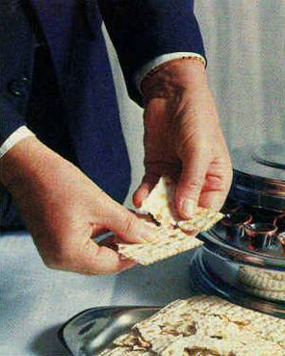
And he took bread, and when he had given thanks, he broke it and gave it to them, saying, "This is my body, which is given for you. Do this in remembrance of me."
And likewise the cup after they had eaten, saying, "This cup that is poured out for you is the new covenant in my blood. Lk.22:19-20

Slide 5
The Offering
“For if there be first a willing mind, it is accepted according to that a man hath, and not according to that he hath not.” 2Cor.8:12

