Slide 1
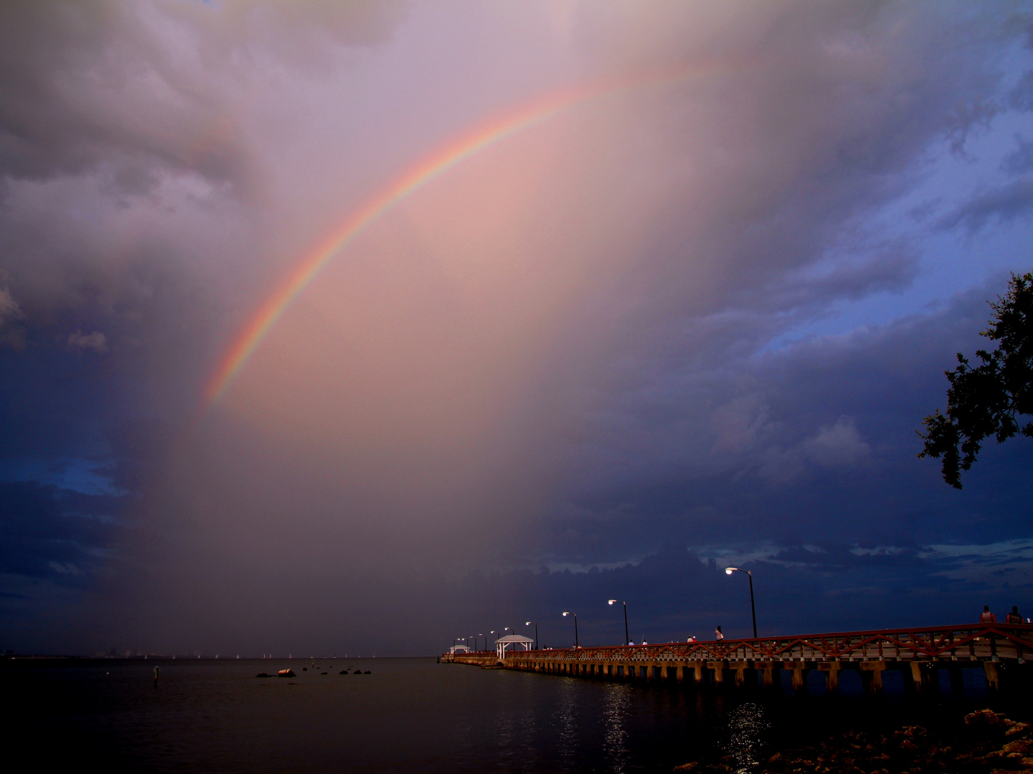
Welcome To Our Services

Slide 2
The Story of Abigail
1 Samuel 25

Slide 3
The Story of Abigail
Nabal was a rich man, vs.1-2
A Contrast of Character, vs.3
Churlish: hard, cruel, severe, obstinate, difficult, fierce, intense, vehement, stubborn, stiff of neck, stiff-necked
Prudence, insight, understanding, good sense
How Did They Pair Up?
Vs.4-9, David asks for favor
Vs.10-13, Nabal answers harshly
Vs.14-31, Abigail wisely intercedes
Vs.32-35, David accepts her pleas
Vs.36-38, The Lord smote Nabal
Vs.39-43, Abigail becomes David’s wife

Slide 4
The Plan of Salvation
Hear the Gospel of Christ, Acts 18:8
Believe in Jesus Christ, Rom.5:1
Repent and Turn to God, Luke 24:47
Confess Jesus Before Men, Matt.10:32
Baptized Into Christ, Gal.3:26-27
-----------------------------
Grow And Be Faithful, 2 Pet.3:18
If An Erring Christian: Repent and Pray God, Acts 8:22

