Slide 1
A Radical Change
A Study of Isaiah 11
Rom.15:8-12

Slide 2
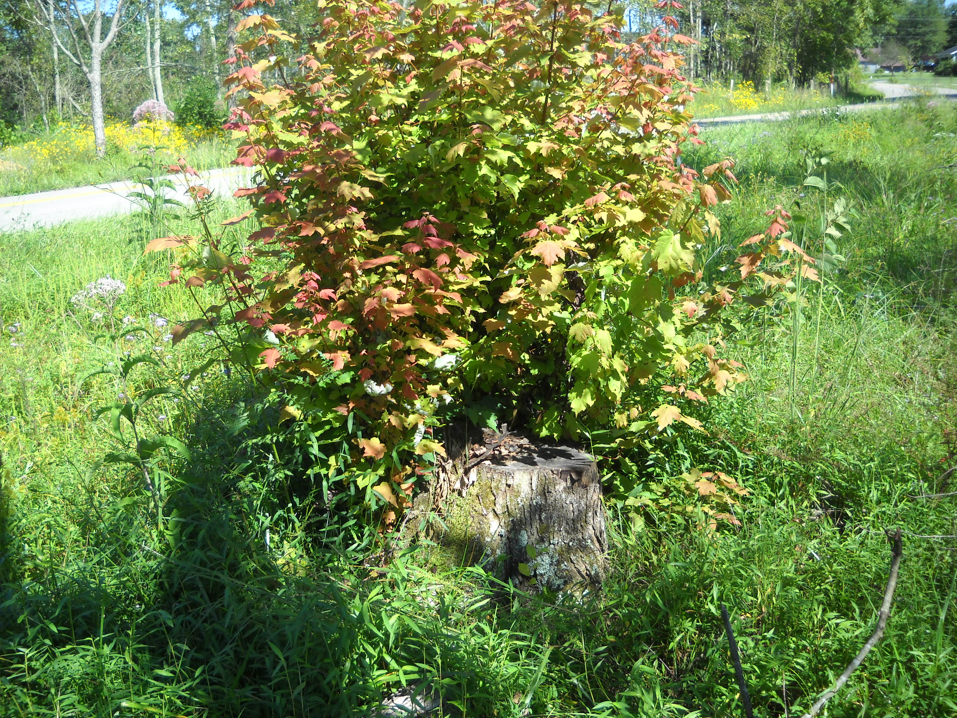
A Radical Change
Who vs.1-5
“The Branch”
2Sam.7:12-17; Jer.22:28-30; Jer.23:5-6
A Righteous Character of the Messiah, vs.1-5

Slide 3
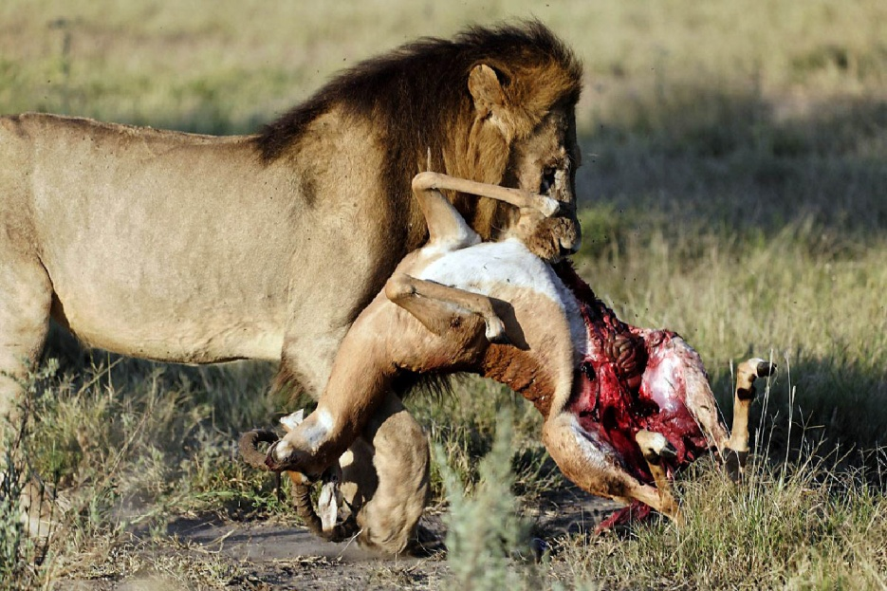
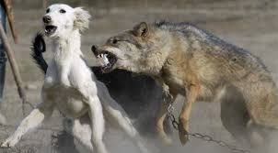
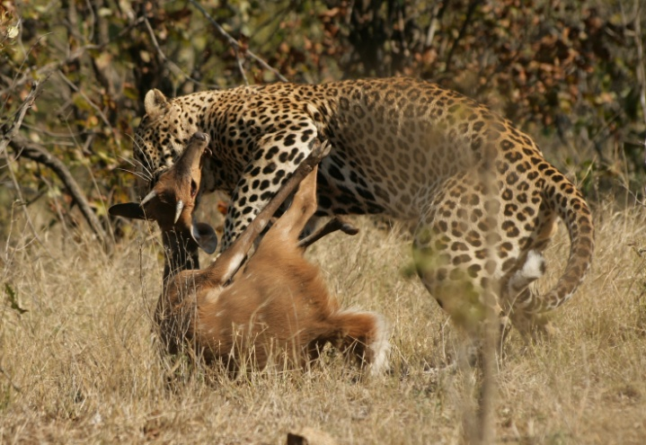
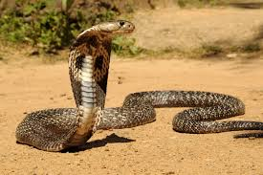
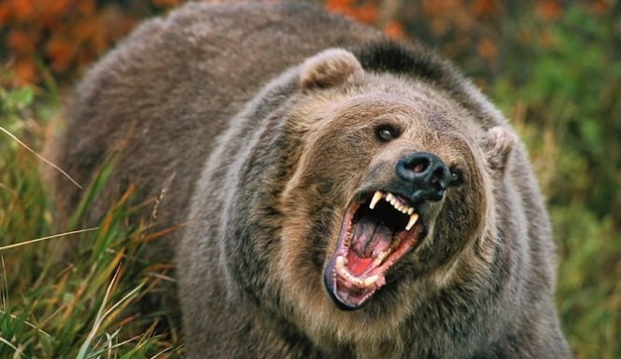
A Radical Change
Who vs.1-5
What vs.6-8
Animals Used In Scriptures: Jn.1:29; Lk.13:32; Phil.3:2; Matt.25:33; Matt.23:33
2Cor.5:17
Illustration: Matt.10:3; Lk.6:15; Gal.3:28; Jn.4:9

Slide 4
A Radical Change
Who vs.1-5
What vs.6-8
Where vs.9a
Is.2:2-3; “Mountain” Jer.51:25

Slide 5
A Radical Change
Who vs.1-5
What vs.6-8
Where vs.9a
Why vs.9b

Slide 6
A Radical Change
Who vs.1-5
What vs.6-8
Where vs.9a
Why vs.9b
When vs.10
Rom.15:12

Slide 7
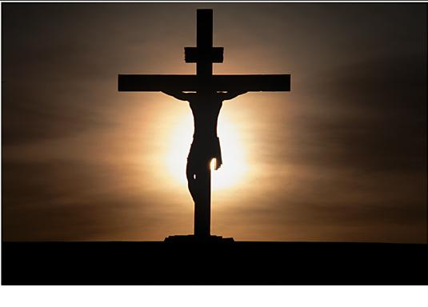
A Radical Change
Who vs.1-5
What vs.6-8
Where vs.9a
Why vs.9b
When vs.10
The Ensign vs.10-16
2 Tim.2:9

Slide 8
Has The Truth Changed You?
Hear the Gospel of Christ, Acts 2:22
Believe in Jesus Christ, Rom.1:16
Repent and Turn to God, Luke 24:47
Confess Jesus Before Men, Acts 8:37
Baptized Into Christ, Gal.3:26-27
Grow And Be Faithful, 1Pet.2:2
If Err From The Faith: Repent and Pray God I Jn.1:9

