Slide 1
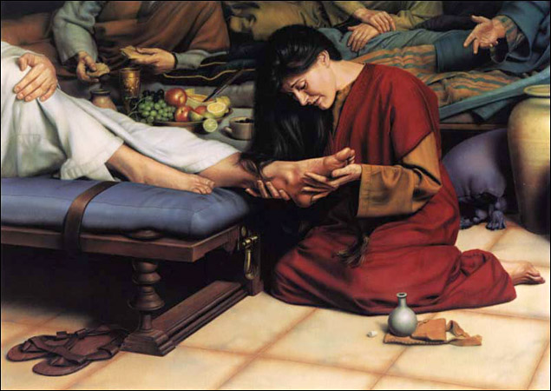
“For A Memorial of Her”
Matt.26:1-13, Mk.14:1-9, Jn.12:1-8

Slide 2
“For A Memorial of Her”
Her Sacrifice, Love & Devotion are Incredible
The Ointment – “spikenard” Pure Nard, Perfumed oil, “It grows in the Himalayas. The extracted perfume is an oil, which was used by the Romans for anointing the head. Its great costliness is mentioned by Pliny.”
Very Costly - extremely expensive, of weighty value
300 Pence, Denarii How much is that?
Matt.20:1-2, “It was the pay of a Roman soldier in Christ's time.” 300 Days of Work
Factory, Teacher, Bank, Restaurant, Farmer . . .
If we come every service = 4 hours a week, 2 weeks equal 1 day work. 2 X 300 = 600 weeks, 11.53 years

Slide 3
“For A Memorial of Her”
Her Sacrifice, Love & Devotion are Incredible
Jn.12:4-6, Judas said it was a waste. Extravagance, Excessive, (He Was Covetous)
Mk.14:6, “Wrought a good work” “A Beautiful work”
Mk.14:7, Always have the Poor
Mk.14:8, She hath done what she could, 2Cor.8:12
Mk.14:8, Anoint for burial
Mk.14:9, A memorial of her

Slide 4
A Home In Heaven
Faithfulness
Baptism
Confession
Repentance
The Ladder to Eternity
Believe
Hear
Sin

