Slide 1
Romans 12:1-2
Therefore I urge you, brethren, by the mercies of God, to present your bodies a living and holy sacrifice, acceptable to God, which is your spiritual service of worship. And do not be conformed to this world, but be transformed by the renewing of your mind, so that you may prove what the will of God is, that which is good and acceptable and perfect

Slide 2
Romans 12:1-2
(1)Therefore I urge you, brethren, by the mercies of God, to present your bodies a living and holy sacrifice, acceptable to God, which is your spiritual service of worship. (2) And do not be conformed to this world, but be transformed by the renewing of your mind, so that you may prove what the will of God is, that which is good and acceptable and perfect

Slide 3
A Look at our Brain and Self-Control

Slide 4
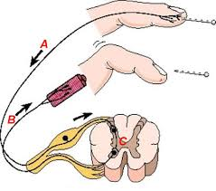
A Simple Spinal Reflex

Slide 5
Patellar Reflex

Slide 6
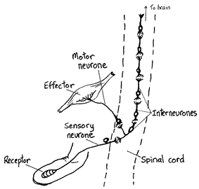
The Brains Role in a Reflex?

Slide 7
The Brains Role in a Reflex?

Slide 8
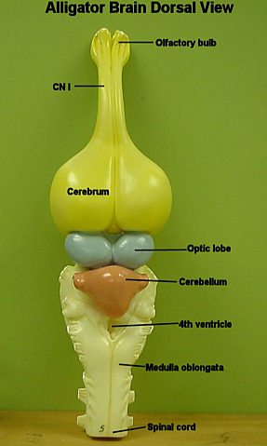
The Simple Reptile Brain
Self and Now
Survival
Camouflage
Defense
Eating
Reproduction
Comfort

Slide 9
Simple Solutions to Problems

Slide 10
Simply Seeking Comfort

Slide 11
The Dog Brain
Instincts
Basic Emotions (Feelings)
Memory/ history
Basic reasoning
Not “higher” reasoning

Slide 12
“I press toward the mark for the prize of the high calling of God in Christ Jesus.” _{Philippians} _{3:14}

Slide 13
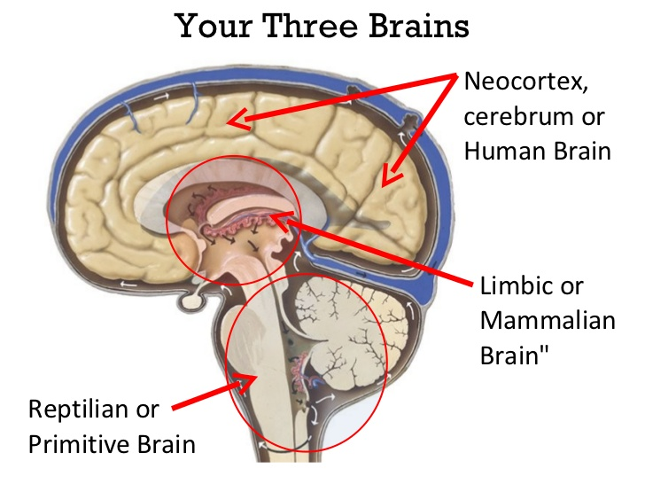
“I press toward the mark for the prize of the high calling of God in Christ Jesus.” _{Philippians} _{3:14}

Slide 14
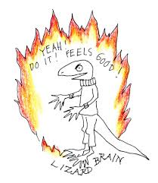
Can you trust your lizard brain?

Slide 15
Willpower!
“For the grace of God has appeared, bringing salvation to all men, instructing us to deny ungodliness and worldly desires and to live sensibly, righteously and godly in the present age…” _{Titus 2:11-12}

Slide 16
I WILL
I WON’T
I WANT

Slide 17
HALT!

Slide 18
Hungry
Angry
Lonely
Tired

Slide 19
Control Our Situation
“But put on the Lord Jesus Christ, and make no provision for the flesh, to gratify it’s desires.”_{Romans 13:14}

Slide 20
I press toward the mark for the prize of the high calling of God in Christ Jesus.” _{Philippians} _{3:14}

Slide 21
I press toward the mark for the prize of the high calling of God in Christ Jesus.” _{Philippians} _{3:14}
And just as they did not see fit to acknowledge God any longer, God gave them over to a depraved {NKJV “debased”} mind, to do those things which were not proper”_{Romans 1:28}

Slide 22
Our "lizard brain” will make decisions for us…. IF we let it!
And We Will!

Slide 23
“Then Jesus was led by the Spirit into the wilderness to be tempted by the devil. After fasting forty days and forty nights, he was hungry”_{Matt. 4:1-2}

Slide 24
Conscious Mind- 10% of Decisions
Subconscious Mind – 90% of Decisions
Imagination
Self-concept
Beliefs
Habits
Memory
Emotions
Instincts and reflex actions
Analytical Logical
Willpower

Slide 25
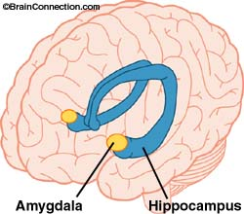
The Brain’s Emotional Center

Slide 26
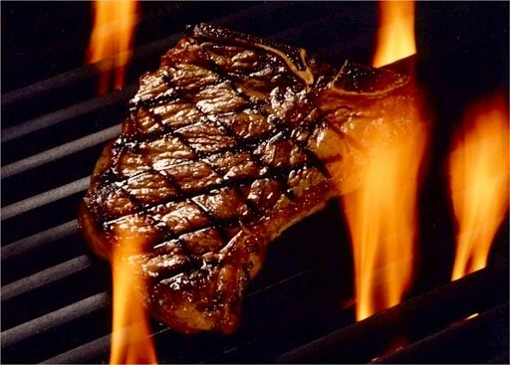

Slide 27
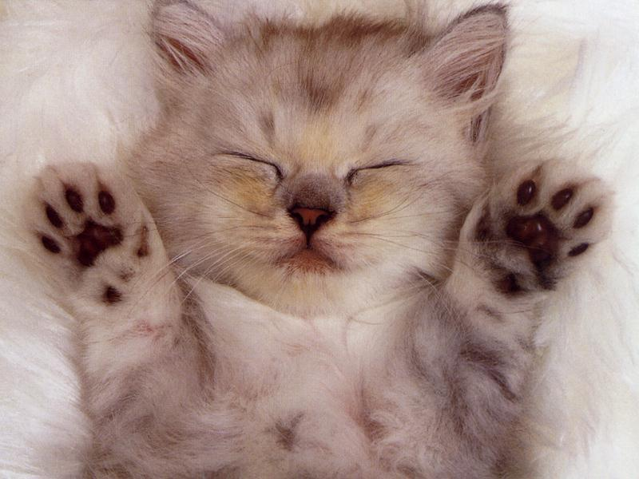
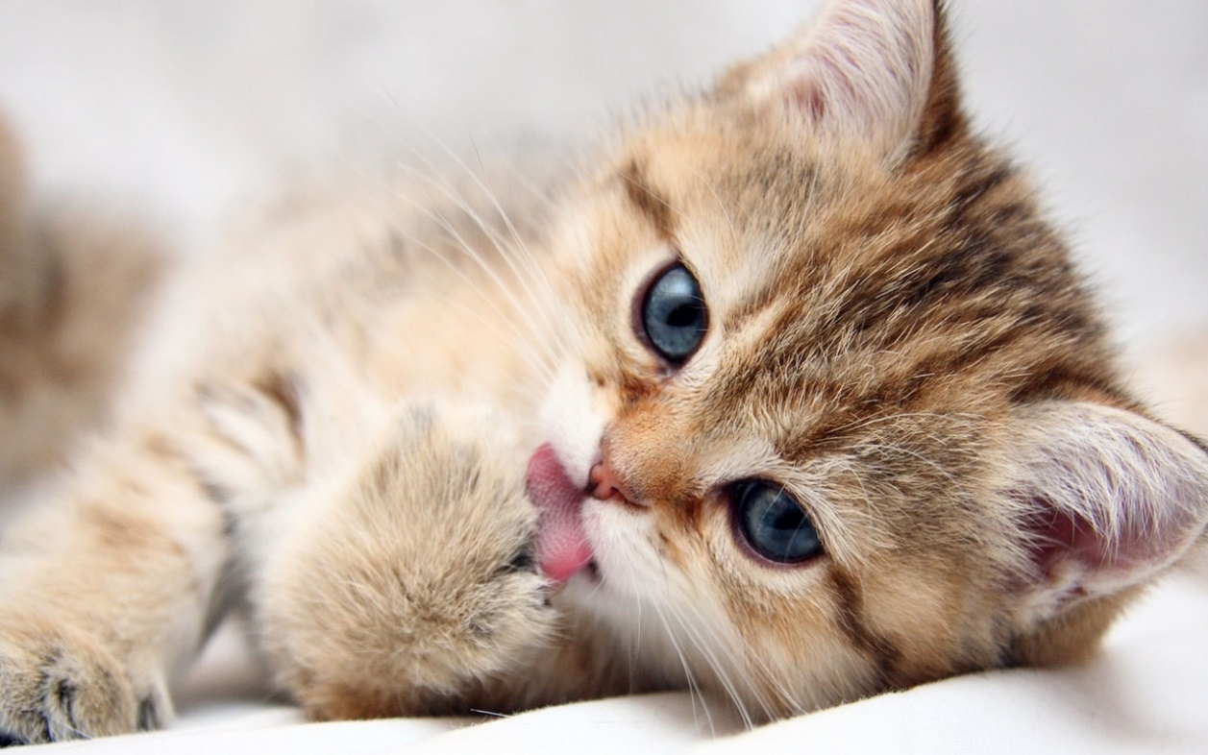

Slide 30
Romans 12:1-2
Therefore I urge you, brethren, by the mercies of God, to present your bodies a living and holy sacrifice, acceptable to God, which is your spiritual service of worship. And do not be conformed to this world, but be transformed by the renewing of your mind, so that you may prove what the will of God is, that which is good and acceptable and perfect

Slide 31
Psalms 119:92-112 Retraining Our Heart…
….thus taming our lizard brain!

