Slide 1
“Daughters of Jerusalem”
Could you explain (luke 23:29-31) to me please? Thank you.
Luke 23:27-31

Slide 2
“Daughters of Jerusalem”
The Context. Vs.20-26, (This event found only in Luke’s Gospel)
Vs.28, A Contrast of Emphasis, 1 Jn.3:18, 1Pet.3:3-4, Jn.6:2:27
Vs. 29, Normally being barren is sad, Lk.1:7, Gal.4:27 a quote from Is.54:1. Great difficulties would come, cf. Matt.24:19-21, 2Kgs 6:24-29
Quotes From Josephus, How bad things got in Jeruslaem

Slide 3
Now of those that perished by famine in the city, the number was prodigious, and the miseries they underwent were unspeakable; for if so much as the shadow of any kind of food did any where appear, a war was commenced presently, and the dearest friends fell a fighting one with another about it, snatching from each other the most miserable supports of life. Nor would men believe that those who were dying had no food, but the robbers would search them when they were expiring, lest any one should have concealed food in their bosoms, and counterfeited dying; nay, these robbers gaped for want, and ran about stumbling and staggering along like mad dogs, and reeling against the doors of the houses like drunken men; they would also, in the great distress they were in, rush into the very same houses two or three times in one and the same day.

Slide 4
Moreover, their hunger was so intolerable, that it obliged them to chew every thing, while they gathered such things as the most sordid animals would not touch, and endured to eat them; nor did they at length abstain from girdles and shoes; and the very leather which belonged to their shields they pulled off and gnawed: the very wisps of old hay became food to some; and some gathered up fibres, and sold a very small weight of them for four Attic [drachmae]. But why do I describe the shameless impudence that the famine brought on men in their eating inanimate things, while I am going to relate a matter of fact, the like to which no history relates, either among the Greeks or Barbarians? It is horrible to speak of it, and incredible when heard. I had indeed willingly omitted this calamity of ours, that I might not seem to deliver what is so portentous to posterity, but that I have innumerable witnesses to it in my own age; and besides, my country would have had little reason to thank me for suppressing the miseries that she underwent at this time.

Slide 5
There was a certain woman that dwelt beyond Jordan, her name was Mary; her father was Eleazar, of the village Bethezob, which signifies the house of Hyssop. She was eminent for her family and her wealth, and had fled away to Jerusalem with the rest of the multitude, and was with them besieged therein at this time. The other effects of this woman had been already seized upon, such I mean as she had brought with her out of Perea, and removed to the city. What she had treasured up besides, as also what food she had contrived to save, had been also carried off by the rapacious guards, who came every day running into her house for that purpose. This put the poor woman into a very great passion, and by the frequent reproaches and imprecations she east at these rapacious villains, she had provoked them to anger against her; but none of them, either out of the indignation she had raised against herself, or out of commiseration of her case, would take away her life; and if she found any food, she perceived her labors were for others, and not for herself;

Slide 6
and it was now become impossible for her any way to find any more food, while the famine pierced through her very bowels and marrow, when also her passion was fired to a degree beyond the famine itself; nor did she consult with any thing but with her passion and the necessity she was in. She then attempted a most unnatural thing; and snatching up her son, who was a child sucking at her breast, she said, "O thou miserable infant! for whom shall I preserve thee in this war, this famine, and this sedition? As to the war with the Romans, if they preserve our lives, we must be slaves. This famine also will destroy us, even before that slavery comes upon us. Yet are these seditious rogues more terrible than both the other. Come on; be thou my food, and be thou a fury to these seditious varlets, and a by-word to the world, which is all that is now wanting to complete the calamities of us Jews."

Slide 7
As soon as she had said this, she slew her son, and then roasted him, and eat the one half of him, and kept the other half by her concealed. Upon this the seditious came in presently, and smelling the horrid scent of this food, they threatened her that they would cut her throat immediately if she did not show them what food she had gotten ready. She replied that she had saved a very fine portion of it for them, and withal uncovered what was left of her son. Hereupon they were seized with a horror and amazement of mind, and stood astonished at the sight, when she said to them, "This is mine own son, and what hath been done was mine own doing! Come, eat of this food; for I have eaten of it myself! Do not you pretend to be either more tender than a woman, or more compassionate than a mother; but if you be so scrupulous, and do abominate this my sacrifice, as I have eaten the one half, let the rest be reserved for me also." After which those men went out trembling, being never so much affrighted at any thing as they were at this, and with some difficulty they left the rest of that meat to the mother. Upon which the whole city was full of this horrid action immediately; and while every body laid this miserable case before their own eyes, they trembled, as if this unheard of action had been done by themselves. So those that were thus distressed by the famine were very desirous to die, and those already dead were esteemed happy, because they had not lived long enough either to hear or to see such miseries.

Slide 8
“Daughters of Jerusalem”
The Context. Vs.20-26, (This event found only in Luke’s Gospel)
Vs.28, A Contrast of Emphasis, 1 Jn.3:18, 1Pet.3:3-4, Jn.6:2:27
Vs. 29, Normally being barren is sad, Lk.1:7, Gal.4:27 a quote from Is.54:1. Great difficulties would come, cf. Matt.24:19-21, 2Kgs 6:24-29
Vs.30, Tremendous duress from the Roman Jewish War. Hos.10:8, Rev.6:15-17
Vs.31, Green Trees versus Dry Trees. Fiery trials and tribulations will be different. “If you think that is bad, wait until …” Dan.9:26-27,

Slide 9
The Plan of Salvation
Hear the Gospel of Christ, Acts 18:8
Believe in Jesus Christ, Rom.5:1
Repent and Turn to God, Luke 24:47
Confess Jesus Before Men, Acts 8:37
Be Baptized for the Remission of Sins, Ac.2:38
---------------------------------
Be Thou Faithful Unto Death, Rev.2:10
If Err From The Faith: Repent and Pray God Acts 8:22

Slide 10
This Do In Remembrance of Me
Is.53:3 He was despised, and rejected of men; a man of sorrows, and acquainted with grief: and as one from whom men hide their face he was despised; and we esteemed him not.
Is.53:4 Surely he hath borne our griefs, and carried our sorrows; yet we did esteem him stricken, smitten of God, and afflicted.
Is.53:5 But he was wounded for our transgressions, he was bruised for our iniquities; the chastisement of our peace was upon him; and with his stripes we are healed.

Slide 11
The Privilege of Giving
“Now concerning the collection for the saints, as I have given order to the churches of Galatia, even so do ye.
Upon the first day of the week let every one of you lay by him in store, as God hath prospered him, that there be no gatherings when I come.” 1Cor.16:1-2

Slide 12
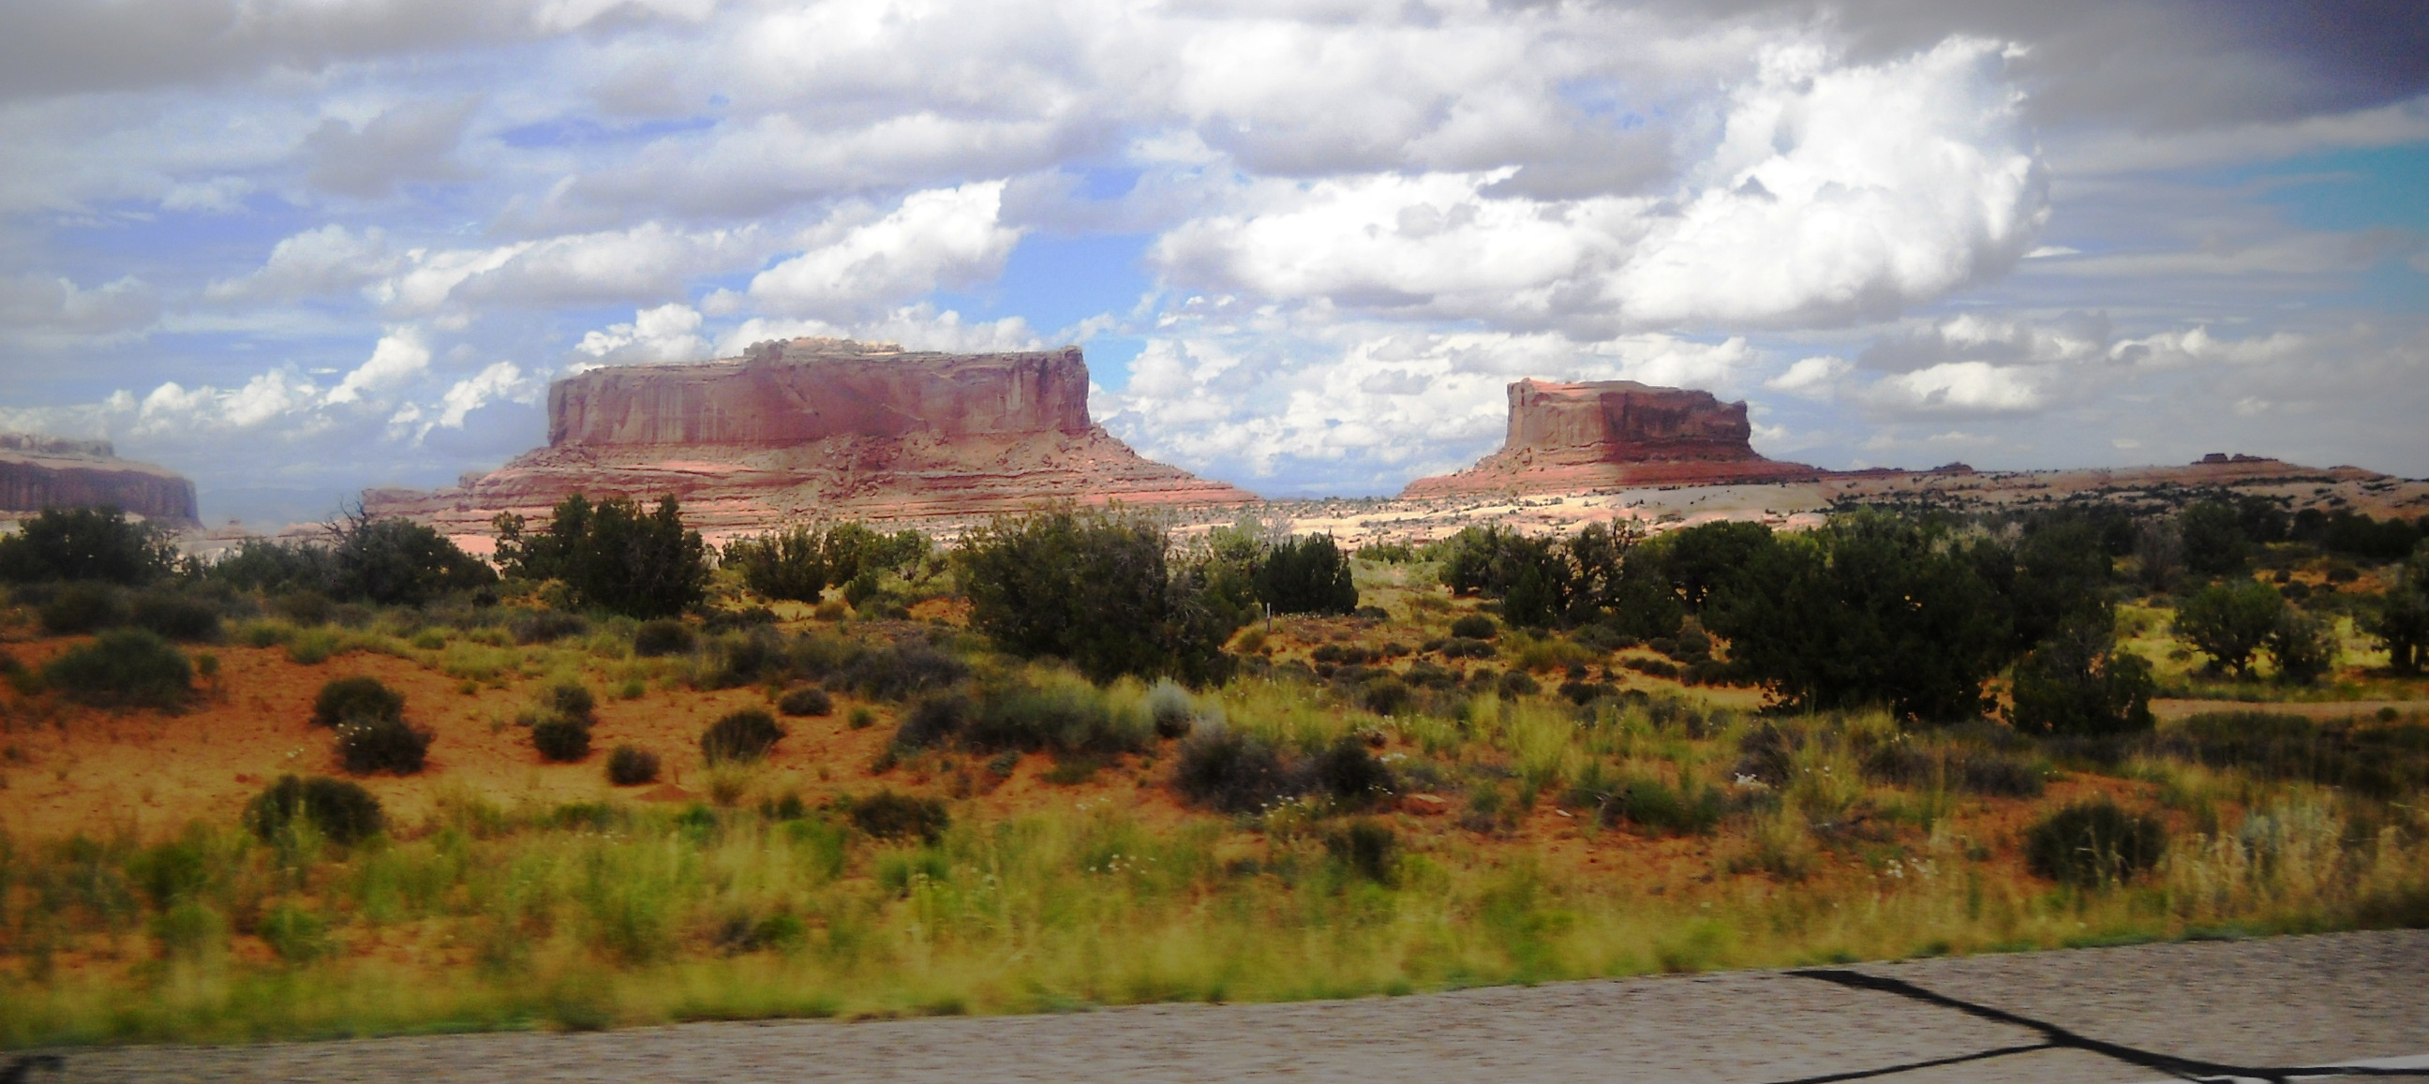
Thanks For Coming Out Today

