Slide 1
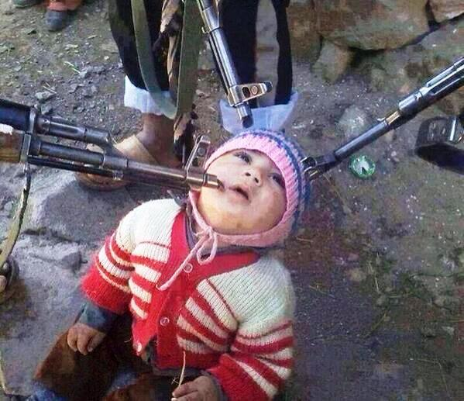
“A Picture is Worth A Thousand Words”

Slide 2
Lessons to Consider
Innocency of Children
Rom.7:9, Matt.18:2-3
Jonah 4:11, Ezk.18:20
The Cruelty of Sin
1 Pet.5:8, Eph.4:17-19
Jam.3:13-18, 2Kg.8:12
“Criminals, Barbarians, Cursed, Injustice, Ignorant, Animals, Enemies of God, Idiots”

Slide 3
Lessons to Consider
Righteous Anger
Eph.4:26-27, Mk.3:1-5
Exod.32:19
False Religion Blinds
Jn.16:2, Acts 26:9-10
Rom.10:1-3, 1Tim.1:12-16

Slide 4
Lessons to Consider
“Tough Guys” Will Fall
Prov.16:18, Jam.4:6
Dan.3:30-33, 37
The Innocent Lamb of God
Jn.18:1-14, Matt.27:27-35

Slide 5
The Steps of Salvation
Hear the Gospel of Christ, Acts 18:8
Believe in Jesus Christ, Rom.5:1
Repent and Turn to God, Luke 24:47
Confess Jesus Before Men, Acts 8:37
Be Baptized for the Remission of Sins, Ac.2:38
---------------------------------
Be Thou Faithful Unto Death, Rev.2:10
If Err From The Faith: Repent & Pray God Ac.8:22

