Slide 1
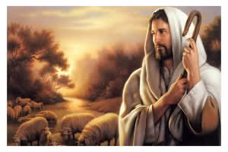
I Am The Good Shepherd
John 10:1-18

Slide 2
Figure Used Frequently
John 10:1-18
Ps.23:1-6
Ezk.34:23-24
Ezk.37:22-24
Heb.13:20-21
1 Peter 2:25
1 Peter 5:4

Slide 3
Be One Fold
John 10:16
Ezk.37:22
Eph.4:4
Eph.2:11-18
Eph.3:6

Slide 4
The Shepherd Leads the Sheep
John 10:3-4
Ps.23:2-3
Ps.119:105, Guided By His Word
Willing, Rev.7:3
Ps.110:3
Not Drive Sheep
Sheep Know His Voice, Jn.10:3-5,27
Sheep Follow Him Jn.10:4, 27

Slide 5
The Shepherd Feeds the Sheep
John 10:9
Ps.23:2
Ezk.34:23
Matt.5:6
1 Pet.2:2

Slide 6
The Shepherd Protects the Sheep
John 10:11-13
Risk Life, Not a Hireling
Rod of Comfort, Ps.23:4
Jn.10:28-29, Secure in His Hands
Dies For The Sheep, Jn.10:17-18
Unfathomable Love! Eph.3:14-21

Slide 7
The Shepherd Died For You
Hear the Gospel of Christ, Acts 18:8
Believe in Jesus Christ, Acts 16:31
Repent and Turn to God, Acts 17:30
Confess Jesus Before Men, Acts 8:37
Be Baptized For Forgiveness, Acts 2:38
---------------------------------
Cleave Unto The Lord, Acts 11:23
If Err From The Truth: Repent & Pray God Acts 8:22

