Slide 1
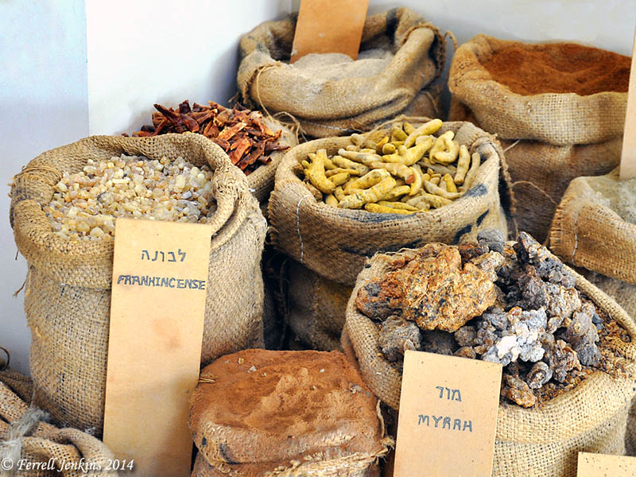
Welcome To Our Services

Slide 2
The Great Invitation
Matt. 11:28-30

Slide 3
The Great Invitation
The Problem of Humanity
Labor - To feel fatigue; by implication to work hard: (bestow) labor, toil, be wearied
Heavy Laden - to load up (properly as a vessel or animal), i.e. (figuratively) to overburden with ceremony (or spiritual anxiety), be heavy laden.
The Burden of Sin, Rom.3:23
Guilt, Shame, Bad Conscience, Weight of Sin
Fear of Death, Heb.2:14-15
Hidden from the Proud, vs.25
Seek Human Solutions - Blame others; Ignore Problem, “Good Old Boy,” Good As…, Escapism

Slide 4
The Great Invitation
Who is Inviting Us?
Jesus The Son of The Living God
He is the Only Way – John 14:6
Personal Pronouns Used 7 Times
The Focus is on Christ, 1 Cor.1:17-18, 2:2
Not Come to the Church
Not Come to Baptism
Eph.5:32, Don’t Get the Cart Before the Horse

Slide 5
The Great Invitation
Why Should We Accept the Invitation?
The Offer of Rest: To repose (literally or figuratively (be exempt), remain); by implication to refresh: - take ease, refresh, (give, take) rest. To cause or permit one to cease from any movement or labor in order to recover and collect his strength. To give rest, refresh, to give one’s self rest, take rest.
Now – Forgiveness, Eph.2:14-16
In Death – Rev.14:13
In Eternity – Heb.4:9-11

Slide 6
The Great Invitation
How Do We Accept This Rest?
Come To Jesus, Jn.1:12, Gal.3:26-27, Matt.28:18-19
Submission To His Yoke, Matt.28:20
Learn of Me, Jn.6:44-45
The Character of Jesus, Meek and Lowly of Heart
Follow in His Steps, Matt.18:3-4, 20:27-28
The Promise of The Lord?
Yoke is Easy and Burden is Light
1 Jn.5:3, Not Burdensome, Irksome
Labor of Love, Gen.29:20
Put it in Balance of Eternity, Rom.8:28, 2 Cor.4:17-18

Slide 7
Jesus Invites You To Come
Hear the gospel of Christ, Acts 18:8
Believe in Jesus Christ, Acts 16:31
Repent and Turn to God, Acts 17:30
Confess Jesus Before Men, Acts 8:37
Be Baptized For Forgiveness, Acts 2:38
---------------------------------
Cleave Unto The Lord, Acts 11:23
If Err From The Truth: Repent & Pray God Acts 8:22

