Slide 1
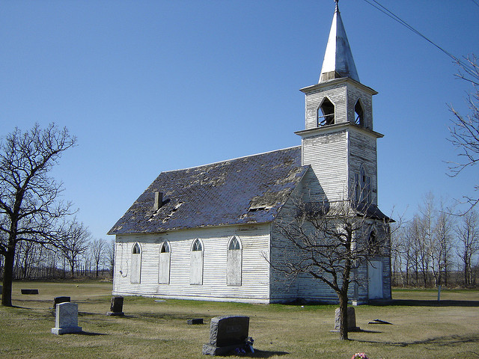
Don't Call Me Just A
"Christian"

Slide 2
Don't Call Me Just A "Christian"
"Christian(s)" only appears in the bible three (3) times
Acts 11:26; Acts 26:28; & 1 Peter 4:16

Slide 3
What is a "Christian"
A "Christian" has repented that old things have passed away, and all things are become new -
2 Cor 5:17
A "Christian" has confessed Jesus Christ is the Son of God -Acts 8:37
A "Christian" has risen out of the watery grave of baptism to newness of life - Romans 6:4-5
Don't Call Me Just A "Christian"

Slide 4
Don't Call Me Just A "Christian"
We should strive to be called "Disciple"

Slide 5
What is a "Disciple"
Disciple(s) appears over 270 times times in the New Testament.
Being a disciple is more than - a one time confession, repenting, and baptism - just listening to the word
What if we did what the disciples did?

Slide 6
Matthew 28:19-20
A Disciple is a-
learner of the word;
a student of the teachings of Christ;
a teacher of the teachings of Christ to ALL;
disciplined in Christ teachings
Some Christians are not Disciples
II Timothy 2:2

Slide 7
Don't Call Me Just A "Christian"
We should strive to be called "light of the world"

Slide 8
Have We Darkened World?
Matthew 23:1-15
Jesus rebukes the scribes & Pharisees
Calls them Hypocrites 7 times
Living in "Gotcha" religious world: v3-4
Have we done the same? Have we turned into a group of "Gotcha's". v13

Slide 9
Have we taken the good out of serving God?
Have we left our first love? - Rev 2:4
What God created was Good, do we see the Good? Gen: 1-4, 10, 12, 18, 21, 25, 31
Have we bound ourselves and forgot Jesus came to give us life more abundantly? John 10:10
Notes:
Joh 10:10 The thief cometh not, but for to steal, and to kill, and to destroy: I am come that they might have life, and that they might have it more abundantly.

Slide 10
Be the Light of the World
Do we only talk about the Darkness, to those living in Darkness? Luke 1:79
Matthew 5:14-16: do we hide our light for Christ under a bushel?
Give them Jesus!
People often can tell what we are against; but can they tell what we stand for? John 14:6
Notes:
Luk 1:79 To give light to them that sit in darkness and in the shadow of death, to guide our feet into the way of peace.
Mat 5:14 Ye are the light of the world. A city that is set on an hill cannot be hid.
Mat 5:15 Neither do men light a candle, and put it under a bushel, but on a candlestick; and it giveth light unto all that are in the house.
Joh 14:6 Jesus saith unto him, I am the way, the truth, and the life: no man cometh unto the Father, but by me.

Slide 11
Don't Call Me Just A "Christian"
Lets strive to be called a Disciple Light of the World

