Slide 1
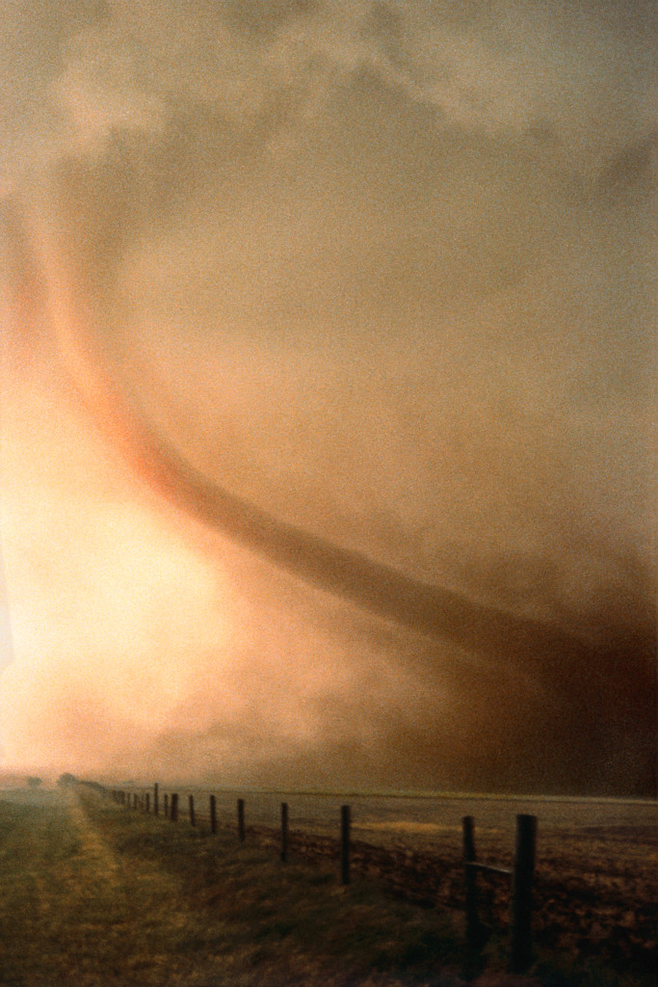
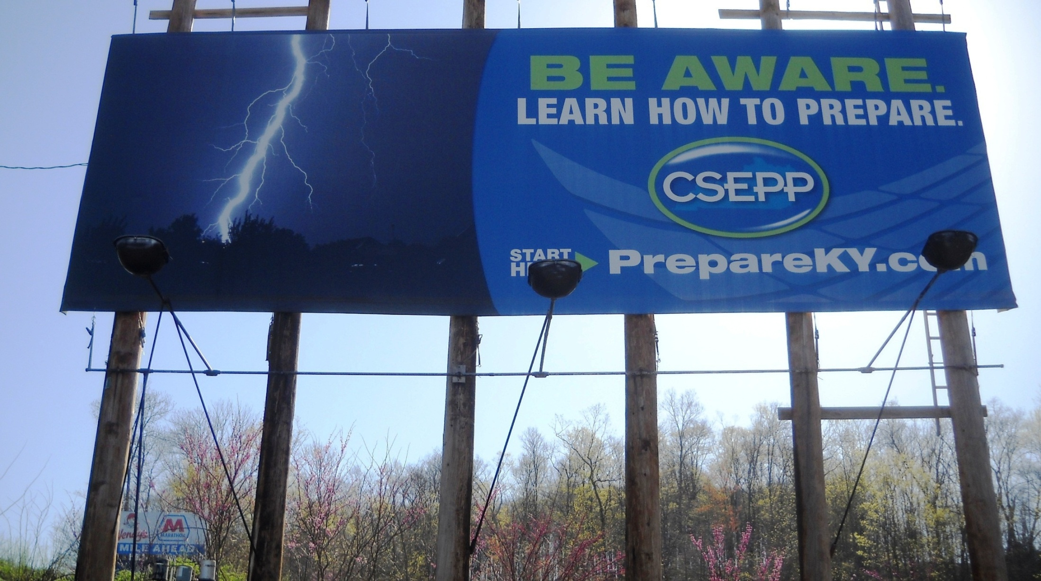
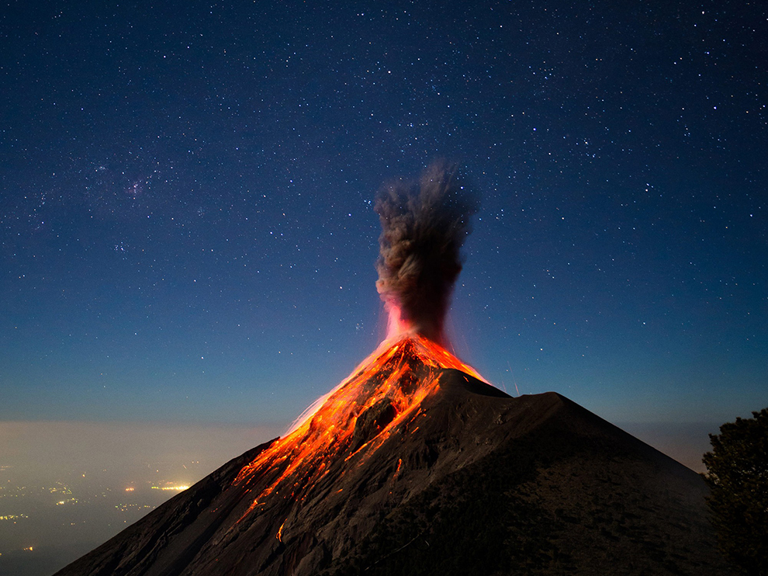
Lightning, Tornados, Fire, Chemical Spills, Flood, Snow & Cold

Slide 2
Be Aware of What?
The Day of the Lord, 1 Thess.5:1-6; 2Pet.3:9-11
The Second Coming of Christ, Jn.14:3, Heb.9:28
The Resurrection of the Dead, Jn.5:28-29, Acts 24:15
The Day of Judgment, Matt.11:21-24, Acts 17:31, Acts 24:25
The Wrath to Come, 1 Thess.1:9-10, Rom.2:5-6

Slide 3
When Will it Happen?
Don’t Know, 1Thess.5:1-3; 2 Pet.3:9-11, Matt.24:36
Be Aware at All Times, Matt.25:1-13, Matt.24:42-44
My Life Can End Today, Jam.4:13-14, 1 Sam.20:3

Slide 4
It Will Affect Us All
Good and Bad Alike, 2 Cor.5:10, Matt.25:31-34, 41, 46
The Resurrection, Jn.5:28-29, Acts 24:15
Some Will Be Translated, 1 Cor.15:51-54, 1 Thess.4:13-17
No Exemptions, Rom.14:10-12

Slide 5
Learn How To Prepare
Jesus is The Savior, Luke 2:11, Tit.2:11-13
Obey The Gospel of Christ, Heb.5:8-9, Acts 6:7
Live Godly, Righteously, Tit.2:11-12, Rom.2:7
Be Faithful, Rev.2:10

Slide 6
You Can Begin To Prepare Tonight
Hear the Gospel of Christ, Rom.10:17
Believe in Jesus Christ John 1:12
Repent and Turn to God, Acts 2:38
Confess Jesus Before Men, Acts 8:37
Be Baptized for Forgiveness, Ac.2:38
---------------------
Be Thou Faithful Unto Death, Rev.2:10
If Err From The Faith: Repent and Pray God Acts 8:22

