Slide 1
Welcome To Our Services

Slide 2
Let Us Worship The Lord
Song Leader – Chris Craig
First Song #
Second Hymn #
Opening Prayer –
Song Before The Lesson #
Invitation Hymn #

Slide 3
“God’s Righteousness”
Rom.10:1-11

Slide 4
What Is the Righteousness of God?
God’s Personal Righteousness, Ps.97:2, Ps.89:14 ESV
Path of Right Living, Ps.23:3, Ps.119:172
God’s Plan to Make Men Right, Rom.1:16-17, Rom.3:21-22, Rom.10:1ff

Slide 5
Paul’s Thoughts on the Jews
His Heart’s Desire and Prayer, vs.1
They Are Zealous, vs.2
Zeal Without Knowledge is Dangerous
But Knowledge Without Zeal is Pathetic
Ignorant of This Righteousness
Establish Own Righteousness
Rebelled Against God’s Righteousness

Slide 6
Righteousness is Available
Faith Brings Righteousness in the Gospel, vs.4
In the Law of Moses, Perfect Obedience Brings Righteousness, vs.5, Gal.3:10-12, Lev.18:5, Rom.4:4-5, Rom.3:23
Easy Access, vs.6-8, Deut.30:11-14
The Problem is not Revelation but the Lack of Faith

Slide 7
Faith in Action
Active, Living Faith, vs.9-10, Mt.10:32
Confess our Sins? Confess we are Saved?
True Believers are Not Ashamed, vs.11
God’s Righteousness Open for All, vs.12
Calling on God, vs.13, Acts 22:16, 1Pet.3:21, Mt.7:21
Preaching Makes the Message Known, vs.14-17, 1 Cor.1:21
Have They All Heard? Vs.18-21

Slide 8
God’s Plan of Righteousness
Hear the Gospel of Christ, Acts 2:22
Believe in Jesus Christ, Rom.1:16
Repent and Turn to God, Luke 13:3
Confess Jesus Before Men, Matt.10:32
Baptized Into Christ, I Pet.3:21
-----------------------------
Grow And Be Faithful, 2 Pet.3:18
If Err As a Christian: Repent and Confess, Acts 19:18

Slide 9
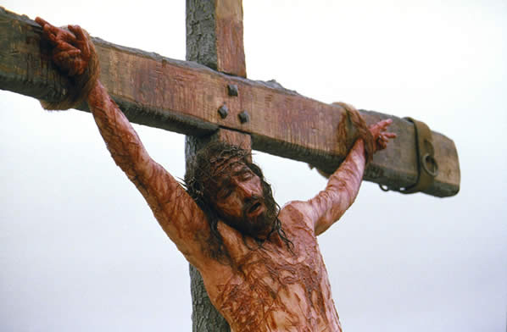
This Do In Remembrance of Me
Luke 23:20 Pilate addressed them once more, desiring to release Jesus,
Luke 23:21 but they kept shouting, "Crucify, crucify him!"
Luke 23:22 A third time he said to them, "Why, what evil has he done? I have found in him no guilt deserving death. I will therefore punish and release him."
Luke 23:23 But they were urgent, demanding with loud cries that he should be crucified. And their voices prevailed.
Luke 23:24 So Pilate decided that their demand should be granted.

Slide 10
The Collection
“Now concerning the collection for the saints, as I have given order to the churches of Galatia, even so do ye.
Upon the first day of the week let every one of you lay by him in store, as god hath prospered him, that there be no gatherings when I come.” 1Cor.16:1-2

Slide 11
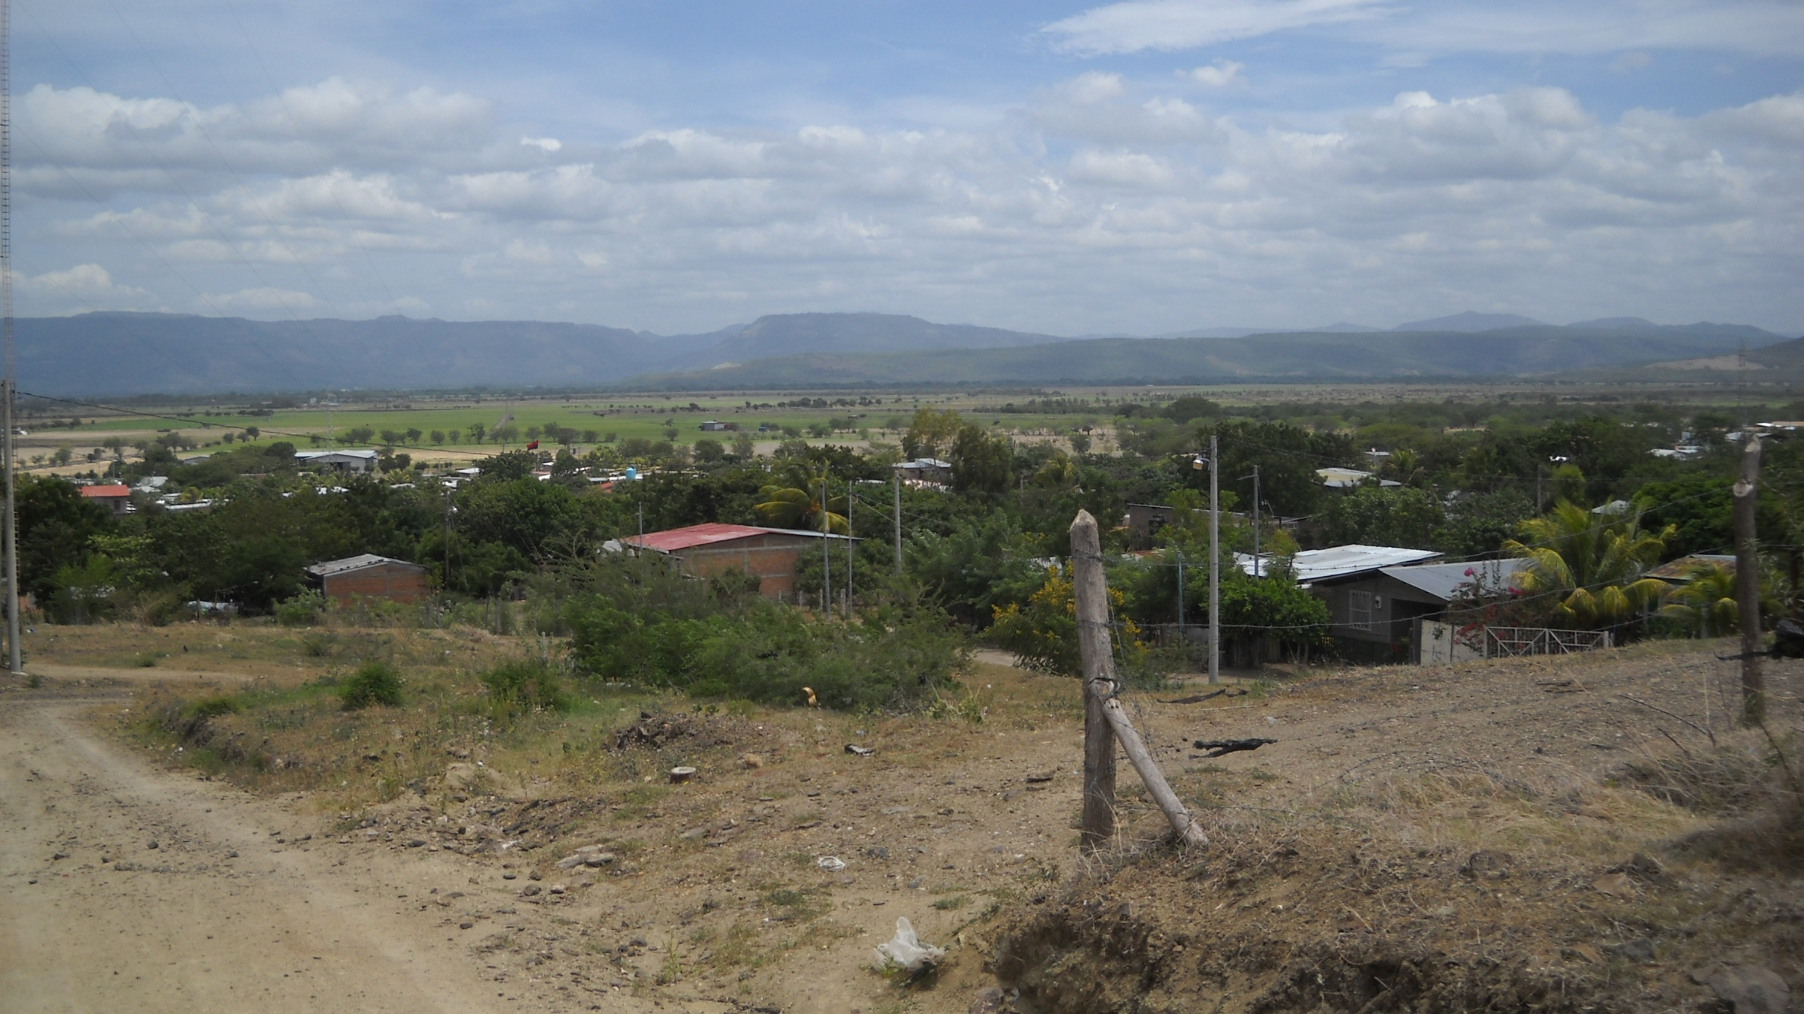
Thanks For Coming Out Today

