Slide 1
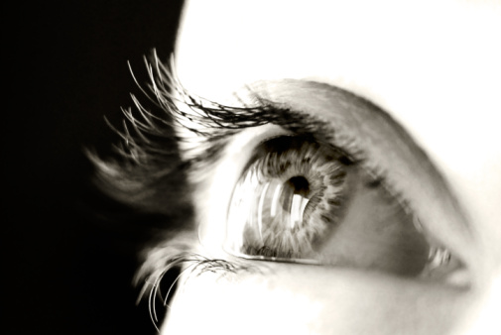
The responsibility I and others have to help people to see Jesus…
“Sir, we wish
to see Jesus”
to help them see…
…the DEITY of Jesus
…the COMPASSION of Jesus
…the AUTHORITY of Jesus
…the DEATH of Jesus
…the EXALTED Jesus

Slide 2
…but whether or not
people come to see Jesus
depends largely
on THEM!
“Sir, we wish
to see Jesus”
In John 9, a blind man sees Jesus…
Others, though seeing, are blinded…
…by fear
…by tradition
…by pride

