Slide 1
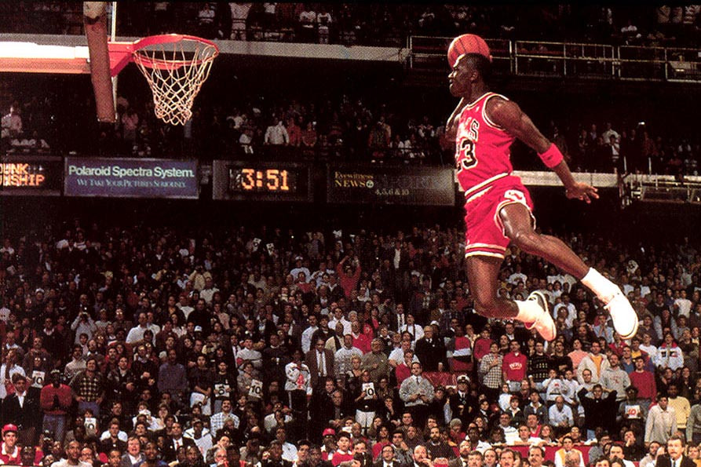
Paul’s Passion For Christ
Passion For the Game, Hard Work, Dedication, Sacrifice
Phil.3:1-15

Slide 2
Paul’s Passion For Christ
Vs.1-2, His Warning
Vs.3, The True Circumcision, Rom.2:28-29
Vs.4-7, His Confidence in the Flesh
Vs.8-9, To Be Found in Him
Vs.10, To Know Christ, Gen.4:1
Vs.11, The Resurrection of Life, Jn.5:28-29, Lk.14:14
Vs.12, Lay Hold on Christ
Vs.13-14, Press Toward the Prize
Vs.15, Strive for Maturity

Slide 3
The Plan of Salvation
Hear the Gospel of Christ, Acts 18:8
Believe in Jesus Christ, Rom.5:1
Repent and Turn to God, Luke 24:47
Confess Jesus Before Men, Acts 8:37
Be Baptized for the Remission of Sins, Ac.2:38
---------------------------------
Be Thou Faithful Unto Death, Rev.2:10
If Err From The Faith: Repent and Pray God, Acts 8:22

