Slide 1
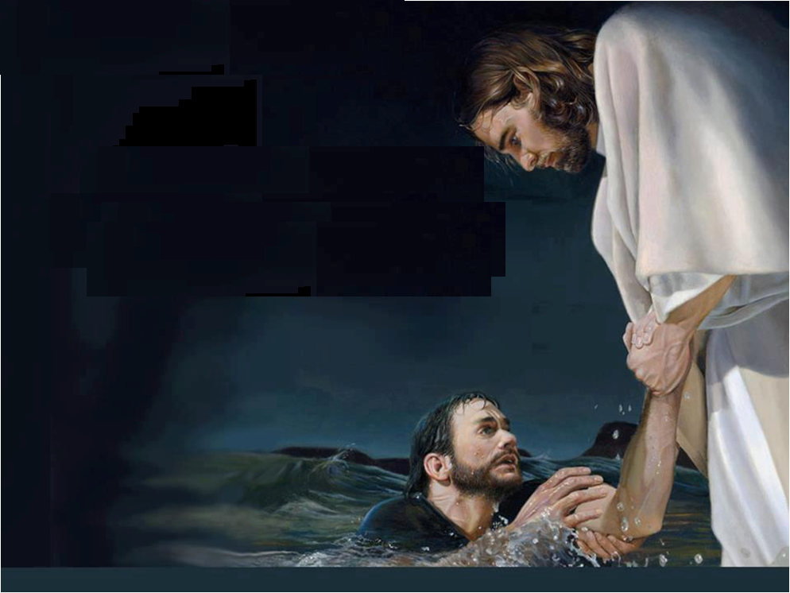
Jesus Can Help
Matt.14:22-33

Slide 2
Jesus Can Help
Drowning Financially
Heb.13:5-6
1 Tim.6:6-11
Phil.4:11-13
Prov.22:7

Slide 3
Jesus Can Help
Drowning in Sorrows
Psalms 18:4-6
Psalms 23:4
Psalms 46:1
Psalms 147:3-5
Isaiah 41:10
2 Cor.1:3-4
Rev 21:2-4

Slide 4
Jesus Can Help
Drowning By Bad Attitudes
James 4:1-10
1 Peter 3:10-12
Gal.5:19-21

Slide 5
Jesus Can Help
Drowning In Family Troubles
Humble Pie
1 Peter 3:1-7
Col.3:18-21

Slide 6
Jesus Can Help
Drowning In Sin
Col.2:13
Rom.7:15-24
Luke 15:16-19
Acts 2:36-41

Slide 7
Jesus Can Help You Today
Hear the Gospel of Christ, Acts 18:8
Believe in Jesus Christ, Rom.5:1
Repent and Turn to God, Luke 24:47
Confess Jesus Before Men, Matt.10:32
Baptized Into Christ, Gal.3:26-27
-----------------------------
Grow And Be Faithful, 2 Pet.3:18
If An Erring Christian: Repent and Pray God, I Jn.1:9

