Slide 1
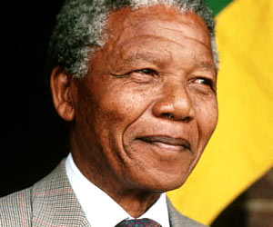
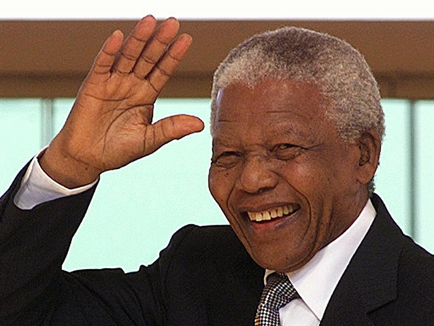
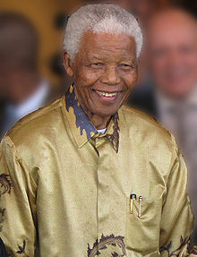
Former South African President Nelson Mandela was revered throughout the world for leading the peaceful transition to multiracial democracy after three centuries of white domination in South Africa.
He was jailed for 27 years under white racist rule and released in 1990. He then steered the divided country from the apartheid (the state of being apart) era to an all-race democracy, becoming South Africa's first black president in 1994. He Died Thursday Dec.5, 2013. 95 Years old.

Slide 2
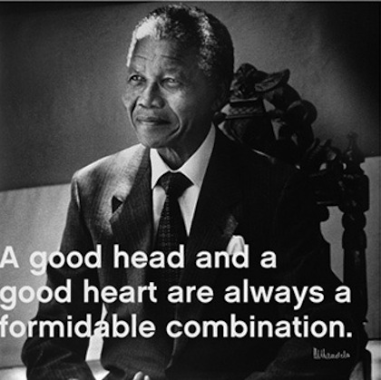
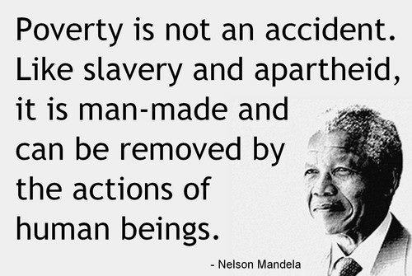
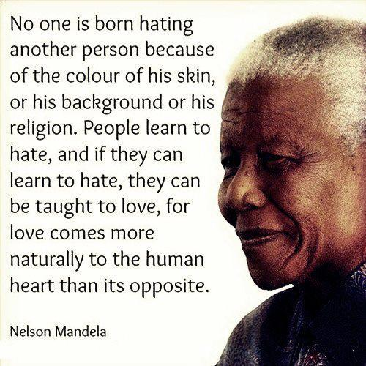
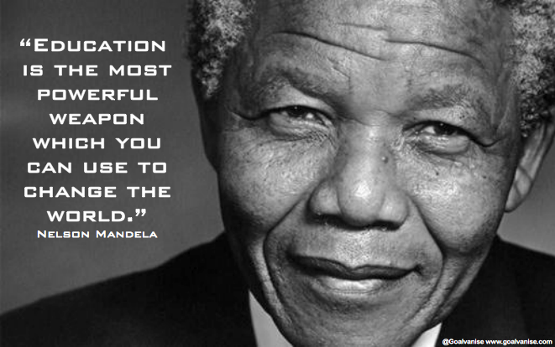

Slide 3
“The Greatest Man to Walk Upon the Earth…”
Many Comments From Twitter or From the Internet, reported on The News Friday morning.

Slide 4
“The Greatest Man to Walk Upon the Earth…”
Human Emotions Can Cloud Thinking
People Wear Rose Colored Glasses
Founding Fathers of America
Abraham Lincoln
Inventors
Bible Characters: Abraham, Joseph, Moses
Elijah, Isaiah, Jeremiah, Daniel
Paul, Peter
I Tim.2:5
Christ Jesus

Slide 5
“The Greatest Man to Walk Upon the Earth…”
Christ Jesus is the Greatest Man to Walk upon the Earth!
Human Side: John 1:14, Phil.2:5-11, Heb.2:14-18, Heb.4:14-16
Divine Side: John 1:1-3, John 14:7-9, Phil.2:5-11, Col.2:9, Heb.1:3-8

Slide 6
The Plan of Salvation
Hear the Gospel of Christ, Acts 18:8
Believe in Jesus Christ, Rom.5:1
Repent and Turn to God, Luke 24:47
Confess Jesus Before Men, Acts 8:37
Be Baptized for the Remission of Sins, Ac.2:38
---------------------------------
Be Thou Faithful Unto Death, Rev.2:10
If Err From The Faith: Repent and Pray God Acts 8:22

