Slide 2
⁷ “But now ask the beasts, and they will teach you; And the birds of the air, and they will tell you; ⁸ Or speak to the earth, and it will teach you; And the fish of the sea will explain to you. ⁹ Who among all these does not know That the hand of the Lord has done this, ¹⁰ In whose hand is the life of every living thing, And the breath of all mankind?
Job 12 (NKJ)

Slide 3
A LESSON FROM GEESE

Slide 4
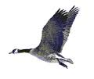
A LESSON FROM GEESE
GEESE ILLUSTRATE THE CONCEPT OF FELLOWSHIP

Slide 5
A LESSON FROM GEESE
Fellowship:
“to have in common”
“to share”
“to participate for a common cause”

Slide 6
⁴² And they continued steadfastly in the apostles’ doctrine and fellowship, in the breaking of bread, and in prayers.
Acts 2 (NKJ)

Slide 7
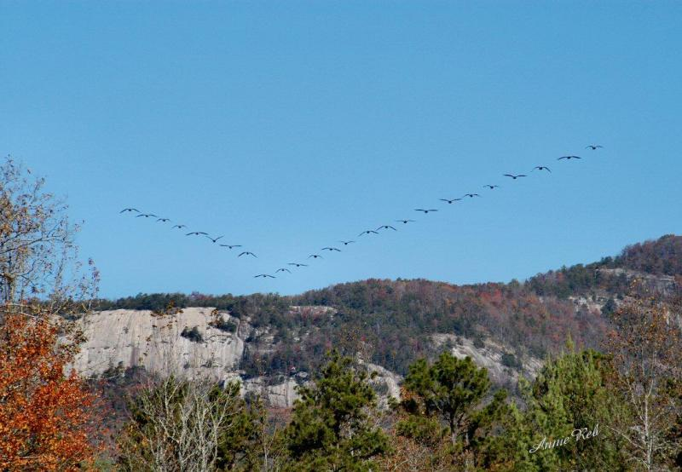

Slide 8
⁶ If we say that we have fellowship with Him, and walk in darkness, we lie and do not practice the truth.
⁷ But if we walk in the light as He is in the light, we have fellowship with one another, and the blood of Jesus Christ His Son cleanses us from all sin.
1 Jn. 1 (NKJ)

Slide 9
A LESSON FROM GEESE
GEESE ILLUSTRATE THE CONCEPT OF FELLOWSHIP
GEESE ILLUSTRATE THE CONCEPT OF SHARING THE WORKLOAD

Slide 11
²⁵ that there should be no schism in the body, but that the members should have the same care for one another.
²⁶ And if one member suffers, all the members suffer with it; or if one member is honored, all the members rejoice with it.
1 Cor. 12 (NKJ)

Slide 12
A LESSON FROM GEESE
GEESE ILLUSTRATE THE CONCEPT OF FELLOWSHIP
GEESE ILLUSTRATE THE CONCEPT OF SHARING THE WORKLOAD
GEESE ILLUSTRATE THE CONCEPT OF ENCOURAGEMENT

Slide 13
HONK
HONK
HONK
HONK

Slide 14
HONK
HONK
HONK
HONK
HONK
HONK
HONK
HONK
HONK
HONK
HONK
HONK
HONK
HONK
HONK
HONK
HONK
HONK
HONK
HONK

Slide 15
¹¹ Therefore comfort each other and edify one another, just as you also are doing.
1 Thess. 5 (NKJ)

Slide 16
¹³ but exhort one another daily, while it is called “Today,” lest any of you be hardened through the deceitfulness of sin.
Heb. 3 (NKJ)

Slide 17
³⁶ And Joses, who was also named Barnabas by the apostles (which is translated Son of Encouragement), a Levite of the country of Cyprus,
Acts 4 (NKJ)

Slide 18
A LESSON FROM GEESE
GEESE ILLUSTRATE THE CONCEPT OF FELLOWSHIP
GEESE ILLUSTRATE THE CONCEPT OF SHARING THE WORKLOAD
GEESE ILLUSTRATE THE CONCEPT OF ENCOURAGEMENT
GEESE ILLUSTRATE THE CONCEPT OF SHARING BURDENS WITH ONE ANOTHER

Slide 19
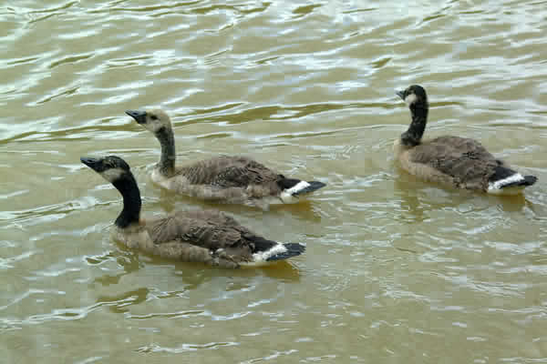

Slide 20
² Bear one another’s burdens, and so fulfill the law of Christ.
Gal. 6 (NKJ)

Slide 21
¹ Now we who are strong ought to bear the weaknesses of those without strength and not just please ourselves.
Rom. 15
(New American Standard Bible)

Slide 22
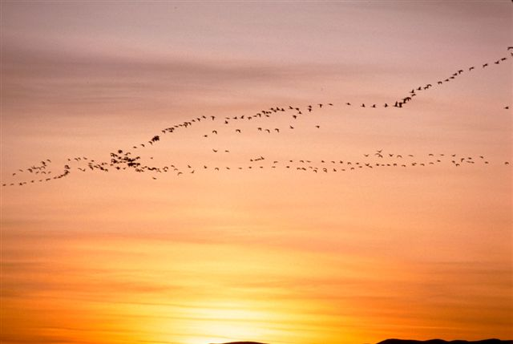
YOU DON’T HAVE TO BE A SCIENTIST...
…To learn from God’s marvelous creation; you only need to stop long enough to observe and let God reveal His wonders to you.

Slide 23
The Conditions Of Salvation
Hear the Gospel of Christ - Rom.10:17
Believe in Jesus Christ - Rom.1:16
Repent and Turn to God - Luke 13:3
Confess Jesus Before Men - Matt.10:32
Baptized Into Christ - Acts 2:38-39
Grow And Be Faithful - 2 Pet.3:18
If Err From The Faith: Repent and Pray God – 1 John 1:9

Slide 25
Preached at:
Bethel – 10/13/2013
Vaught Ridge – 10/20/2013
Providence – 10/20/2013

