Slide 1
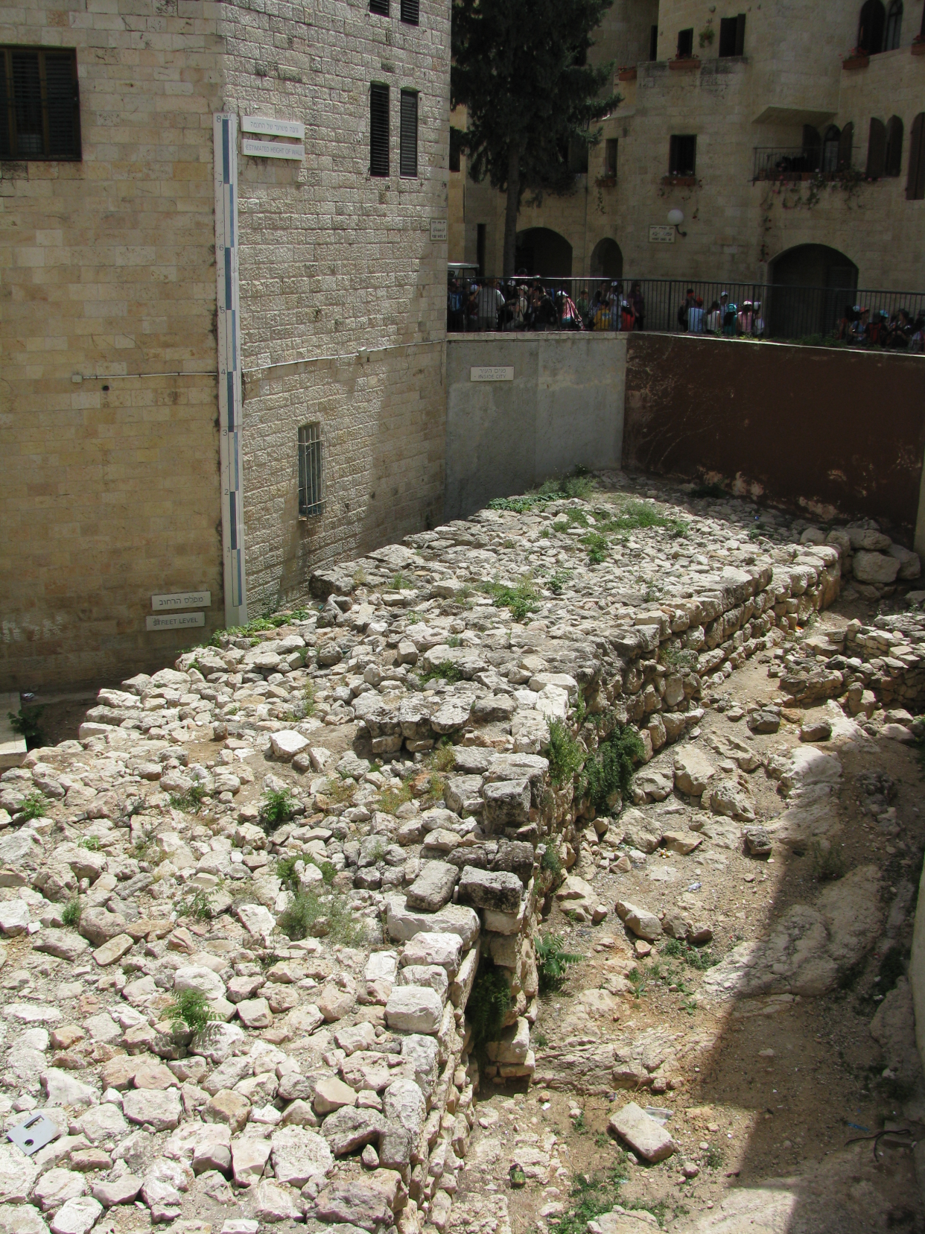
NEHEMIAH
God’s Keys for Rebuilding Broken Things

Slide 2
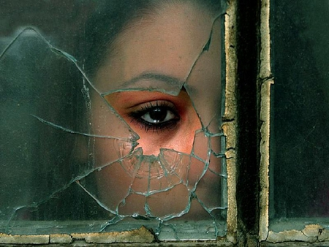
GOD REBUILDS BROKEN THINGS
A life of addiction (drugs, pornography)
Upbringing: physical or sexual abuse, neglect
Estrangement from family
Troubled marriage
Life after divorce
Broken friendships
New life into an old church
Dysfunctional family
Life after prison
Life-changing injury, illness, or surgery
Business on the ropes
Failing country and faltering economy
Church recovering from division
Faltering personal faith

Slide 3
Rebuilding Broken Things
Good Leadership
People with a Mind to Work
Willing to Battle a Persistent Enemy
Overcoming Discouragement from Brethren
Reverence for God and His Word
Serious about Repentance
People who are Devoted to Prayer

Slide 4
Key Dates (BC):
606 586 536
(first captives)
(Jerusalem destroyed)
(first captives returned)
Nehemiah 445 Nehemiah
161 yrs.
141 yrs.
91 yrs.

Slide 5
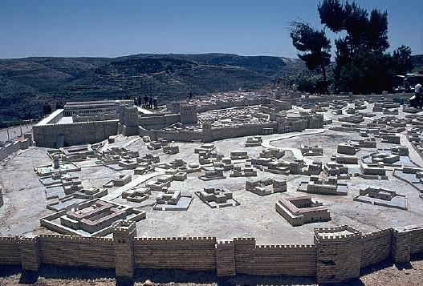
Jerusalem
2.1 miles in length 35 feet, average height 35 towers 8 gates

Slide 6
A VISION EMERGES
“Visions are born in the soul of a man who is consumed with the tension between what is and what could be. . . Vision is a clear mental picture of what could be, fueled by the conviction that it should be. . . Vision requires visionaries, people who have allowed their minds and hearts to wander outside the artificial boundaries imposed by the world as it is. A vision requires an individual who has the courage to act on an idea.” (Andy Stanley, Visioneering, pgs.17,18)

