Slide 1
California a Land of Superlatives

Slide 2
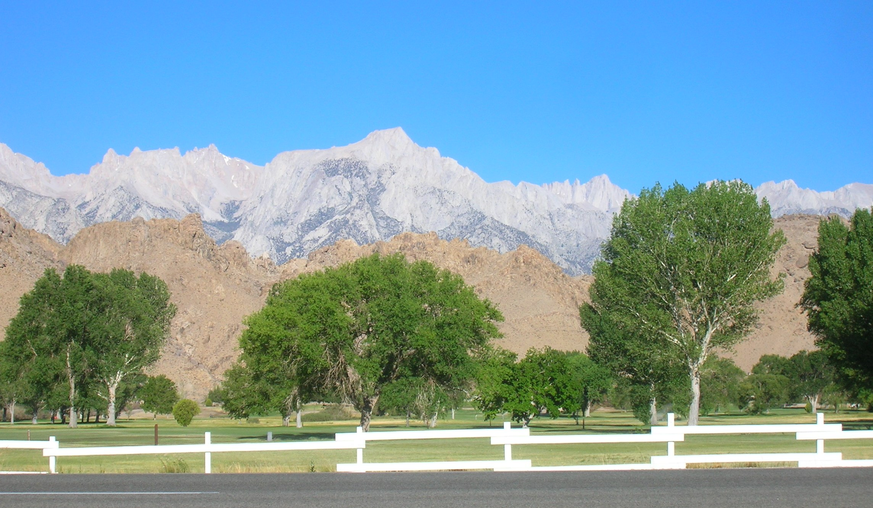
Mt. Whitney – 14,496 feet Tall

Slide 3
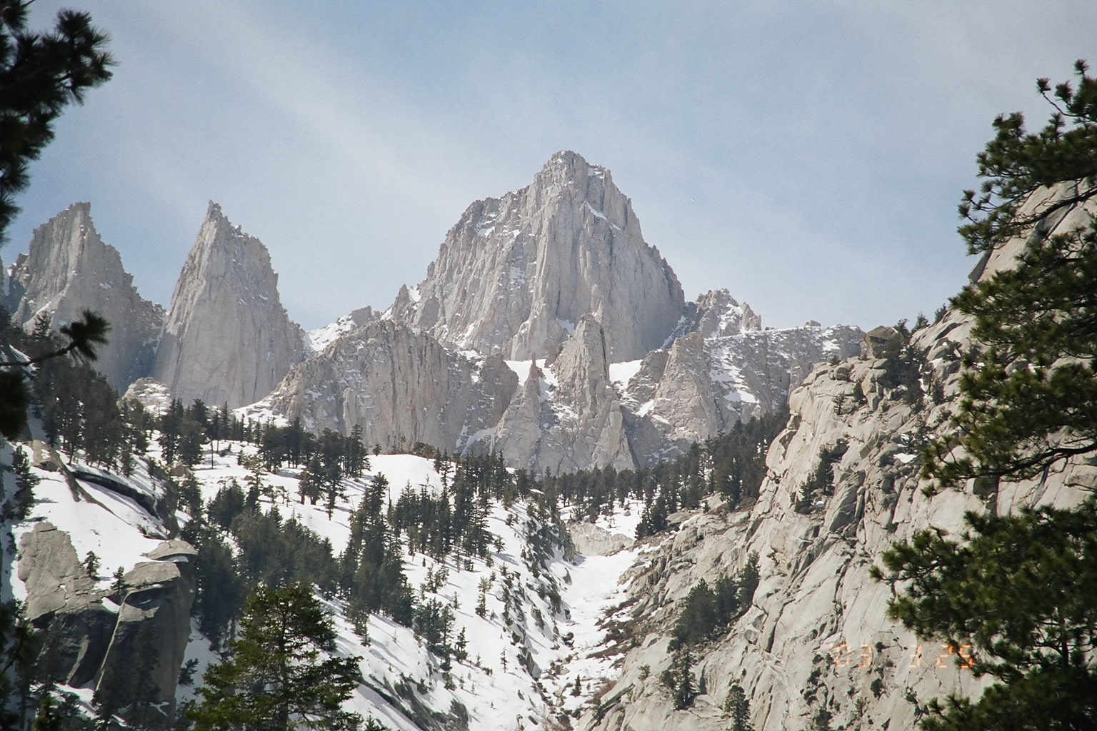

Slide 4
The San Joaquin Valley ~ 70 miles by 300 miles

Slide 7
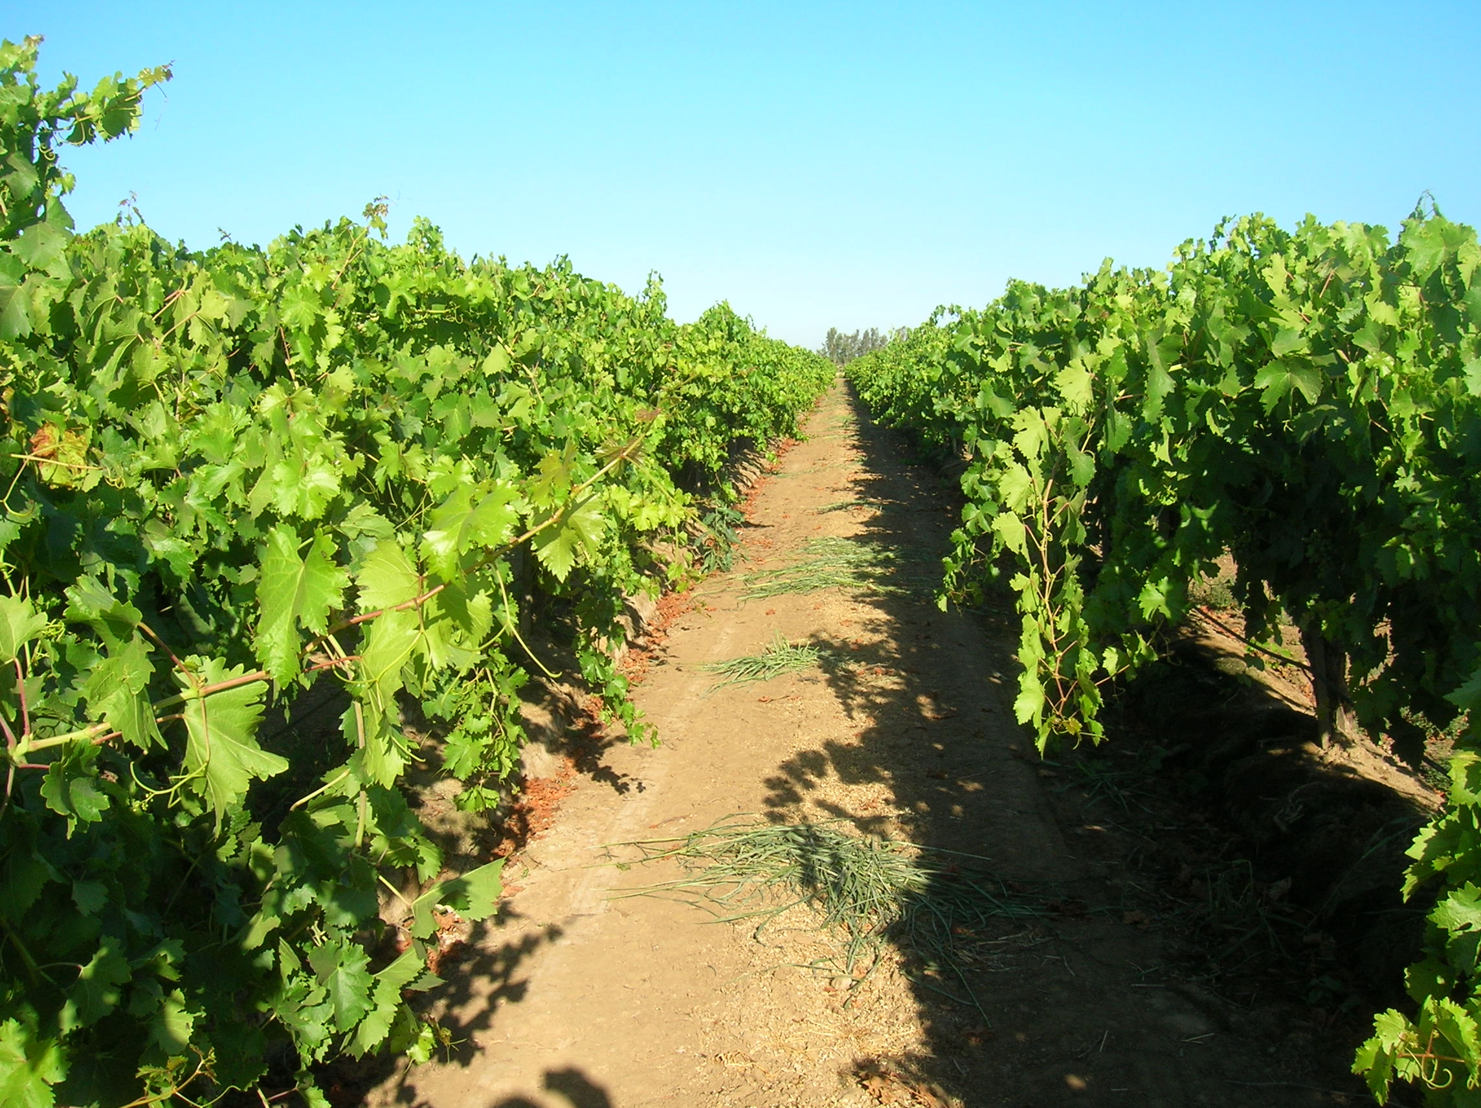

Slide 10
36 Feet
Volume of Wood ~ 52,513 cu ft

Slide 16
Badwater Basin 282 feet below sea level

Slide 17
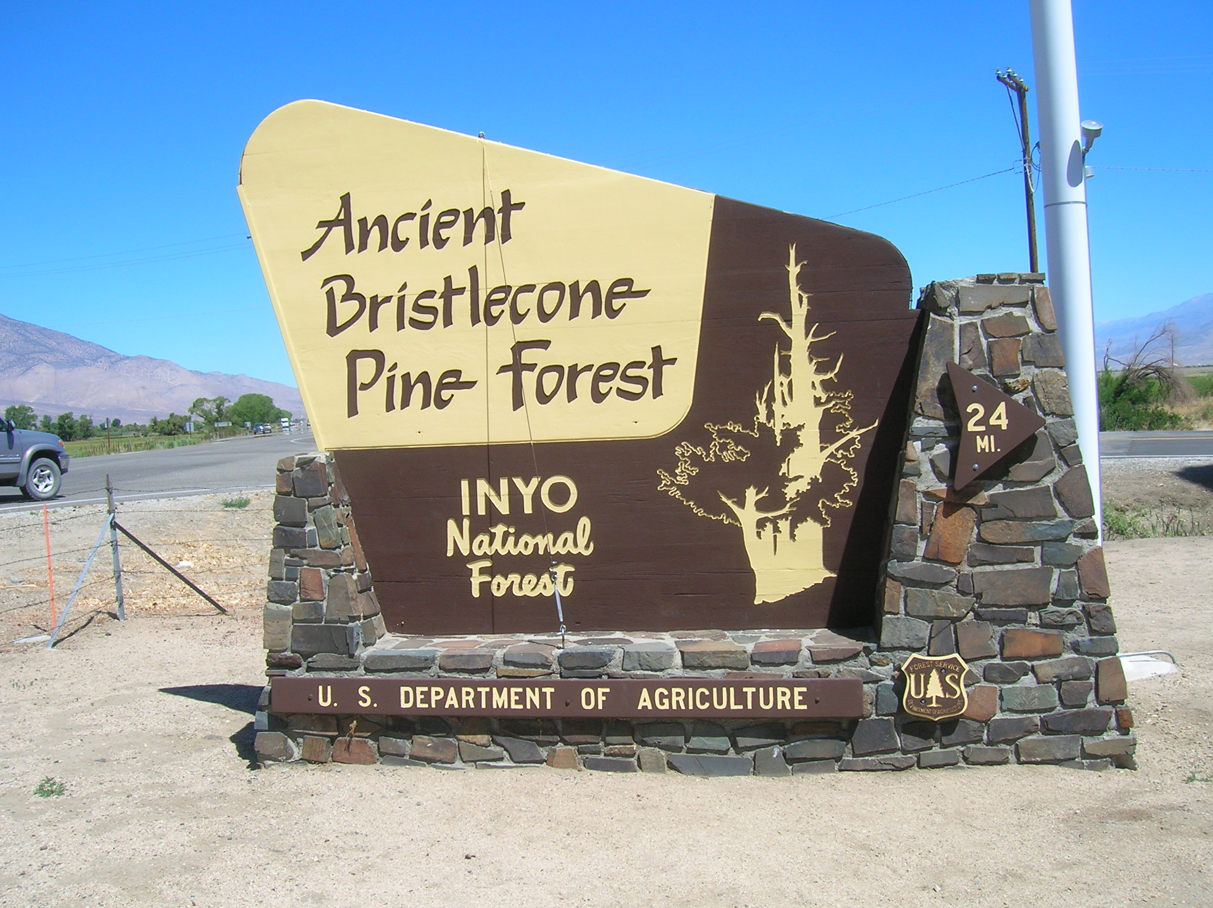

Slide 18
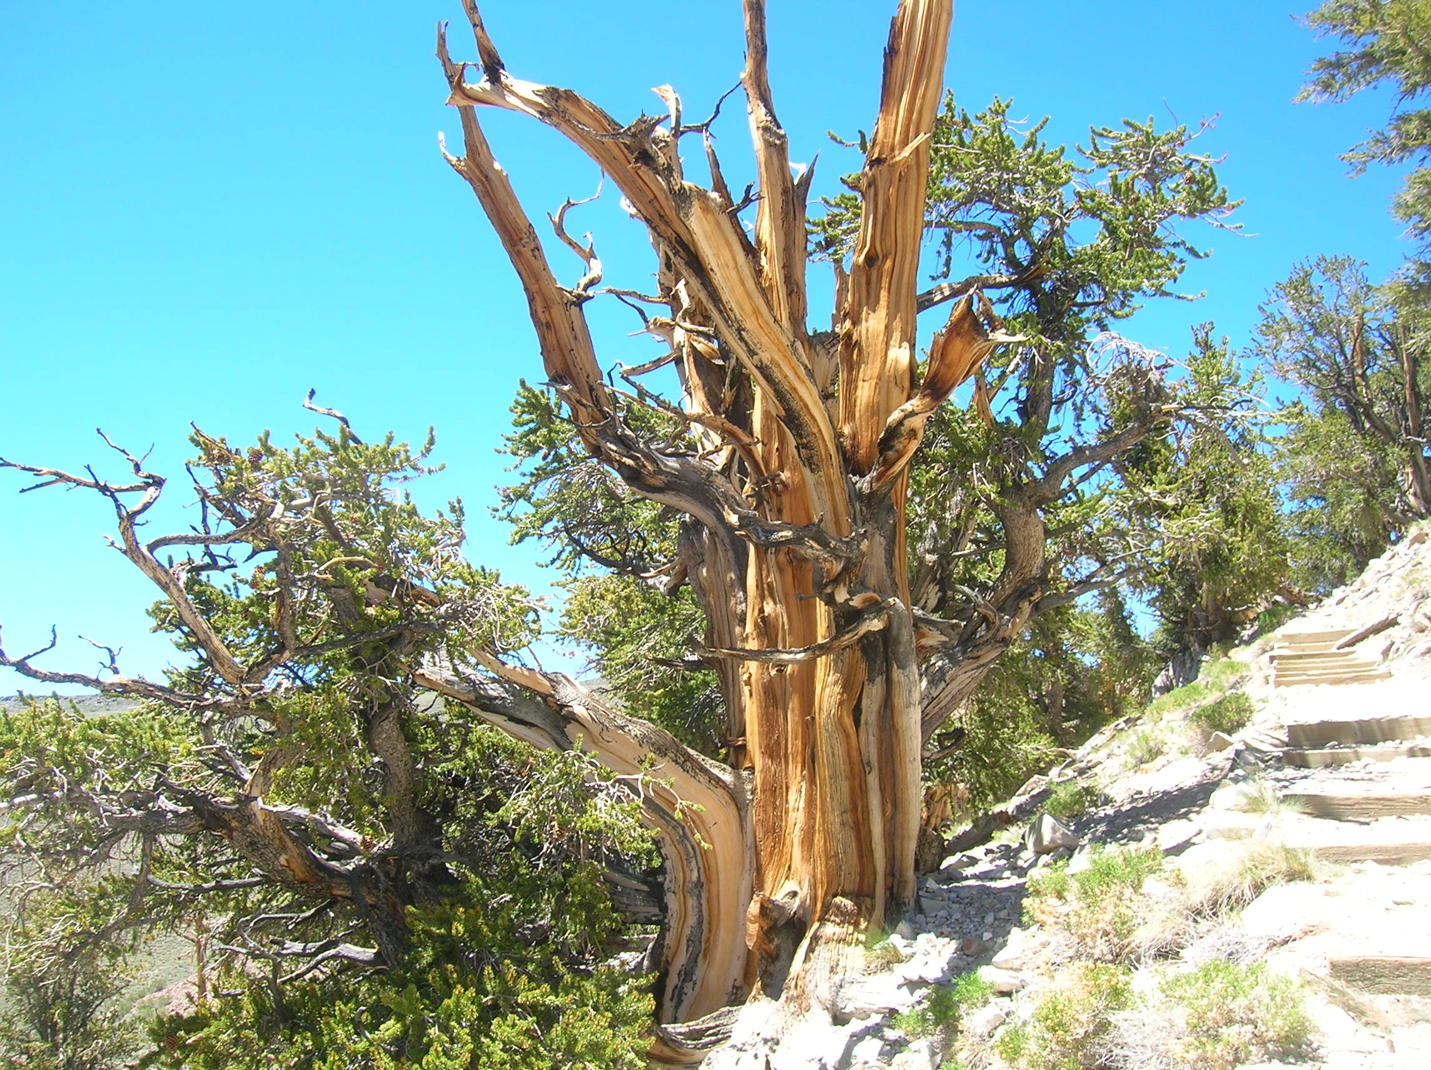
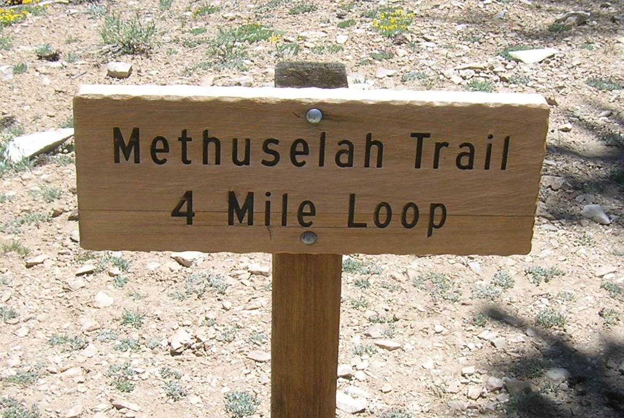
Methuselah Tree
The Bristlecone Pine
4845 Years Old
5062 Years Old

Slide 19
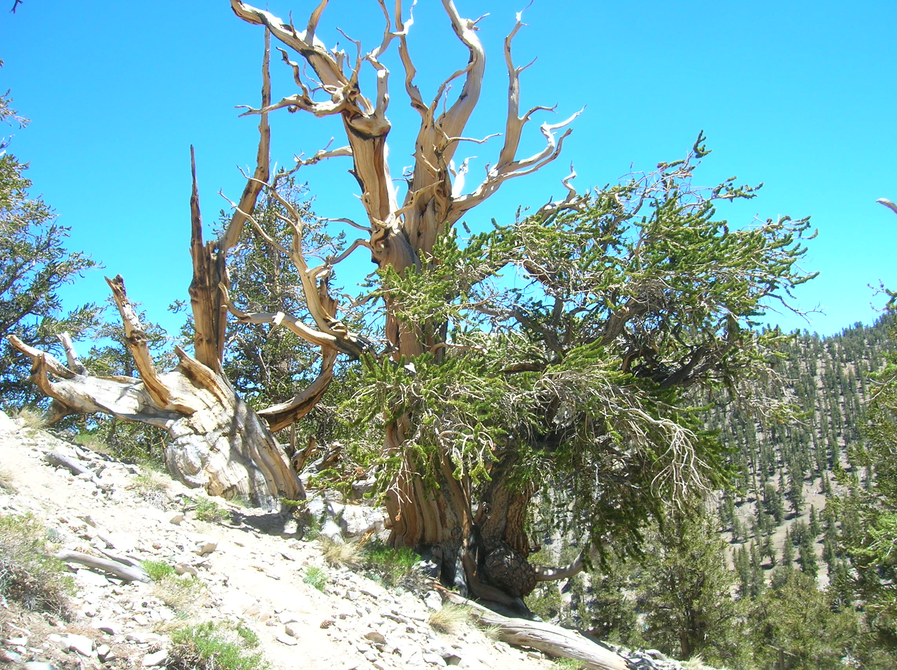
Why only 5062 Years Old?
Gen.6-8 - The Flood

Slide 20
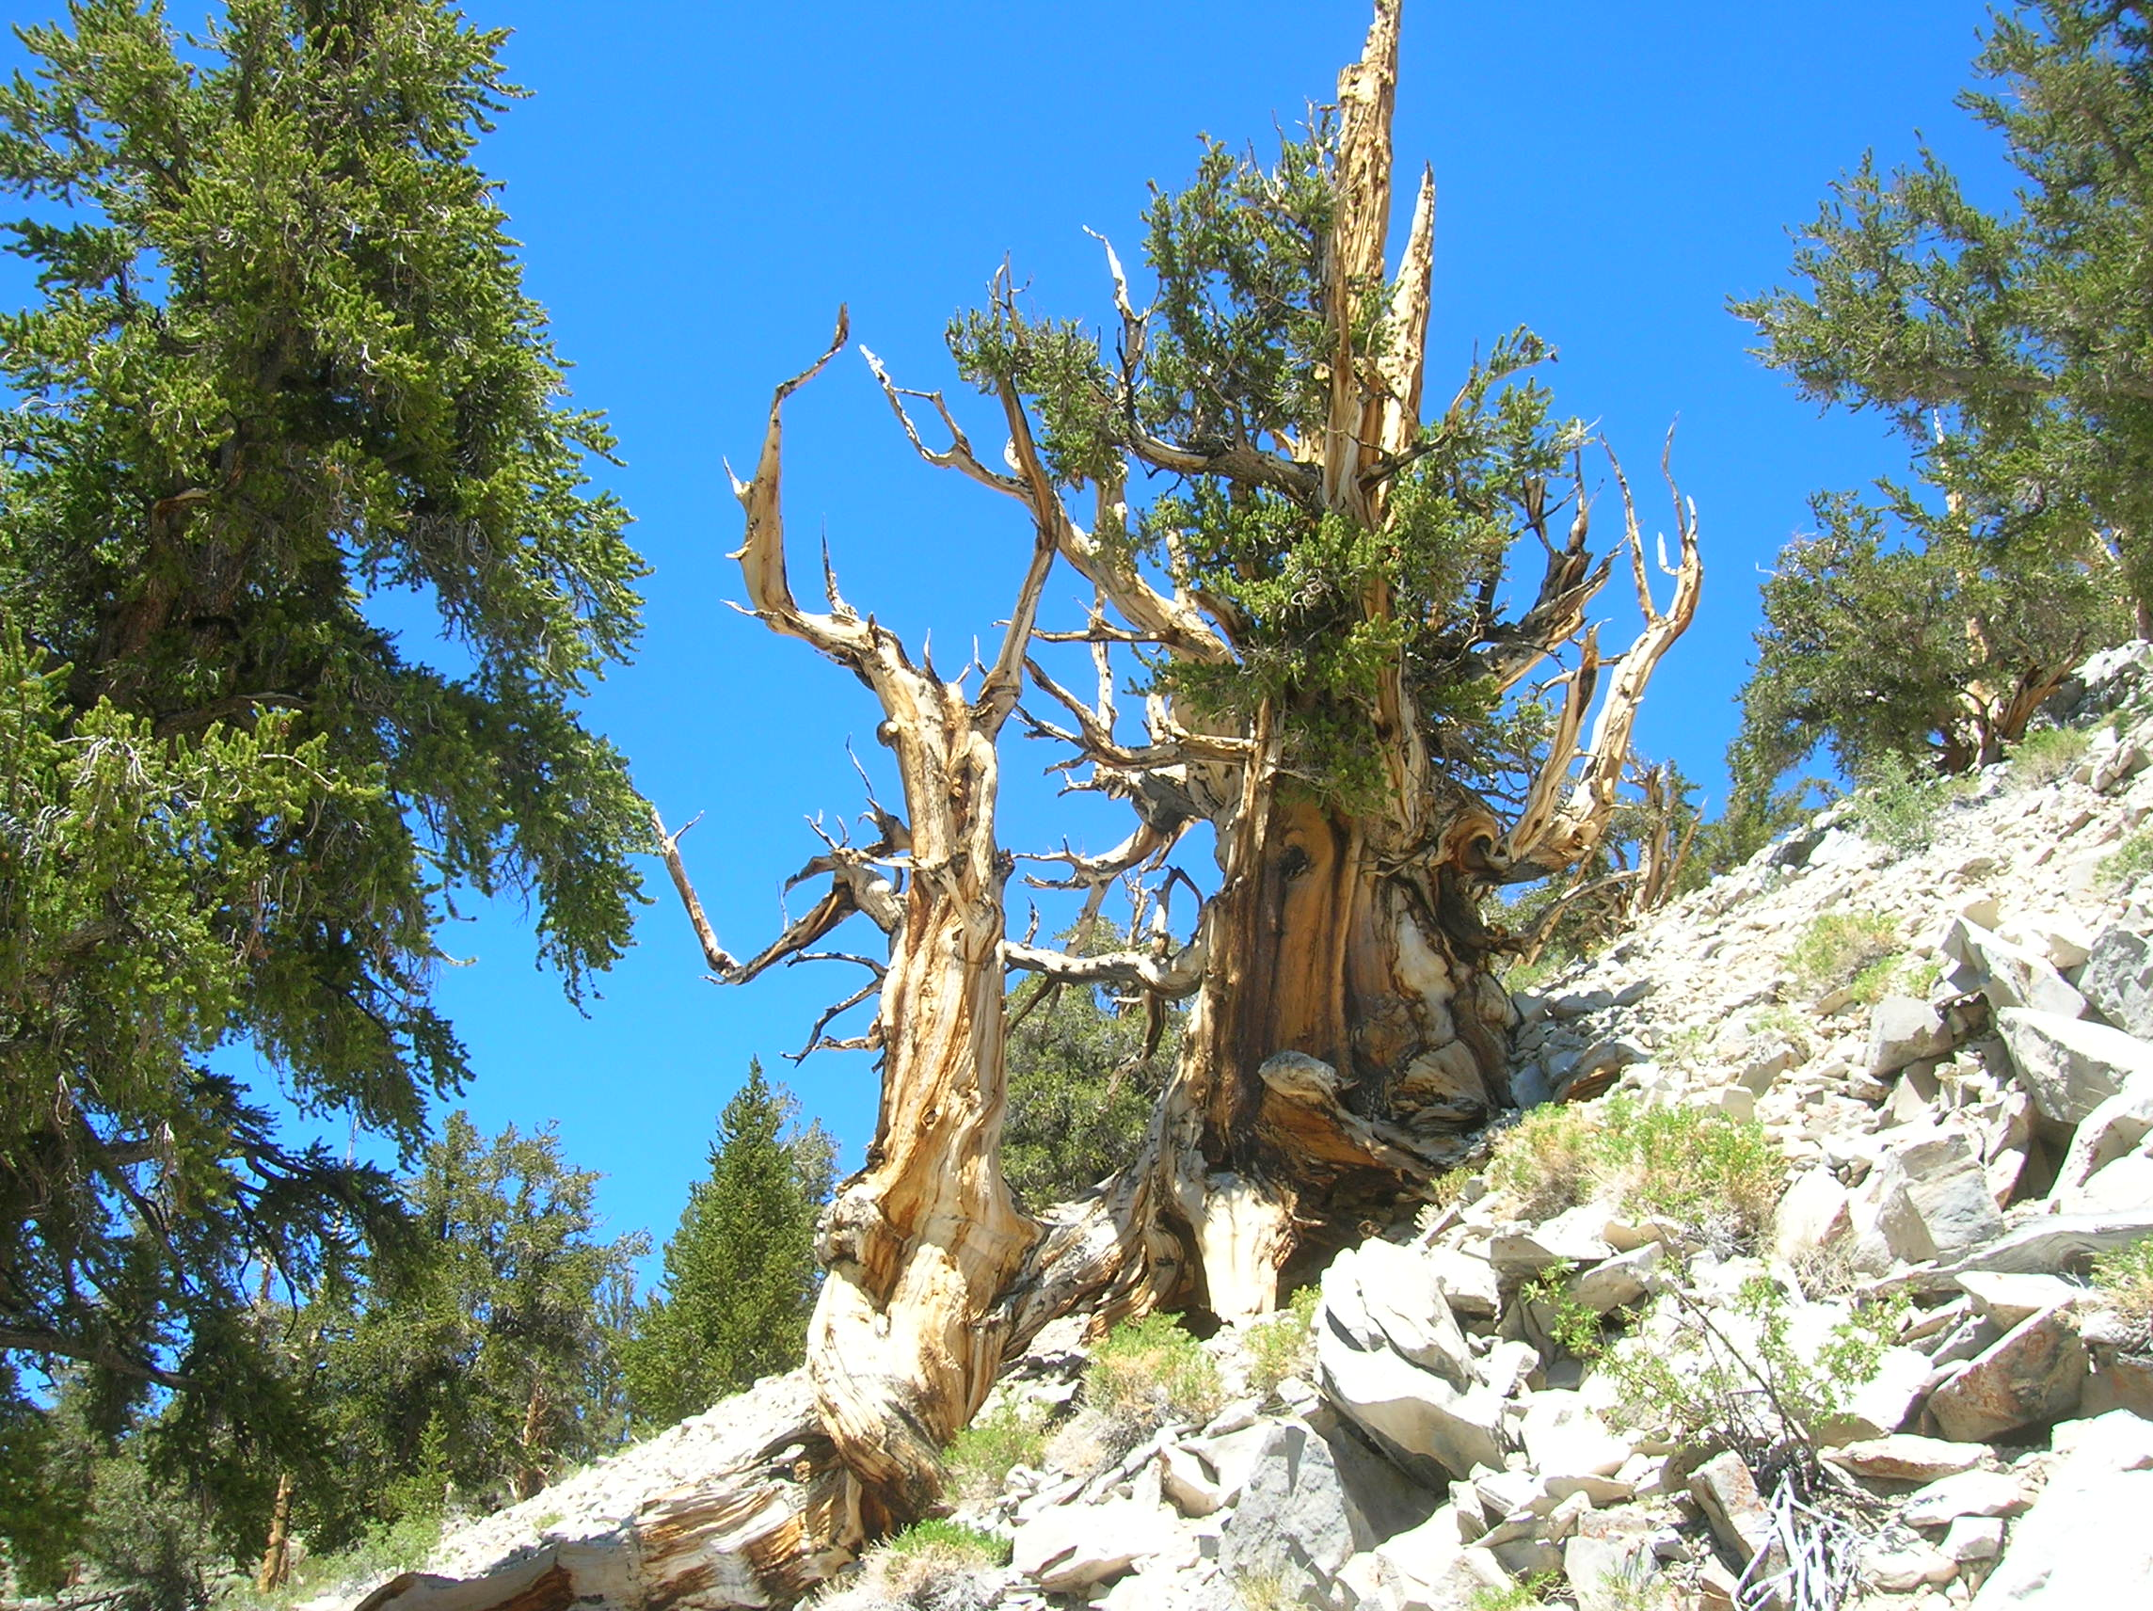
4000 - 5000 Year Old Trees
Great Events of Human History
The Civil War
The Declaration of Independence
Columbus Discovers America
Roman Coliseum, Aqueducts, Roads
The Mayan Temples
The Great Pyramids of Egypt

Slide 21
4000 - 5000 Year Old Trees
Great Events of Bible History
The Tower of Babel –Gen.11
Abraham and the Patriarchs Gen.12-50
Moses, 10 plagues, Cross Red Sea, Giving the Law
Joshua, the Judges, the Kings, the Prophets
The Captivities, the Return of Israel, Temple Rebuilt
The 4 Great World Powers, Daniel 2
John the Baptist, the Birth, the Life and the Death of Jesus
Birth of the N.T. Church – Acts 2,
Spread of the Gospel, The Epistles, Full Revelation
The Falling Away, The Dark Ages, Reformation, Restoration

Slide 22
The Plan of Salvation
Hear the gospel of Christ, Acts 18:8
Believe in Jesus Christ, Acts 16:31
Repent and Turn to God, Acts 17:30
Confess Jesus Before Men, Acts 8:37
Be Baptized For Forgiveness, Acts 2:38
---------------------------------------
Cleave Unto The Lord, Acts 11:23
If Err From The Truth: Repent & Pray God Acts 8:22

