Slide 1
A Centurion's Great Faith
Matt.8:5-13
Luke 7:1-10

Slide 2
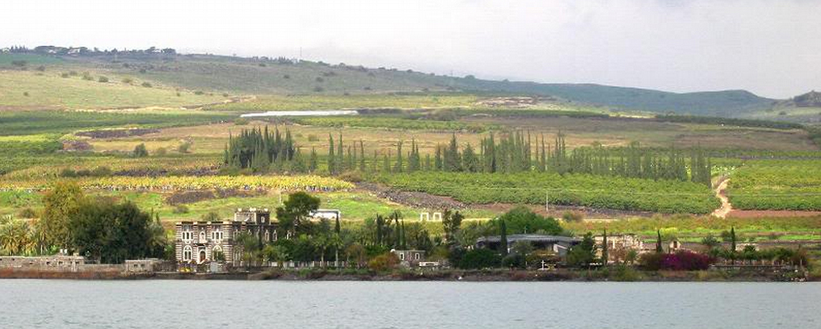
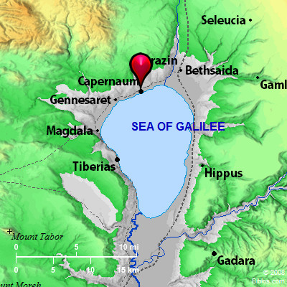
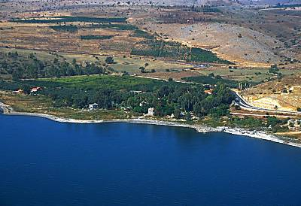
Capernaum

Slide 3
A Centurion's Great Faith
His Servant Was a Dear Friend: Vs.2, “Valued (figuratively): - dear, more honorable, precious, in reputation.” His actions showed it, vs.3. Prov.17:17
What Others Thought About Him: Vs.3-5 Character
The elders of the Jews acted on his request.
They pleaded with Jesus earnestly. (not Stoic)
Said he was Worthy to Help.
They Said He Loved our Nation.
He Built us a Synagogue.
He Was a Humble Man: Vs.6-7
Isaiah 6:5, Luke 5:8, Luke 18:10-13

Slide 4
A Centurion's Great Faith
He Understood Authority: Vs.8
Go -------------> He Goes
Come ---------> He Comes
Do This ------> He Does It
Do We Know Jesus has All Authority? Mt.28:18
Do We Respect and Submit to that Authority?
Jesus Marveled At Him: Vs.9 To Be in Awe, Wonder
Many Things We Wonder and are Amazed about
2 Times Jesus Marveled, Here and in Mk.6:1-6
He Was a Man of Great Faith: Vs.9
Weak Faith - Rom.4:19 Little Faith - Matt.8:26
Dead Faith - Jam.2:17-20 Saving Faith - Heb.10:39

Slide 5
The Plan of Salvation
Hear the Gospel of Christ, Acts 18:8
Believe in Jesus Christ, Rom.5:1
Repent and Turn to God, Luke 24:47
Confess Jesus Before Men, Acts 8:37
Be Baptized for the Remission of Sins, Ac.2:38
---------------------------------
Be Thou Faithful Unto Death, Rev.2:10
If Err From The Faith: Repent and Pray God Acts 8:22

