Slide 1
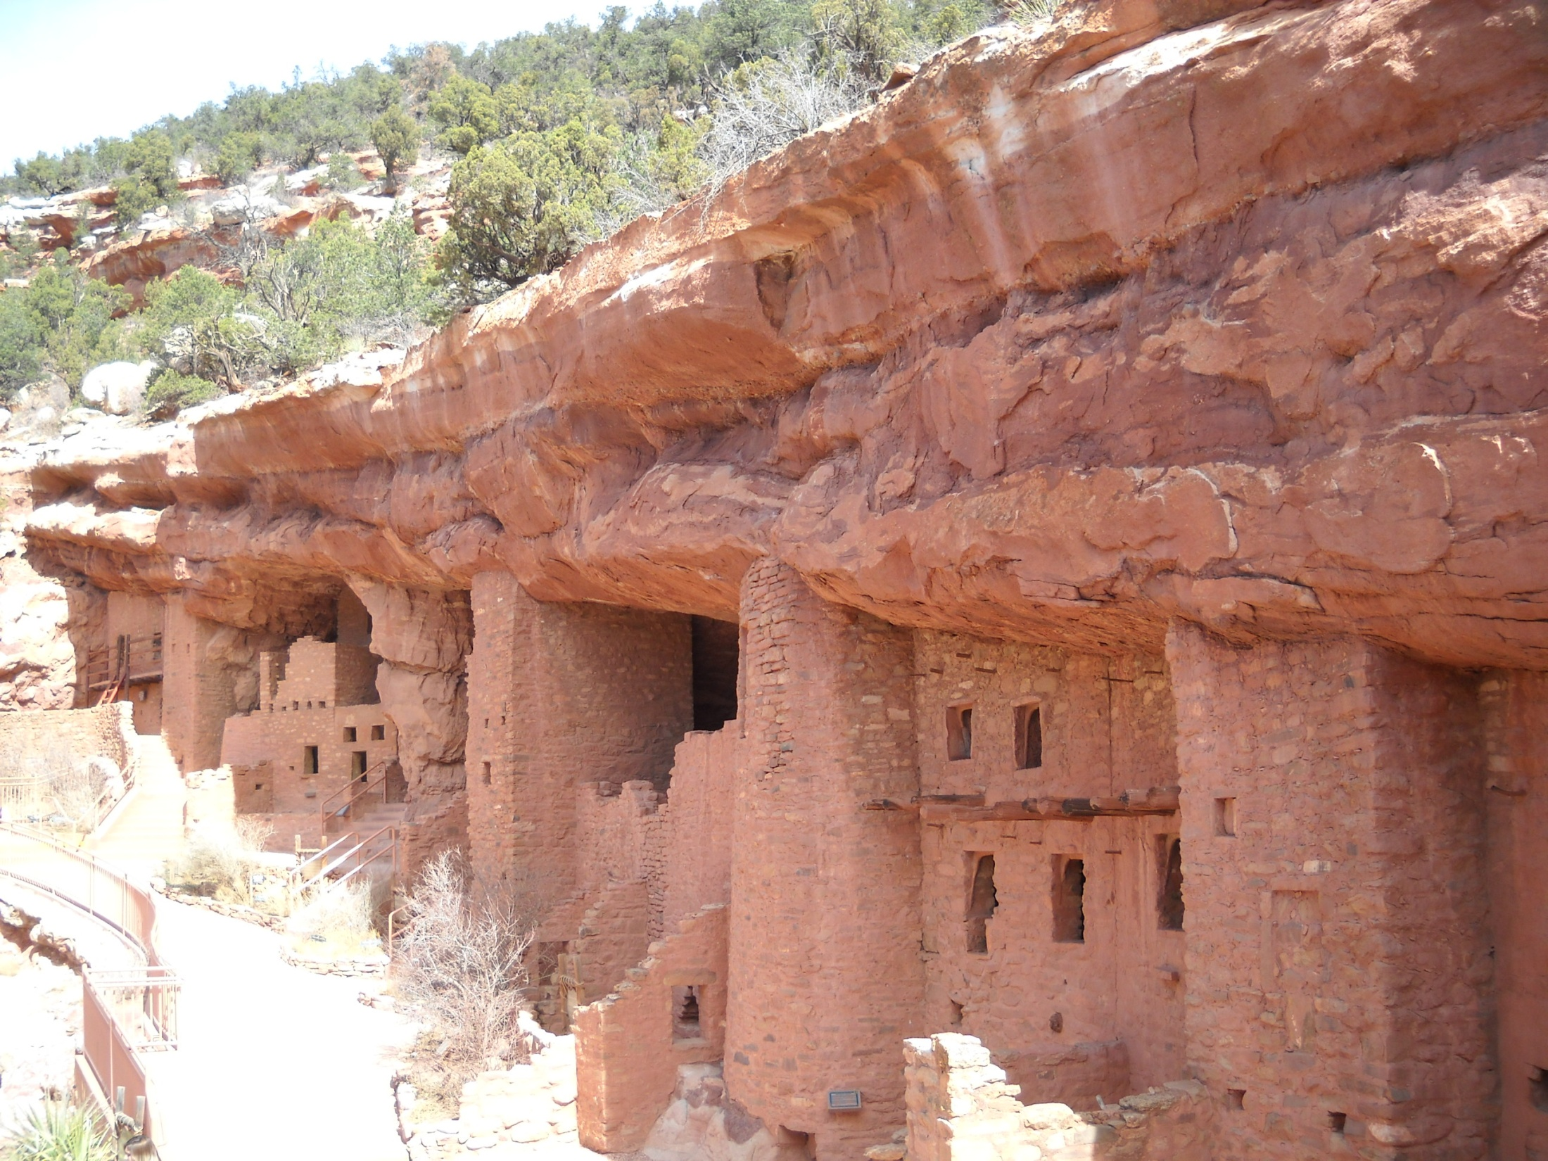
Welcome To All

Slide 2
Let Us Worship In Song
Song Leader – Pat Craig
First Hymn # 426
Second Song # 194
Opening Prayer – Aaron McKibben
Song Before the Lesson # 283
Invitation Hymn # 284
Closing Song #442

Slide 3
Who Is A Wise Man?
James 3:13-18

Slide 4
Vs.13 Who Is A Wise Man?
Same Distinction as in Rom.8:1ff, Gal.5:11-25, Peacemakers vs. Troublemakers, Wisdom From Above – Wisdom From Below
Show It By Conduct, Not Empty Words, Jm.2:18, Tit.1:16
Meekness of Wisdom – Eph.5:17
Mere Knowledge – 1 Cor.8:1

Slide 5
Vs.14-16 - Imbibe on Worldly Wisdom
But if you have bitter jealousy and selfish ambition in your hearts, do not boast and be false to the truth. ESV
“Top Dog,” Politic for My Way, Carnally Motivated
Lie Against the Truth – 1 Jn.1:8, 10
Wisdom Not From Above - Earthly, Natural, Demonic
Jealousy, Factions, Rivalry, Troubles, Selfish Ambition, Strife, Confusion, Disorder, Vile Deeds
3 Jn.9-10, 2 Cor.10-12, Acts 15

Slide 6
Vs.17-18 - The Wisdom From Above
But the wisdom from above is first pure, then peaceable, gentle, open to reason, full of mercy and good fruits, impartial and sincere. ESV
Connected to Pure Word of God, Sound Doctrine
All The Lovely Qualities Taught by Holy Spirit, Gal.5:22-23
Peace, Tranquility, Get Along, Unselfish, Longsuffering, Love God, Merciful, Genuine
Sow Peace, Make Peace – Mt.5:9, Mk.9:50, Rom.12:18, 2Cor.13:11, Heb.12:14

Slide 7
The Plan of Salvation
Hear the Gospel of Christ, Acts 2:22
Believe in Jesus Christ, Acts 16:31
Repent and Turn to God, Acts 17:30
Confess Jesus Before Men, Acts 8:37
Baptized Into Christ, I Pet.3:21
---------------------------------------------
Grow And Be Faithful, 1 Pet.2:2
If Err as a Christian: Repent and Pray God 1 Jn.1:9

Slide 8
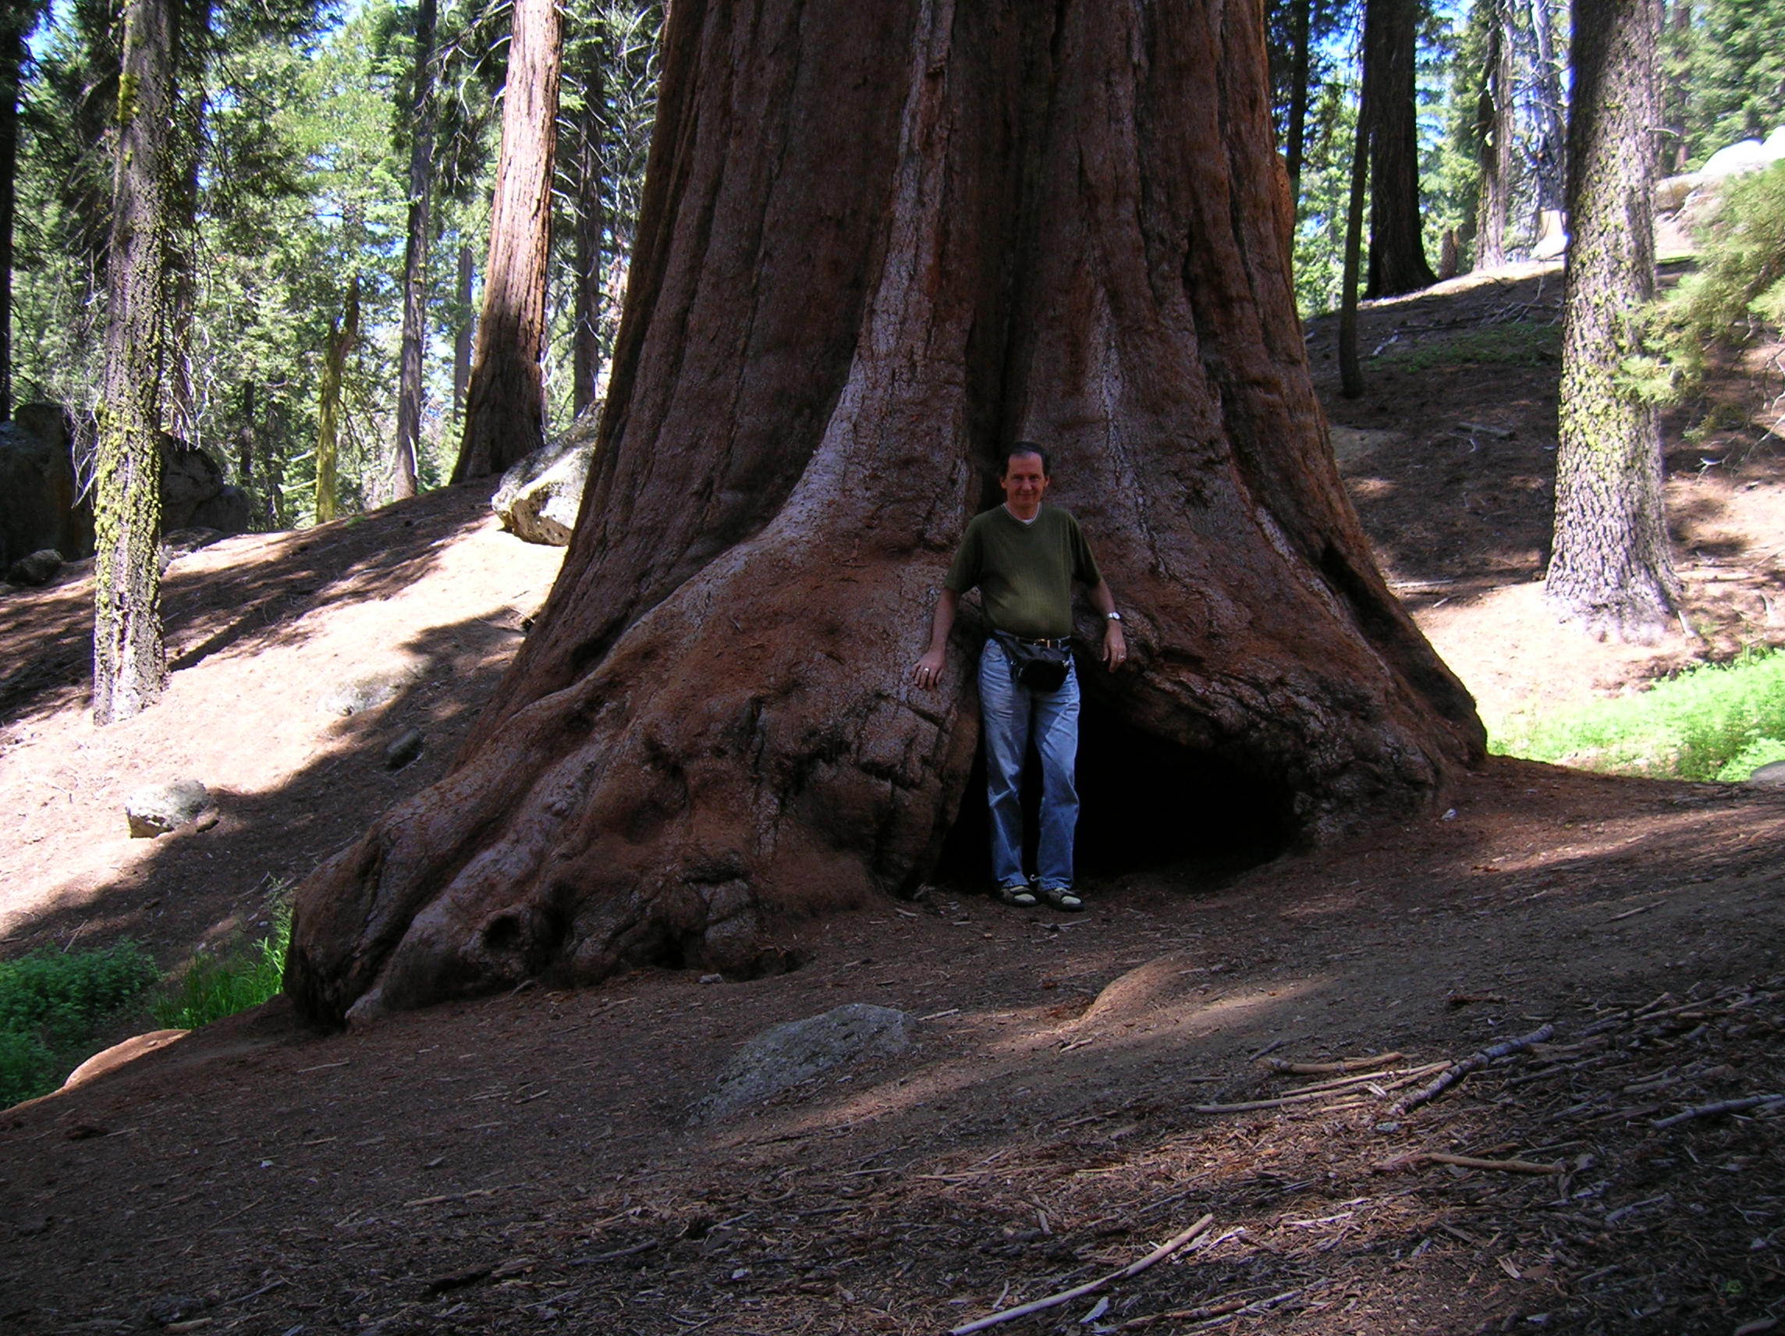
Thanks For Coming Out

