Slide 1
Welcome To Our Services

Slide 2
Let Us Worship God In Song
Song Leader – Chris Craig
First Song # 14 Supp.
Second Hymn # 492
First Prayer – Roy Reynolds
Song Before the Lesson # 218
Invitation Song # 280

Slide 3
“Upon This Rock”
Matt.16:13-19

Slide 4
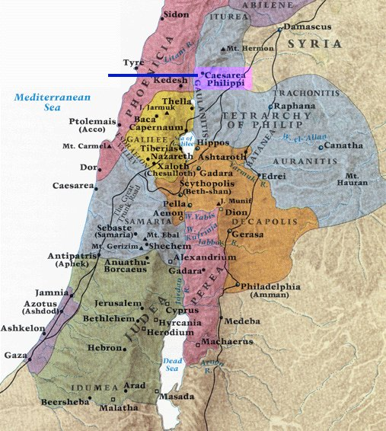
Where The Teaching took Place

Slide 5
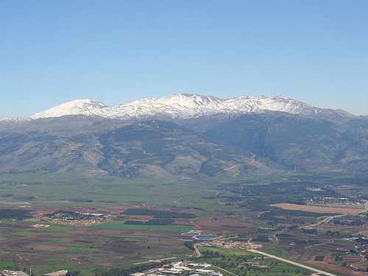
Mount Hermon the tallest peak in Israel at 9,232 ft.

Slide 6
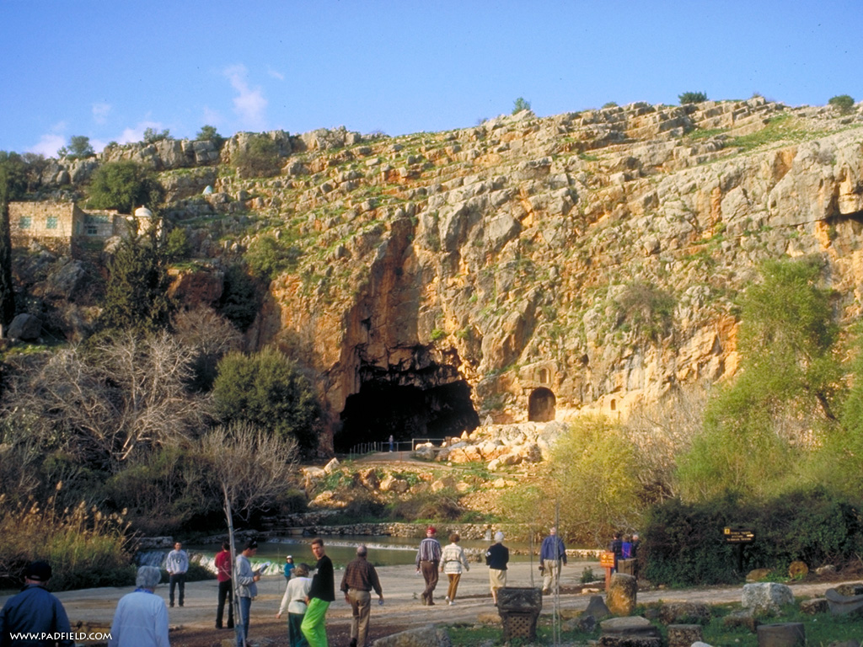
Caesarea Philippi

Slide 7
The Questions vs.13-16
What Are Men Saying about Me?
Their Answers – vs.14
What Do You All Think About Me?
Peter’s Answer – vs.16
A Divine Revelation vs.17

Slide 8
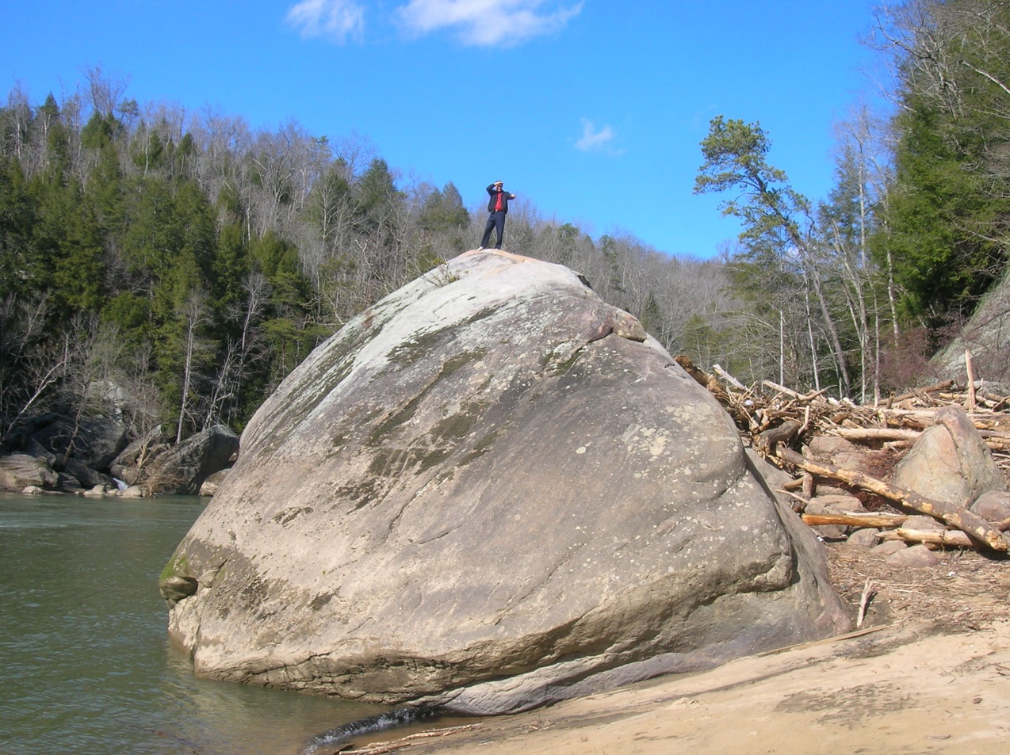
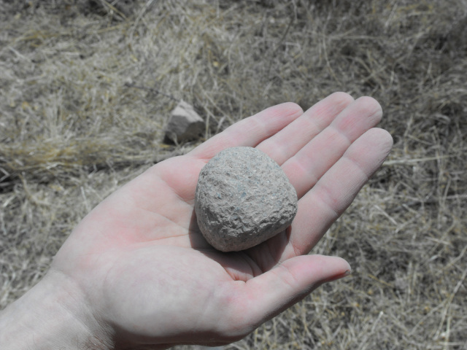
The Great Promise of vs.18
Catholic Reasoning
Peter – “Petros” ~ Rock “Petra”
The Confession – His Deity (Deut.32:15, 18, 31, 37)
I Cor.3:11
I Will Build – Future Tense
My Church – Singular
Gates of Hades

Slide 9
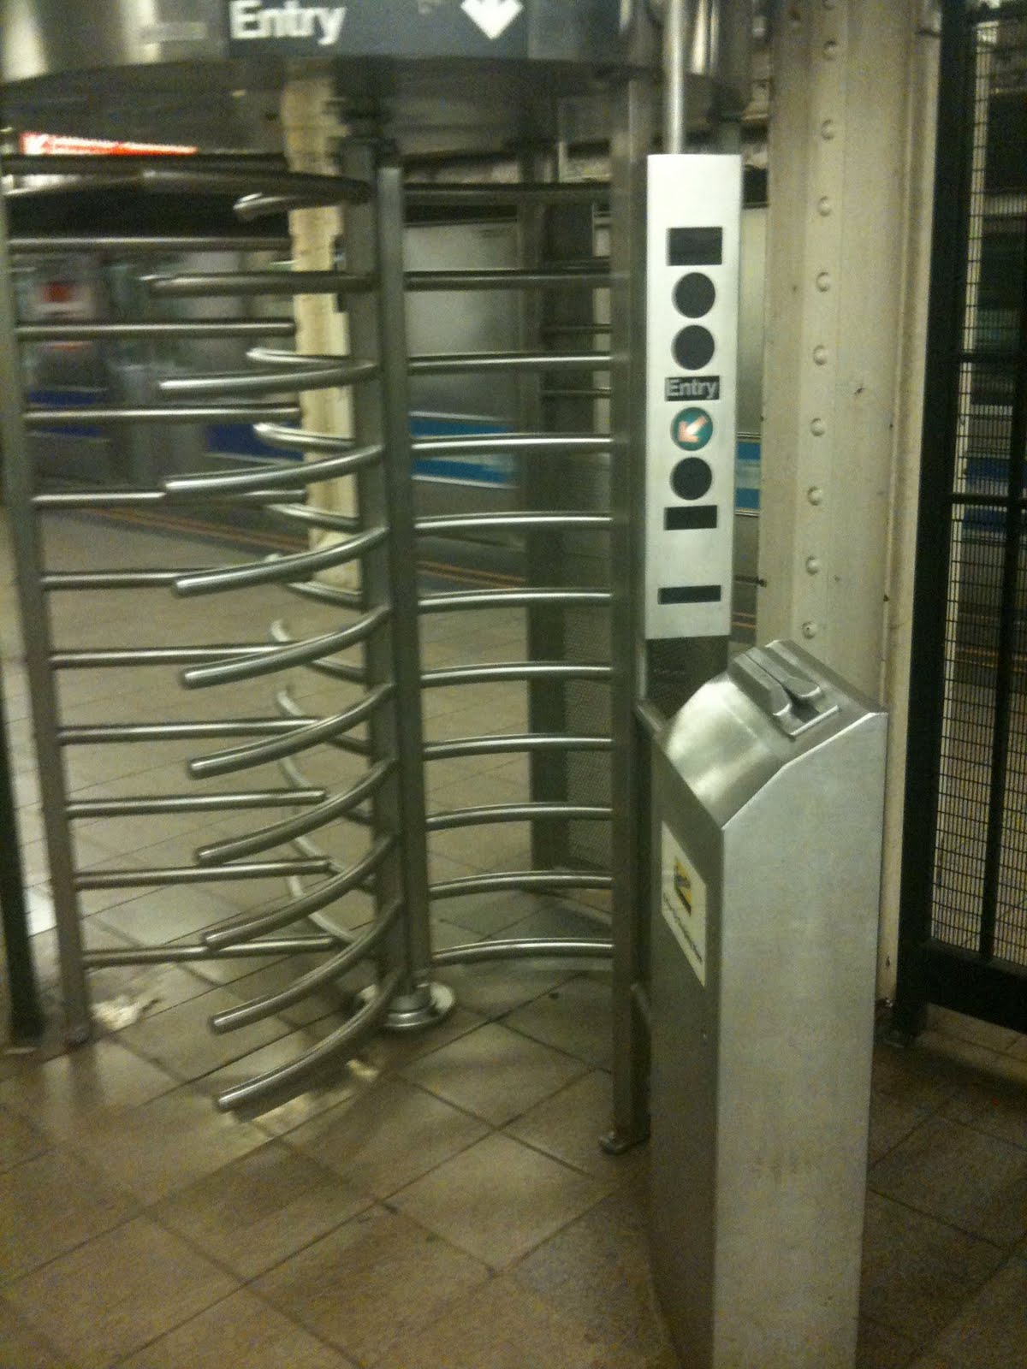
Hades – Place of Disembodied Spirits
Gates of Hades
One-way Turnstiles

Slide 11
The Plan of Salvation
Hear the Gospel of Christ, Acts 18:8
Believe in Jesus Christ, Rom.5:1
Repent and Turn to God, Luke 24:47
Confess Jesus Before Men, Acts 8:37
Be Baptized for the Remission of Sins, Ac.2:38
---------------------------------
Be Thou Faithful Unto Death, Rev.2:10
If Err From The Faith: Repent and Pray God Acts 8:22

Slide 12
This Do In Remembrance of Me
Is.53:3 He was despised, and rejected of men; a man of sorrows, and acquainted with grief: and as one from whom men hide their face he was despised; and we esteemed him not.
Is.53:4 Surely he hath borne our griefs, and carried our sorrows; yet we did esteem him stricken, smitten of God, and afflicted.
Is.53:5 But he was wounded for our transgressions, he was bruised for our iniquities; the chastisement of our peace was upon him; and with his stripes we are healed.

Slide 13
The Collection
“Now concerning the collection for the saints, as I have given order to the churches of Galatia, even so do ye.
Upon the first day of the week let every one of you lay by him in store, as God hath prospered him, that there be no gatherings when I come.” 1Cor.16:1-2

Slide 14
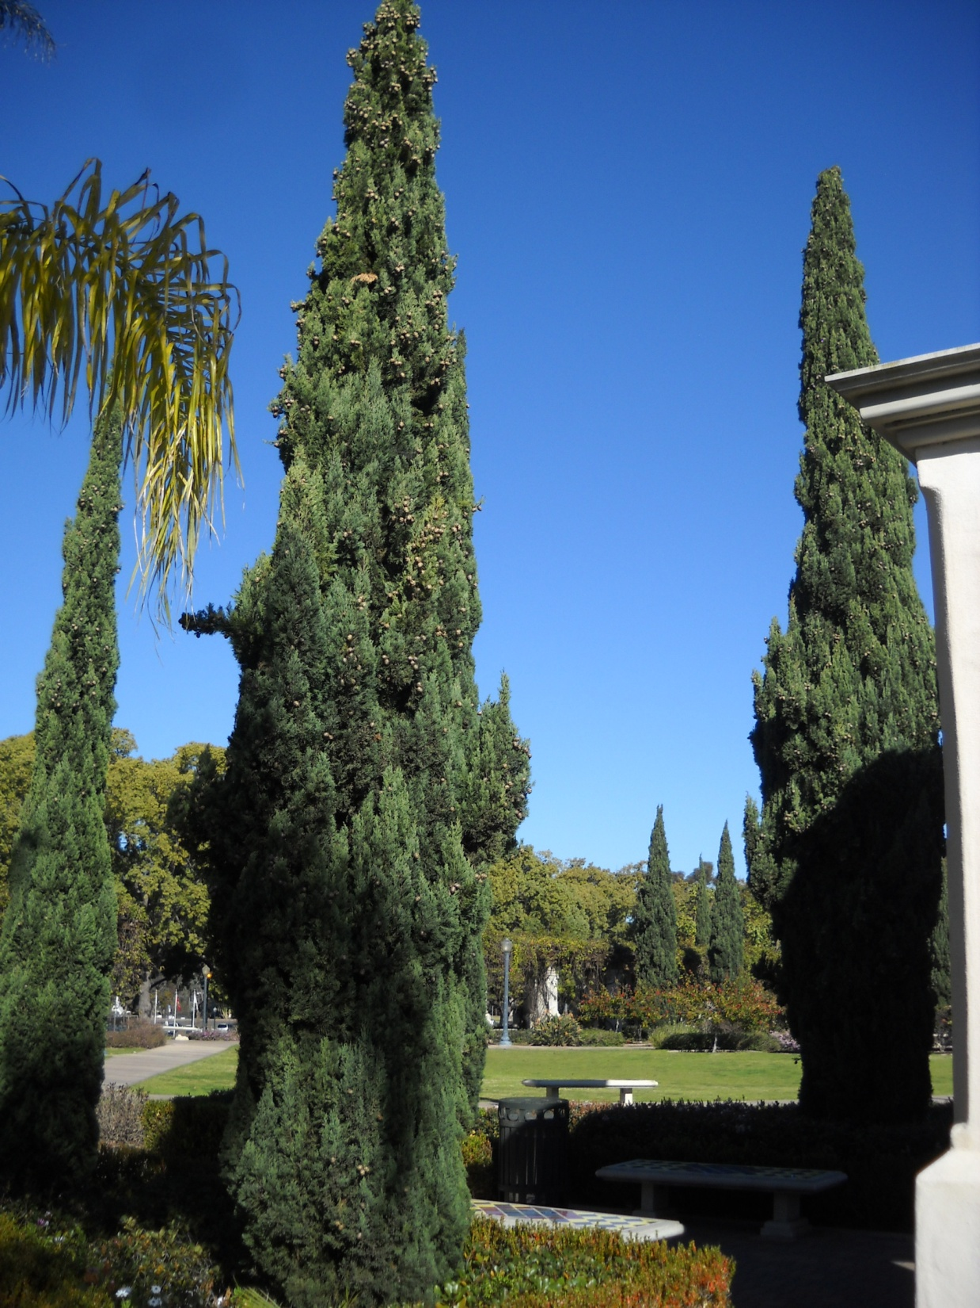
Thanks For Coming Out

