Slide 1
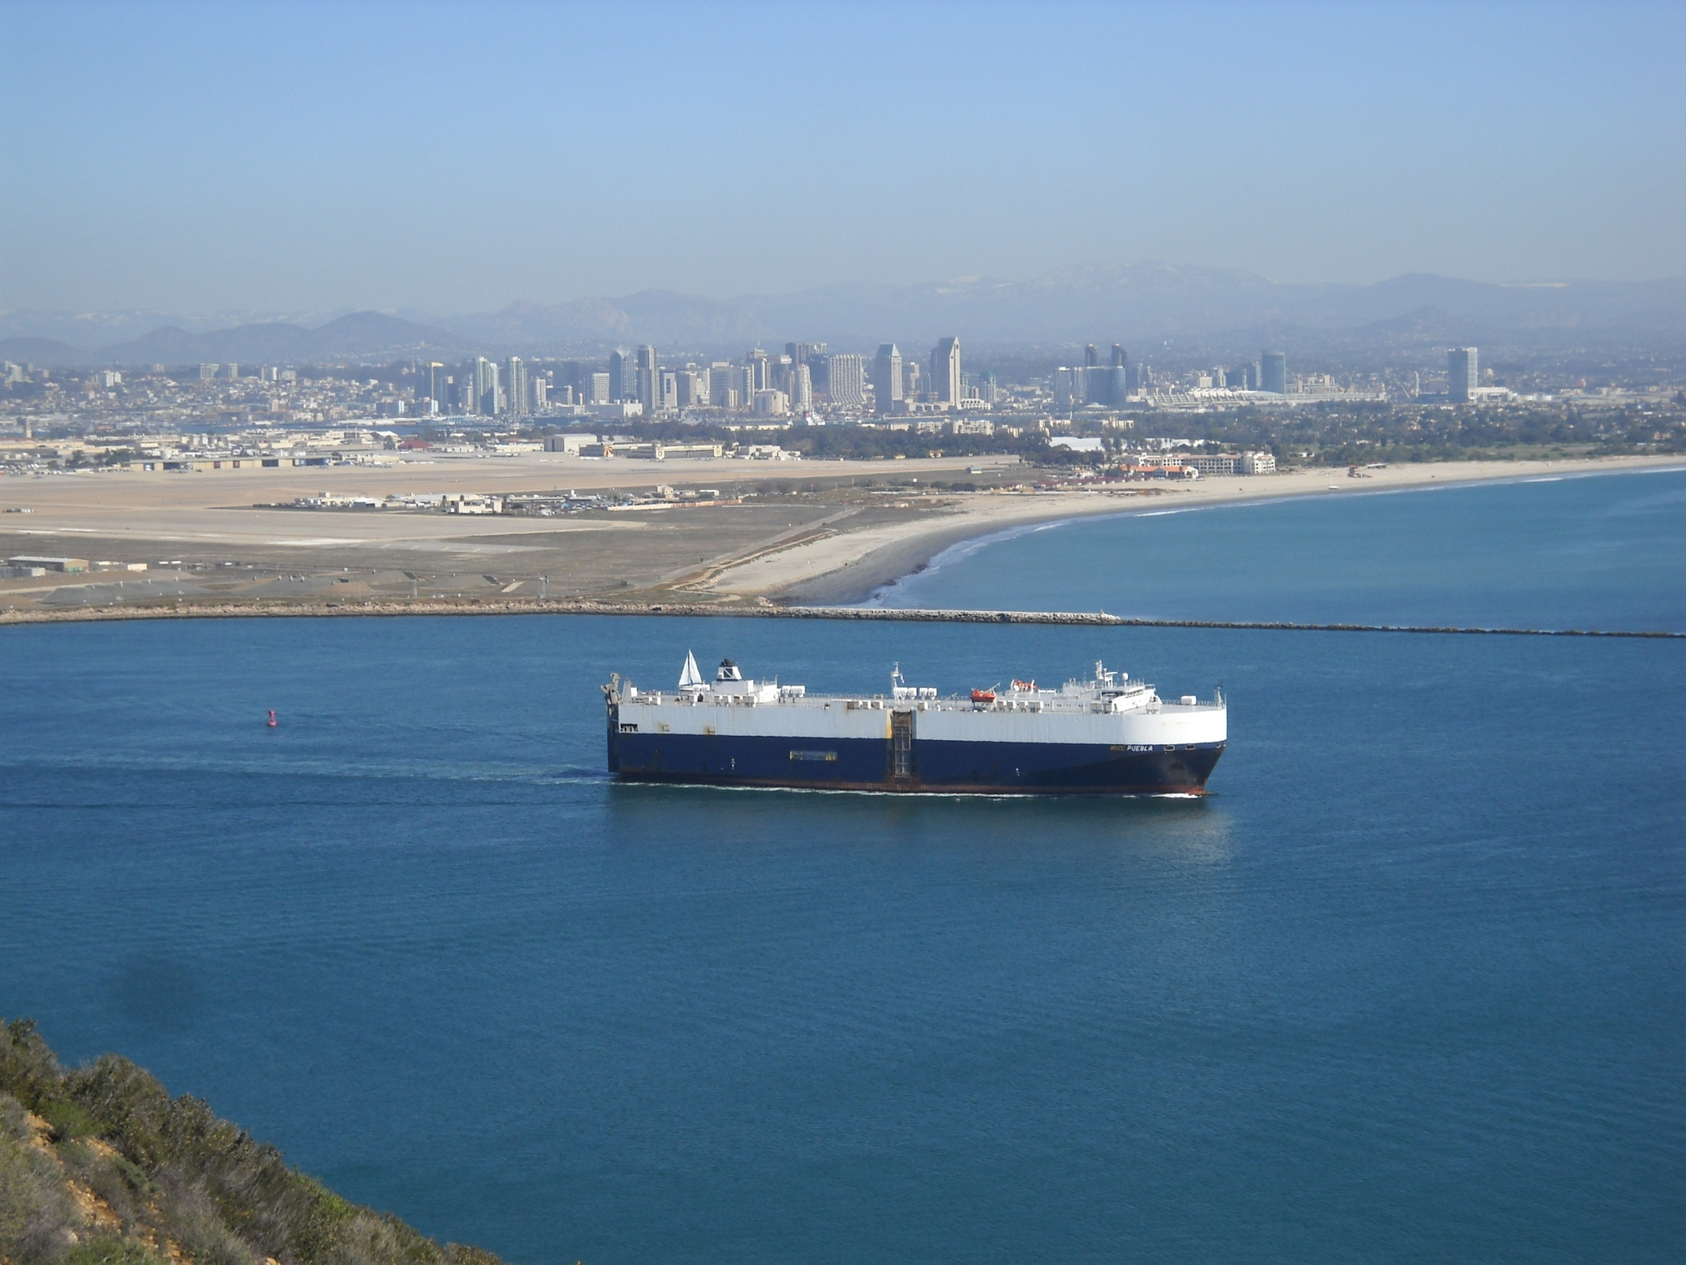
Welcome To Our Services

Slide 2
Let Us Worship In Song
Song Leader – Andy Powell
First Song # 68
Second Hymn # 47
Opening Prayer – Clinton Thompson
Song Before The Lesson # 245
Invitation Hymn # 347

Slide 3
Who Needs a Physician?
Matt.9:9-13

Slide 4
Background
Matthew is Called
“Receipt of custom”
The tax booth ESV, the place where taxes were taken BBE, the place of toll ASV, toll booth VWS
Publicans - tax collectors ESV, A tax farmer, that is, collector of public revenue
A tax gatherer, collector of taxes or tolls, one employed by a publican or farmer general in the collection of taxes. The tax collectors were as a class, detested not only by the Jews, but by other nations also, both on account of their employment and of the harshness, greed, and deception, with which they did their job.
Sat With, Ate With, Talk With
“Birds of a Feather Flock together” Thus Grumble at Him

Slide 5
Who Needs a Physician?
Not Those That are “Whole”
To be strong - To be strong in body, to be robust, to be in sound health
Smug Self Righteous Pharisees
Blind to Their Own Sin-Sick Souls
Jn.3:2-3, Luke 18:9-14, 1 Cor.1:26, Rev.3:17-18
The Sick - Need a Doctor!
The Church – The Hospital for Sinners
Called Out of What? 1Pet.2:9-10, Acts 26:16-18
Rom.5:6-10

Slide 6
None Are “Too” Sick
The Samaritan Woman – John 4
The Corinthians – 1 Cor. 6:9-11
Paul – 1 Tim.1:12-16
Must Come Near To Be Helped – Vs.10
Not Tainted By Sin to Teach Others
Not Pollute Our Homes Talking to Others
Concerned about bringing “Rif-Raf” into the Church

Slide 7
The Pharisees – “Band-Aid” Solution, vs.13
Pharisees – “Separated Ones”
“Holier than Thou” Attitude
Matt.23:23-25 Superficial Religion
Ceremonialism – Isaiah 1:10-15, Jn.18:28
Must Apply the Medicine
Genuine Devotion “Mercy” Micah 6:6-8
Isaiah 1:16-19, Rev.3:19, Acts 17:30

Slide 8
Jesus Can Heal You Also
Hear the Gospel of Christ, Acts 2:22
Believe in Jesus Christ, Rom.1:16
Repent and Turn to God, Luke 13:3
Confess Jesus Before Men, Matt.10:32
Baptized Into Christ, I Pet.3:21
-----------------------------
Grow And Be Faithful, 2 Pet.3:18
If Err As a Christian: Repent and Pray God I Jn.1:9

Slide 9
This Do In Remembrance of Me
Is.53:3 He was despised, and rejected of men; a man of sorrows, and acquainted with grief: and as one from whom men hide their face he was despised; and we esteemed him not.
Is.53:4 Surely he hath borne our griefs, and carried our sorrows; yet we did esteem him stricken, smitten of God, and afflicted.
Is.53:5 But he was wounded for our transgressions, he was bruised for our iniquities; the chastisement of our peace was upon him; and with his stripes we are healed.

Slide 10
The Collection
“Now concerning the collection for the saints, as I have given order to the churches of Galatia, even so do ye.
Upon the first day of the week let every one of you lay by him in store, as God hath prospered him, that there be no gatherings when I come.” 1 Cor.16:1-2

Slide 11
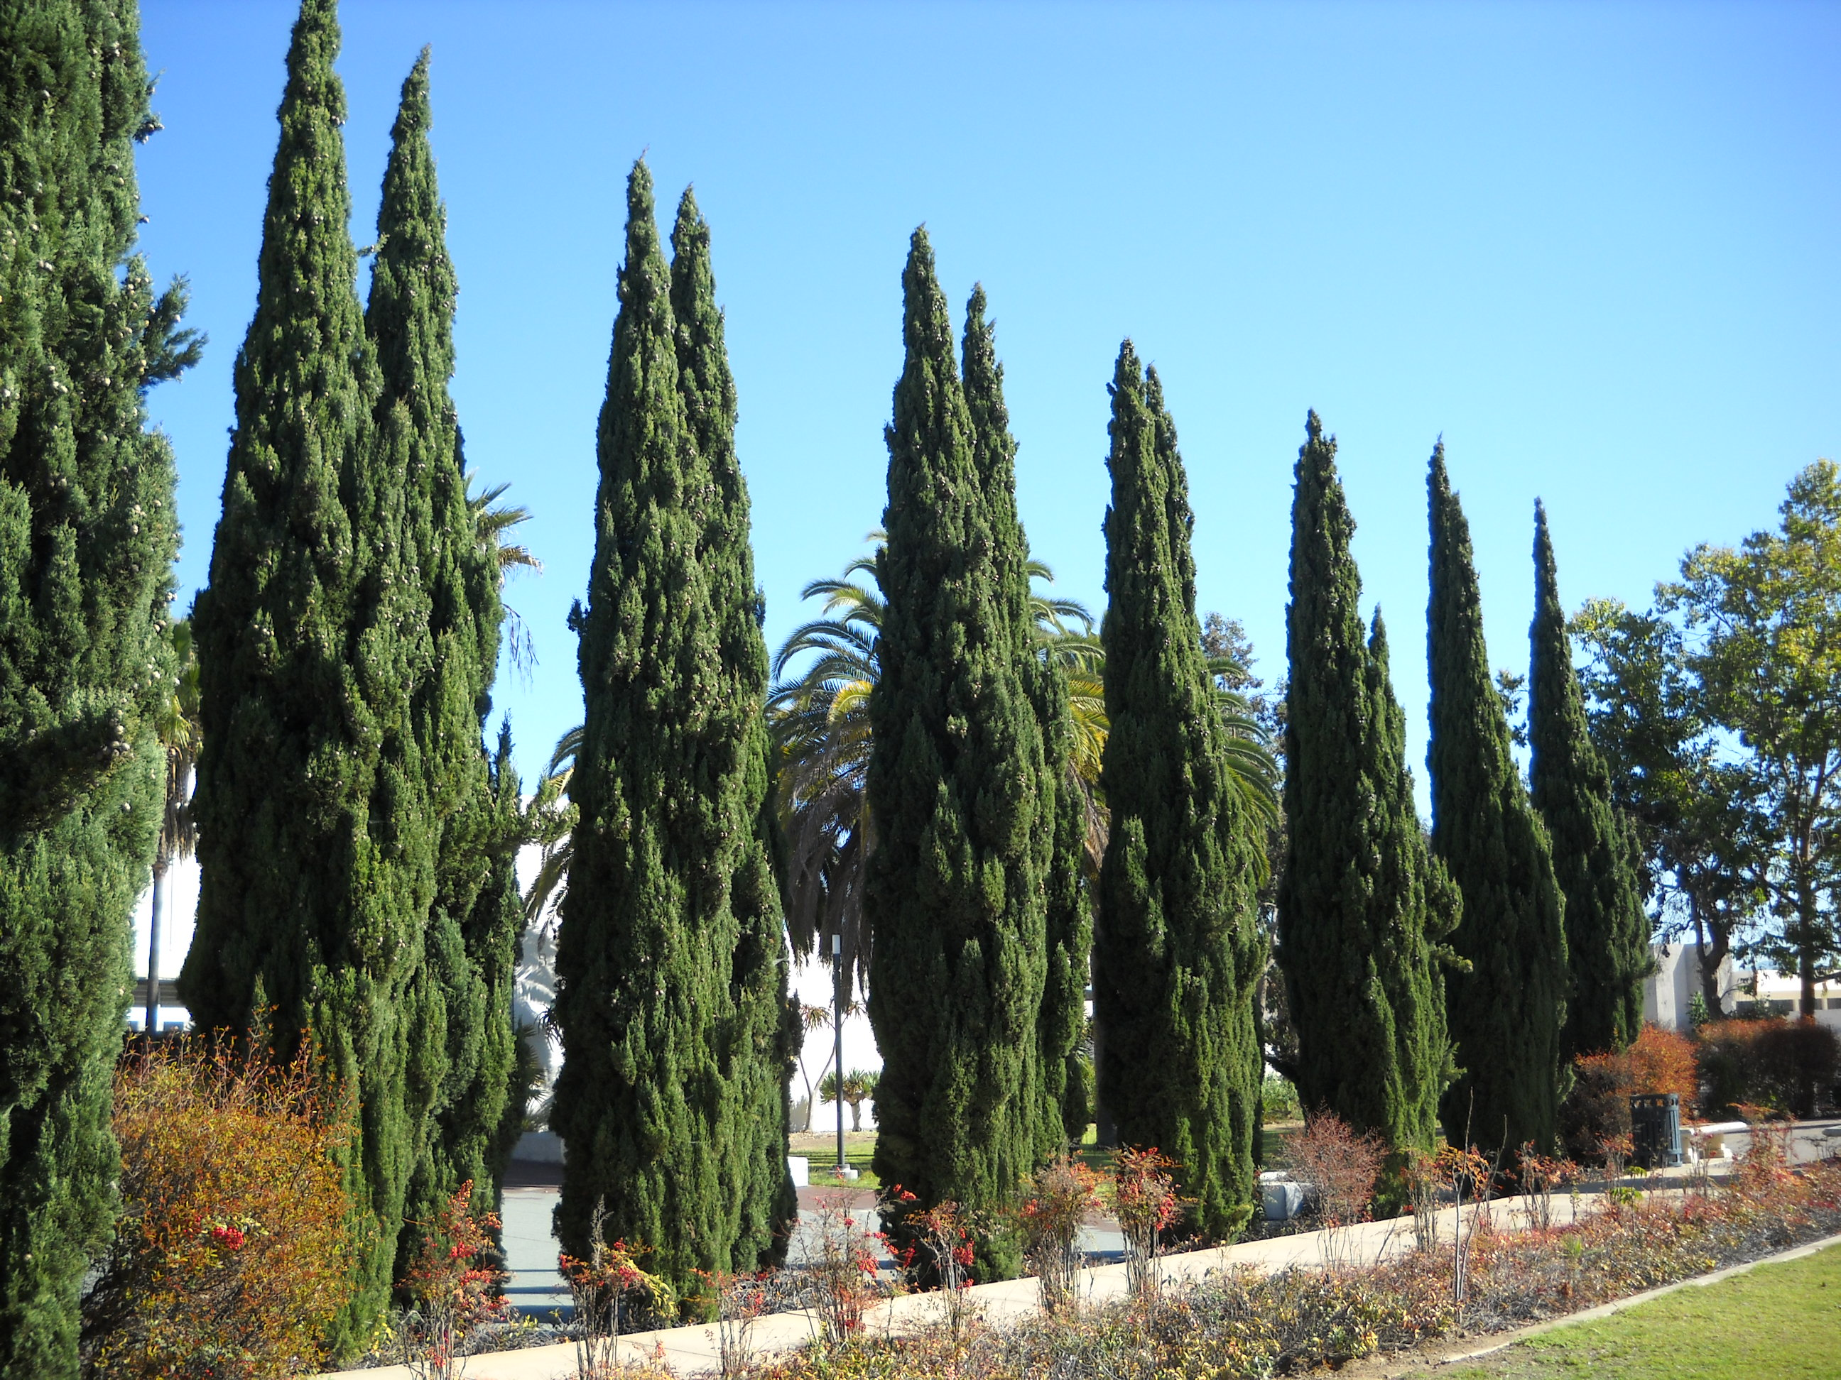
Thanks For Coming

