Slide 1
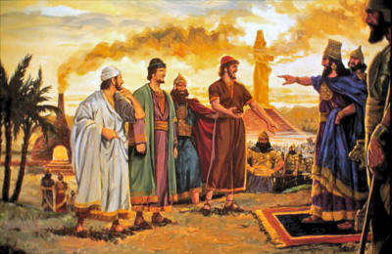
The Power of Faith
Daniel 3

Slide 2
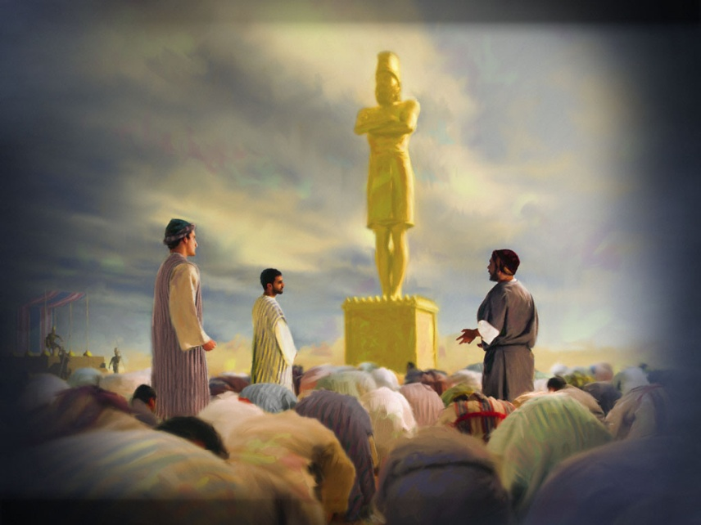
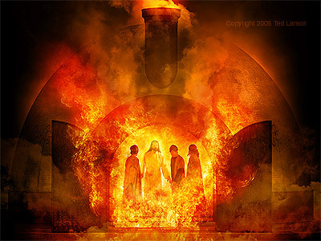
The Power of Faith
Faith Challenged, vs.1-7
Faith Declared, vs.8-18
Faith Tested, vs.19-23
Faith Vindicated, vs.24-27
Faith Victorious, vs.28-30
We are only 3, what can 3 do?
We are young, what can young people do?
We are so far from home, how can we be expected to stand up?
Everybody is doing it, why should we stick out like a sore thumb?
If we bow, we can afterwards live a long and useful life in the service of the Lord.
It’s only a dumb Idol, we will just go through the motions.

Slide 3
The Plan of Salvation
Hear the gospel of Christ, Acts 18:8
Believe in Jesus Christ, Acts 16:31
Repent and Turn to God, Acts 17:30
Confess Jesus Before Men, Acts 8:37
Be Baptized For Forgiveness, Acts 2:38
---------------------------------------
Cleave Unto The Lord, Acts 11:23
If Err From The Truth: Repent & Pray God Acts 8:22

