Slide 1
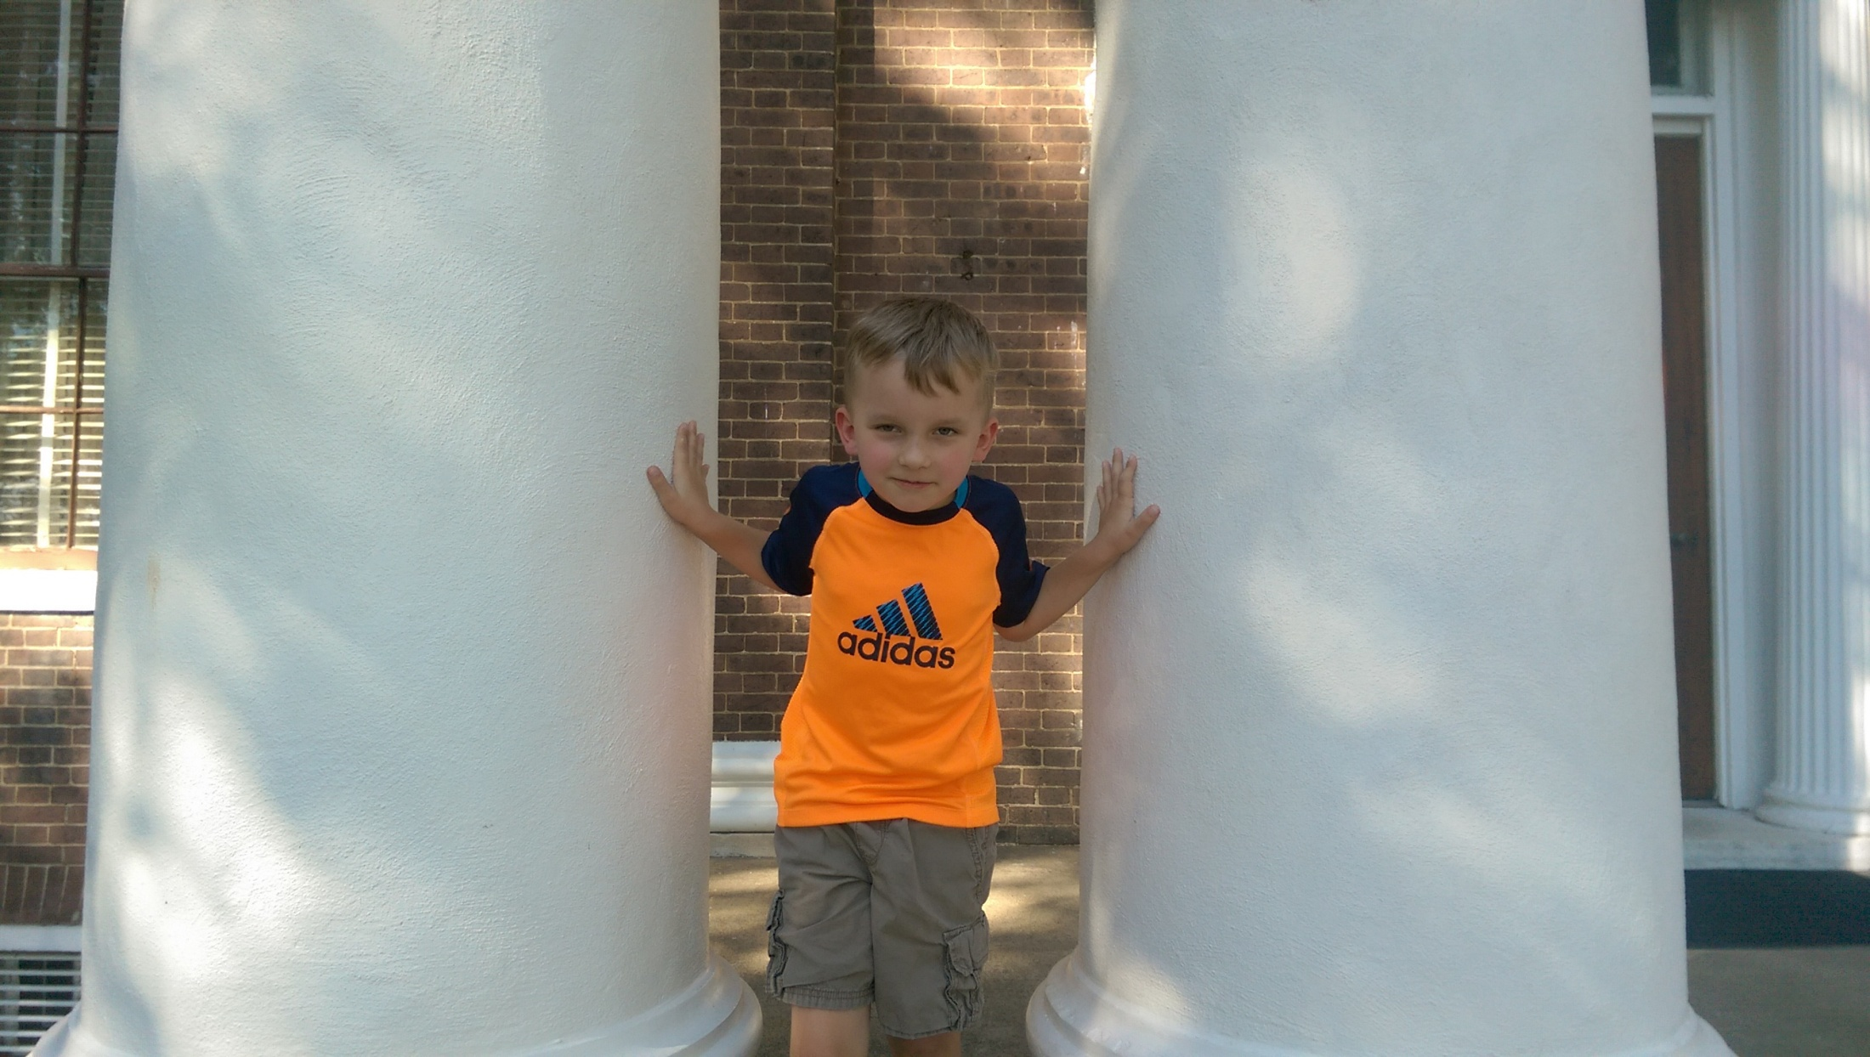
The Story of Samson

Slide 2
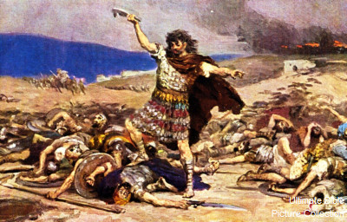
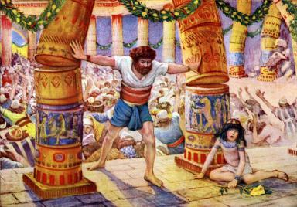
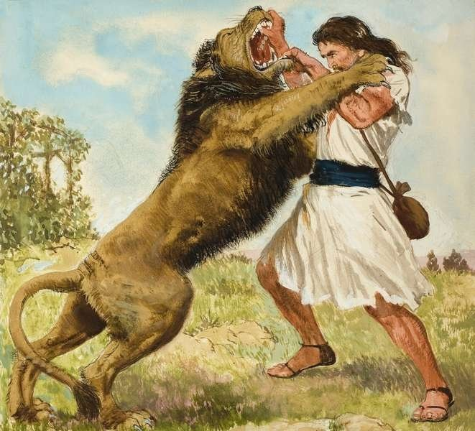
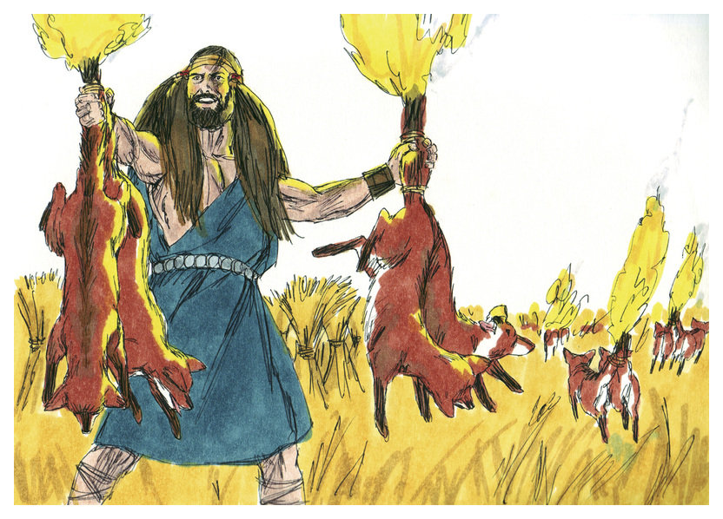
The Story of Samson
One of the Faithful of the OT, Heb.11:32
Chapter 13: Born of Manoah and his wife.
Chapter 14: Key Verse in vs.4. Kills Lion. Riddle
Chapter 15: Foxes & Fire, Jawbone of Donkey
Chapter 16, Delilah, Loses Strength, 2 Pillars

Slide 3
The Steps of Salvation
Hear the Gospel of Christ, Acts 18:8
Believe in Jesus Christ, Rom.5:1
Repent and Turn to God, Luke 24:47
Confess Jesus Before Men, Acts 8:37
Be Baptized for the Remission of Sins, Ac.2:38
---------------------------------
Be Thou Faithful Unto Death, Rev.2:10
If Err From The Faith: Repent & Pray God Ac.8:22

