Slide 1
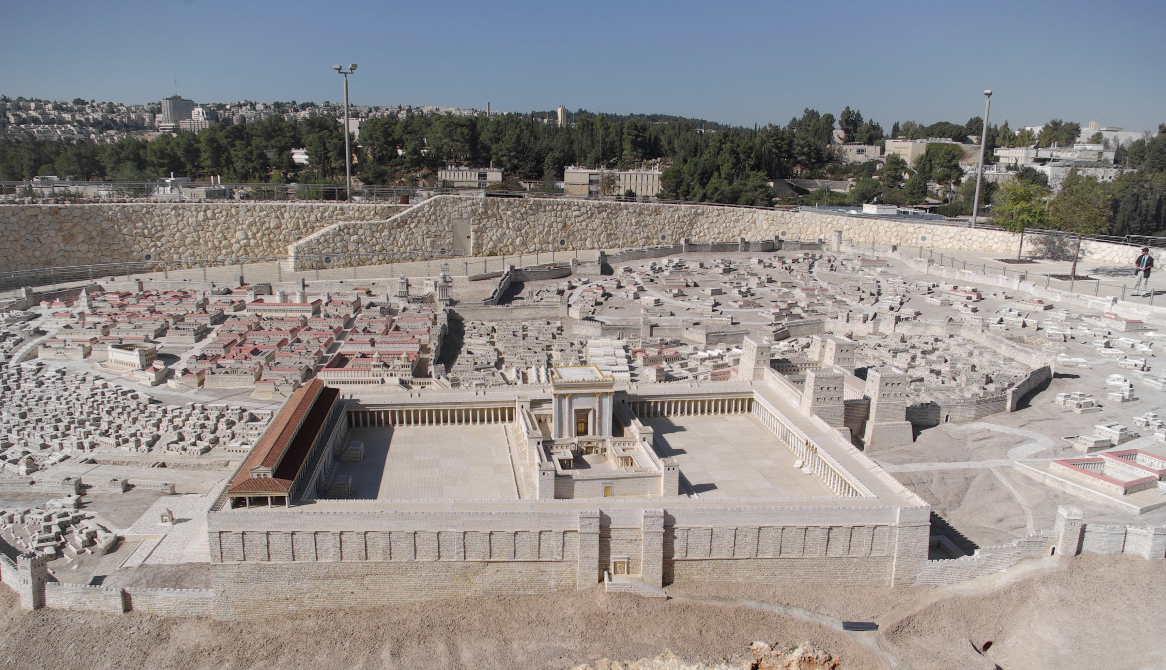
Welcome To Our Services
Model of First Century Jerusalem

Slide 2
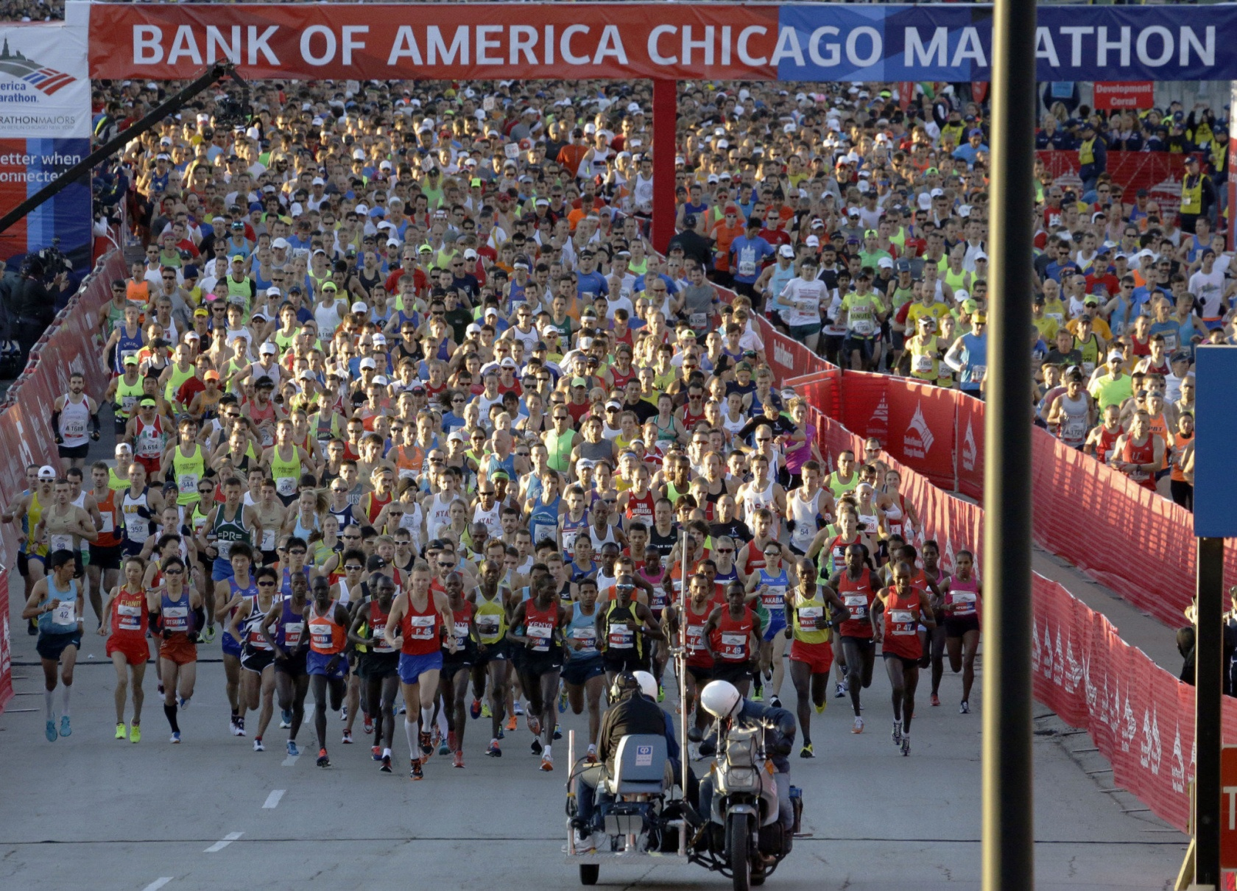
Let Us Run With Endurance
Hebrews 12

Slide 3
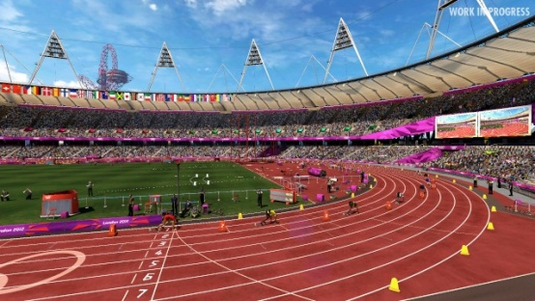
Let Us Run With Endurance
Vs.1-3, Concluding Exhortation From Chapter 11
Vs.4-13, The Chastening of the Lord
Vs.14-17, More Exhortations
Vs.18-23, Mt. Sinai and Mt. Zion Contrasted
Vs.24-29, Refuse not Him that Speaketh

Slide 4
Have You Started The Race?
Hear the Gospel of Christ, Acts 2:22
Believe in Jesus Christ, Rom.1:16
Repent and Turn to God, Luke 13:3
Confess Jesus Before Men, Matt.10:32
Baptized Into Christ, I Pet.3:21
-----------------------------
Grow And Be Faithful, 2 Pet.3:18
If Err From The Faith: Repent and Pray God I Jn.1:9

