Slide 1
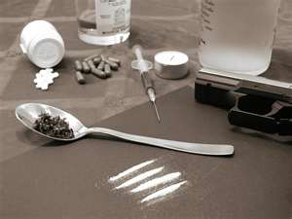
THE AFFLICTION OF DRUG ADDICTION
Notes:
Cocaine, Marijuana, Heroin, Crack, Meth, Pills but, an ever increasing problem in America today is the abuse of all forms of drugs
Simply amazed at Americans, When someone says I'm going on vacation to Mexico---what's the first thing people say. Don’t go to Mexico its dangerous, they have a lot of drugs there

Slide 2
Some say the church should not talk about drug abuse,
Number one reason we should talk about the subject of drug abuse!!

Slide 3
Our Youth & Young Adults
Pro 22:6
Train up a child in the way he should go, And when he is old he will not depart from it.
Peer Pressure with Young Adults
Notes:
Parents are not talking to kids about drugs--------why not-are you waiting till high school?
Everyone of us have a family member or friend that we have as an example with how bad drugs can be, but sometimes we fail to teach that to our kids.
Peer Pressure

Slide 4
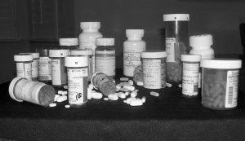
Some say don’t talk about things like this and kids won’t know about. Let me warn you, they know all about it.
TV, songs, movies, video games.
Notes:
Songs, conversations, usually about 5th and 6th grade

Slide 5
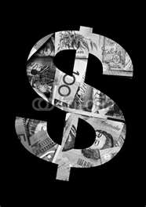
$51 Billion
The amount of Money the U.S. Government spent to fight the war on drugs in 2014.

Slide 6
Prescription Addiction
Notes:
A major problem in this part of the state Xanax, colonapin, lowertabs, suboxen, subutex, oxycoten, percasets, valum
Its okay to take something to fix your problams

Slide 7
How many Countries allow Prescription Medicine Commercials? DTC’s
New Zealand (1981)
United States (1997)
“A society where there is a pill for everything”
Notes:
Restless Leg Syndrome
American Medical Association

Slide 8
How much money was spent on TV ads for prescriptions?
1.5 million
1.5 billion
4.5 million
4.5 billion

Slide 9
Luke 10:34
There is a use for medication in our society
Heart issue
Blood pressure issues
Surgery
The bible does not condemn the use of medication, but it does condemn the abuse of such things.
Notes:
Even if a doctor approves it, but it makes you “not normal” you are have to tell your doctor

Slide 10
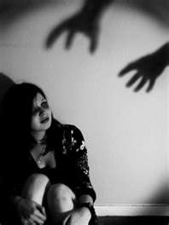
Drug abuse is not only dangerous and harmful but it leads to evil.
People have been known to beg, lie, steal, end even kill to feed their drug habit.
Notes:
It grab a hold and it will not let go. People lose the homes and family over drugs. Grandparents are left to tend to the families.

Slide 11
Leads to Evil Things!
Romans 12:9 says, “Abhor that which is evil; cleave to that which is good.”
I Thessalonians 5:22, “Abstain from all appearance of evil.”

Slide 12
It’s Harmful to your body
1Cor 6:19 Or do you not know that your body is the temple of the Holy Spirit who is in you, whom you have from God, and you are not your own?
1Cor 6:20 For you were bought at a price; therefore glorify God in your body and in your spirit, which are God's.
Notes:
You can tell someone who abuses drugs!!

Slide 13
It’s Harmful to your body
Rom 12:1 I beseech you therefore, brethren, by the mercies of God, that you present your bodies a living sacrifice, holy, acceptable to God, which is your reasonable service.
Rom 12:2 And do not be conformed to this world, but be transformed by the renewing of your mind, that you may prove what is that good and acceptable and perfect will of God.

Slide 14
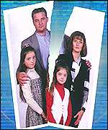
It Breaks Families Apart

Slide 15
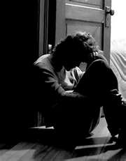
Many want drugs, not only just to get high , but to escape pain.
Depression
Low self-esteem
Financial Hardship
Physical Pain
Notes:
These only gets them further into trouble

Slide 16
How Should Christians NOT React?
Mar 2:16 And when the scribes and Pharisees saw Him eating with the tax collectors and sinners, they said to His disciples, "How is it that He eats and drinks with tax collectors and sinners?"
Mar 2:17 When Jesus heard it, He said to them, "Those who are well have no need of a physician, but those who are sick. I did not come to call the righteous, but sinners, to repentance."
Notes:
Rich, poor, no matter, drugs can effect everyone

Slide 17
How Should Christians React?

Slide 18
Matthew 12
v43 When the unclean spirit is gone out of a man, he walketh through dry places, seeking rest, and findeth none.
v44 Then he saith, I will return into my house from whence I came out; and when he is come, he findeth it empty, swept, and garnished.
v45 Then goeth he, and taketh with himself seven other spirits more wicked than himself, and they enter in and dwell there: and the last state of that man is worse than the first. Even so shall it be also unto this wicked generation.
Use the teachings of Christ to fill the void

Slide 19
How Should Christians React?
Romans 5:8 says, “But God commends his love toward us, in that, while we were yet sinners, Christ died for us.”
“You shall know the truth and the truth shall make you free” (John 8:32).
Notes:
Never forget we were in sin too

Slide 20
Steps for Success
Admit you are powerless over drugs ... that your life has become unmanageable.
Romans 7:18
“For I know that in me (that is, in my flesh,) dwelleth no good thing: for to will is present with me; but how to perform that which is good I find not.”

Slide 21
Steps for Success
Admit to GOD, to yourself, and to others your wrongs.
James 5:16
“Confess your faults one to another, and pray one for another, that ye may be healed……..”

Slide 22
Steps for Success
Be willing to make amends to all those you have harmed. Family, Friends, the church and God.
Matthew 5:23-24
“Therefore if thou bring thy gift to the altar, and there rememberest that thy brother hath ought against thee;” “Leave there thy gift before the altar, and go thy way; first be reconciled to thy brother, and then come and offer thy gift.”

Slide 23
Prescription to Salvation
Hear the Gospel of Christ, Rom.10:17
Believe in Jesus Christ, Acts 16:31
Repent and Turn to God, Luke 13:3
Confess Jesus Before Men, Matt.10:32
Be Immersed in Water, Mk.16:16

