Slide 1
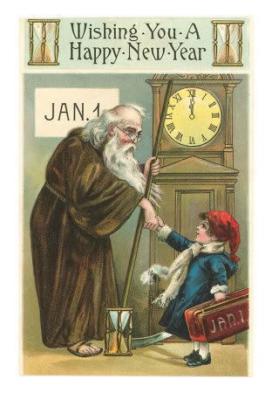
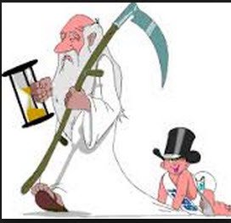
Year End Reflections

Slide 2
Year End Reflections
Time Marches On, Eph.5:16
Some are Born, and Some Die, Eccl.3:2, Heb.9:27
Time is Swift, Jm.4:14, Ps.90-9-12, Job 7:6
The Gospel is Yet Effective, Ac.14:27
The Need to Teach the Lost, Ac.8:4
Satan is Alive & Well, Eph.6:10-16
The Need to Grow, 2Pet.3:18, 1Pet.2:2
Moving Toward Eternity, Rom13:11-12
Rebirth Symbolism, Jn.3:1-8, Rom.6:1-7

Slide 3
You Can Have A Fresh Start Today
Hear the Gospel of Christ, Acts 18:8
Believe in Jesus Christ, Rom.5:1
Repent and Turn to God, Luke 24:47
Confess Jesus Before Men, Matt.10:32
Baptized Into Christ, Gal.3:26-27
-----------------------------
Grow And Be Faithful, 2 Pet.3:18
If An Erring Christian: Repent and Pray God, I Jn.1:9

