Slide 1
“The Word is Not Bound”
2 Tim.2:9
In Prison, In Chains, Under Arrest, Incarcerated, In Shackles, In Bondage

Slide 2
Men Seek To Stop The Message
Jeremiah, 20:1-2, 36:21-25, 37:15-18, 38:6-7
John the Baptist, Mk.6:16-29
Apostles, Acts 4:13-22, Acts 5:17-19, 26-28, 39-42
Stephen, Acts 7:51-60
Saul Persecutes, Acts 8:1-4
Paul and Silas, Acts 16:18-25
Censorship, Tit.1:9-11
Throughout the Dark Ages, Many Assaults
“Electronic Age”- Report as Spam, Unfriend, Block
Word is Sharp & Powerful, Heb.4:12, 1 Pet.1:23-25
At the End of Time, Ps.119:89, John 12:48

Slide 3
God’s Plan to Rescue You
Hear the Gospel of Christ, Acts 18:8
Believe in Jesus Christ, Rom.5:1
Repent and Turn to God, Luke 24:47
Confess Jesus Before Men, Matt.10:32
Baptized Into Christ, Gal.3:26-27
-----------------------------
Grow And Be Faithful, 2 Pet.3:18
If An Erring Christian: Repent and Pray God, 1 Jn.1:9

Slide 4
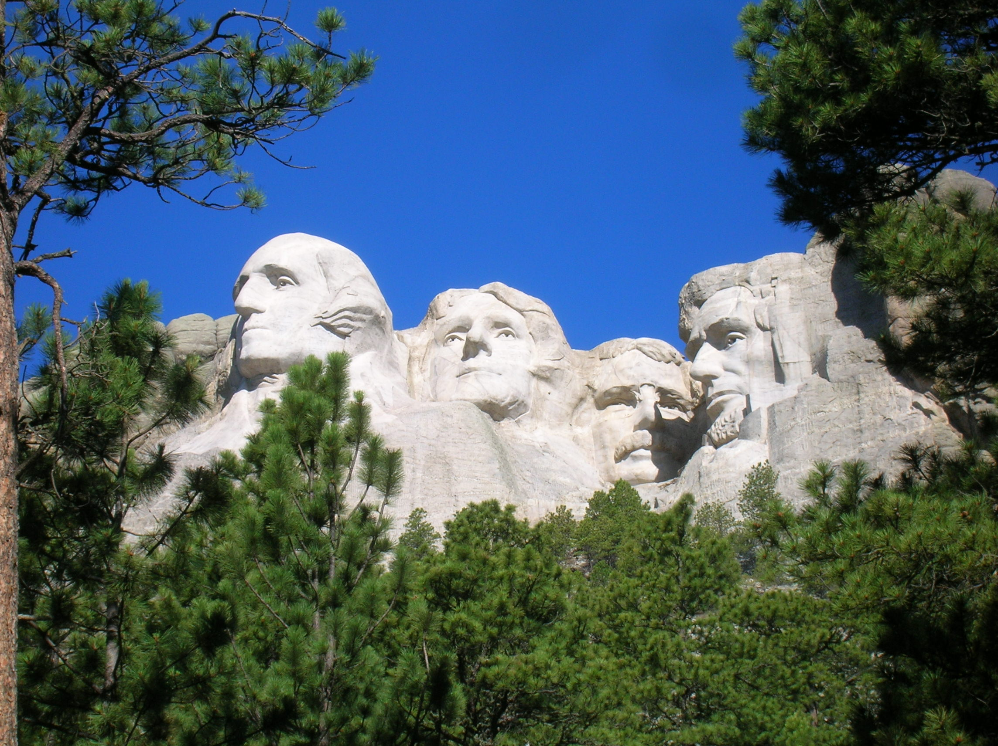
Thanks For Coming

