Slide 1
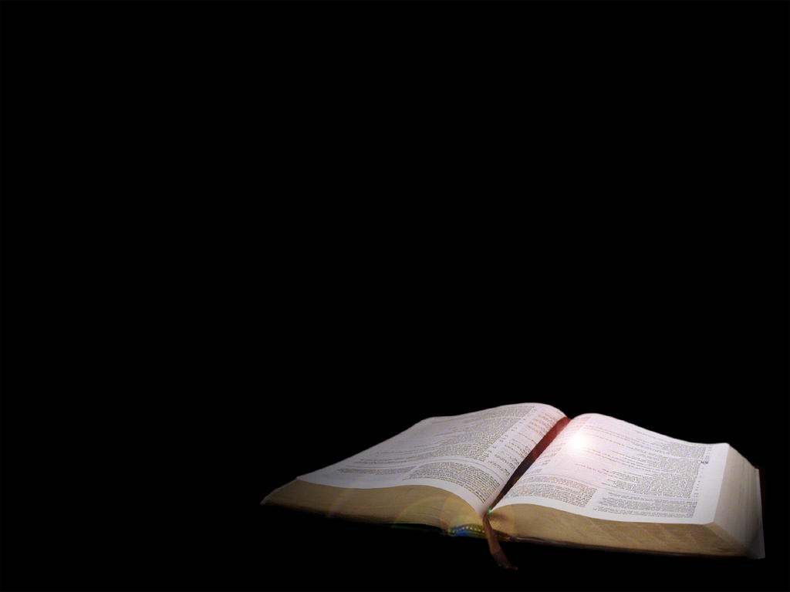
Two Major Hindrances to Communicating Faith to Our Children Wealth and Intermarriage
Deut. 6:10-15; 7:1-6

Slide 2
God’s Special People
Israel was God’s special people
Covenant relationship
“Cut off to God” –circumcision
A matter of the heart
Christians are God’s special people
Chosen
Circumcised
Holy

Slide 3
Daniel I. Block states:
“Until and unless Christians recover a sense of the incredible
privilege of being a holy people belonging to God, the objects
of his gracious election, his treasured people, and targets of
his affection, and until they recover the missional significance
of this calling, the Western church will remain pathetic and
powerless in the face of the challenges of our age.”
NIVAC on Deuteronomy, p. 222

Slide 4
The challenge of wealth
Deut. 6:10-15

Slide 5
Warnings Regarding Wealth
“Do not store up for yourselves treasures on earth . . . but in heaven” (Matt. 6:19-34).
“It is easier for a camel . . .” (Mk. 10:17ff).
“Instruct those who are rich not fix hope on riches, but on God” ( 1 Tim. 6:17).
“You adulteresses, friendship with the world is hostility toward God” (James 4:4-5).

Slide 6
The challenge of intermarriage
Deut. 7:1-6

Slide 7
The Biblical Evidence
In the O.T.
Deut. 7:1-6
Deut. 13:6-11
Gen. 6
Gen. 24
Gen. 27:46-28:9
Judges 3:5-7; 12:9
Josh. 23:12-13
1 Kings 11:9
1 Kings 16:33
Ezra 9 and 10
Neh. 13:23ff

Slide 8
The Biblical Evidence
In the N.T.
1 Cor. 7:12ff; 1 Pet. 3:1ff; Acts 16:1
2 Cor. 6:14-18
1 Cor. 9:5
1 Cor. 7:39

Slide 9
Naomi Schaefer Riley ‘Til Faith Do Us Part
“Those who marry outside their faith tend to take religion less seriously and lose their faith entirely. What had been a temporary state of religious disinterest when a person was single has become a permanent one” (p. 15).
“It is certainly true that interfaith families are less likely to raise their children religiously” (p. xv).

Slide 10
Naomi Schaefer Riley ‘Til Faith Do Us Part
“My survey suggests that interfaith marriages are generally more unhappy—with lower rates of marital satisfaction—often more unstable, with particularly high divorce rates when certain religious combinations are involved” (p. xv).
“Interfaith marriage has become an important vehicle for assimilation and a major driver of religious tolerance” (p. xv.).

