Slide 1
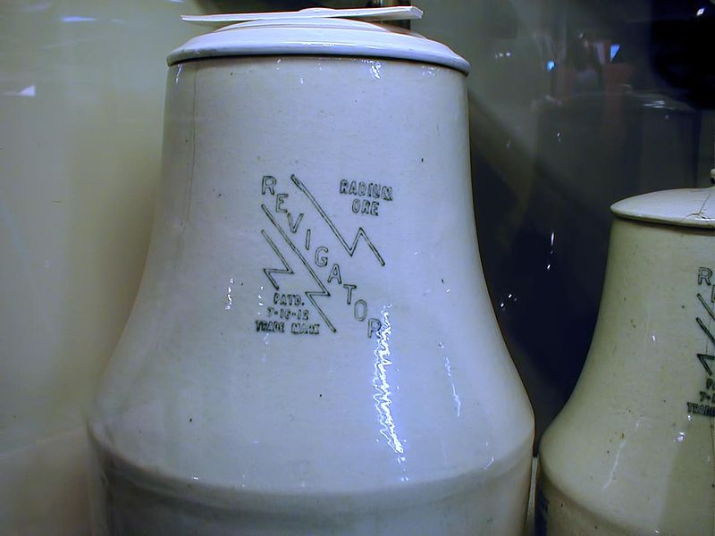
“Physicians of No Value” “Worthless Physicians” ESV “Worthless Quacks” ISV
Job 13:4-5

Slide 2
Physicians of No Value – Worthless Quacks
Context: Job 13:4-5, “Piety Pays – Perversity Punishes”
Expect a Miracle Today. Health and Wealth are Yours to Claim, 3 Jn.2, 1 Pet.2:24, Heb.13:8, 2Tim.4:20, 1Cor.13:8-13
“The Doctrine of Justification by Faith Only is a most Wholesome Doctrine and Very full of Comfort” Rom.3:28, 5:1, Jam.2:24
When Someone Dies, “God Just Wanted to Take Them” Heb.9:27, 1 Cor.15:22, Lk.13:16
The Doctrine of the Eternal Security of the Believer, Jn.10:24-30, Gal.5:1-4, Heb.12:14-15
Baptism is an Outward Sign of an Inward Grace. Mk.16:16, Acts 2:38, Col.2:11-12, 1 Pet.3:21

Slide 3
The Plan of Salvation
Hear the Gospel of Christ, Acts 2:22
Believe in Jesus Christ, Rom.5:1
Repent and Turn to God, Luke 13:3
Confess Jesus Before Men, Matt.10:32
Baptized Into Christ, I Pet.3:21
-----------------------------
Grow And Be Faithful, 2 Pet.3:18
If Err From The Faith: Repent and Pray God I Jn.1:9

