Slide 1
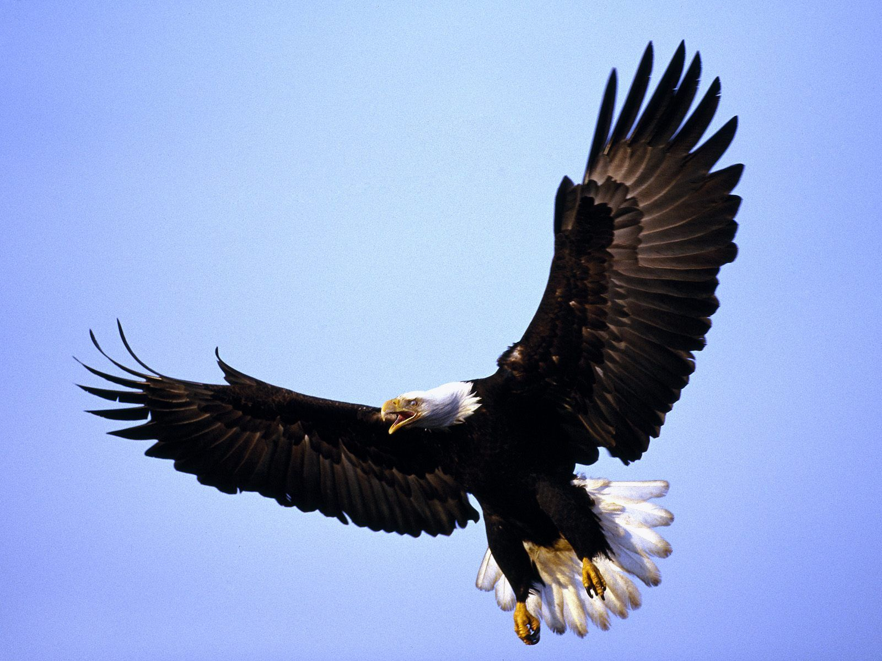
The Glory of God
Isaiah 40

Slide 2
A People Seeking Comfort
Isa. 40:1-2
Israel is a shadow of it’s former self seeking help from a God they forsook.
Who can they turn to?

Slide 3
What Shall I Cry?
Isa. 40:6-8
What do we cry?
Who do we cry too?
Everything is hopeless!!
Isaiah replies only God’s word will stand.

Slide 4
Proclaim The Good News
Isa. 40:9-11
After you have been saved you want to share it with others.
Our God will still comfort and shield us after we forsook Him.
Go and proclaim how truly great our God is.

Slide 5
The Glory of God
Isa. 40:12-17
Water covers 75% of the earth.
The universe is so vast we can barely fathom it.
The mountains are dust.
The hills can be weighed.
God looks at these “great” things and sees only specks.

Slide 6
The Glory of God
Isa. 40:12-17
What can we show God He doesn’t already know?
Nations are a drop in a bucket
Lebanon couldn’t burn enough sacrifices to honor this God.
Everything we call great is empty to Him.

Slide 7
The Folly of Idolatry
Isa. 40:18-20
Can you condense God’s greatness to an idol?
Can we create anything to surpass the ultimate creator if it’s crafted by an inferior craftsman?
What “wonders” has man created that can rival God’s?

Slide 8
Sinfulness of Pride
Isa. 40:21-25
Anything we create will eventually topple.
Anything we put stock in God will do away with in the end.
Anyone we give credence to will fall and their words will pass away.
Who can we tell God to be more like to better Himself?

Slide 9
God Gives strength
Isa. 40:26-31
We assume God can’t understand.
Because He is so great He knows more about us than we know about ourselves.
We cannot help ourselves, someone Has to save us.
Even the strongest grow tired, but we who gain strength from the Lord have a different strength.

Slide 10
God Gives strength
Why look to inferior products, people, or ideas for strength that’s only temporary.
We must continually go to our Lord for strength.
Isa 41:13 For I, the LORD your God, hold your right hand; it is I who say to you, "Fear not, I am the one who helps you."
Isa 41:1 let the peoples renew their strength; let them approach, then let them speak; let us together draw near for judgment.

