Slide 1
Communicating the Faith to Our Children and Grandchildren
Deut. 4:9; 6:1-10;
2 Tim. 1:5; Eph. 6:4

Slide 2
Our Personal Responsibility
We can blame the world.
We can blame the church.
It is our personal responsibility, parents and grandparents.

Slide 3
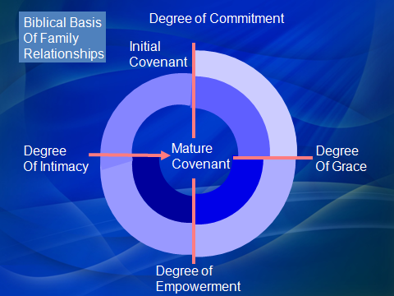
“Unless the Lord builds the house. . .”

Slide 4
Create a trust relationship
We must be unconditionally committed—covenant
We must be gracious
We must empower
Intimacy
Act deliberately!

Slide 5
Communicate faith through instruction
“You shall teach them diligently”
Recommend daily devotional studies
“I don’t know how?”
Some suggestions
Arch Book Series --Video materials
Internet materials
Daily Family Bible Reader, Don Bassett
“Our Spiritual Heritage” Curriculum

