Slide 1
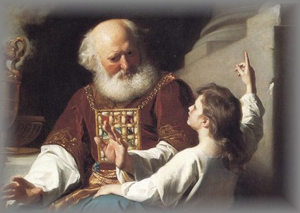
The Story of Young Samuel
1 Sam.3:1-10

Slide 2
The Story of Young Samuel
It’s suggested he was about 12 years old.
Famine in the Land, Amos 8:11, Prov.1:20-33
Eyes waxed dim, “Cataracts.” Deut.34:7
How God used to communicate, Heb.1:1-2
Respectful young man, vs.4-8, Lev.19:32
The Mayor Point to Look at, vs.9-10

Slide 3
“Speak Lord, Thy Servant Heareth”
Respect, Reverence the Lord, Mk.12:1-11
Need to Listen to God, Mt.17:5, Heb.12:25-27
Servant Mindset, Slaves of God: Rom.6:17-18, 22
Hearing Only? Ezk.33:30-33, Jam.1:22-25
Implies to Obey: Illustration, “Did you hear your momma?”
Matt.17:5, Ac.3:22-26, Matt.7:24-27

Slide 4
Will You Be Like Young Samuel?
Hear the Gospel of Christ, Rom.10:17
Believe in Jesus Christ, Acts 16:31
Repent and Turn to God, Acts 17:30
Confess Jesus Before Men, Acts 8:37
Be Immersed for Forgiveness, Acts 2:38
------------------------
Grow In The Grace & Knowledge, 2 Pet.3:18
If Err As a Christian: Repent & Pray God, Acts 19:18

