Slide 1
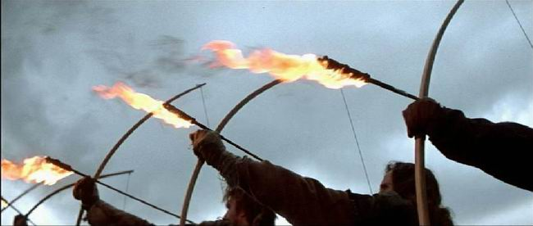
“The Flaming Darts of the Evil One”
Eph.6:10-17
“In all circumstances take up the shield of faith, with which you can extinguish all the flaming darts of the evil one;” ESV

Slide 2
“The Flaming Darts of the Evil One”
The Dart of Sleep, Eph.5:14, Rm.13:11
The Dart of Disobedience, 1Sam.15:13-15, 22-23
The Dart of Difficulties, Ac.14:22, Lk.13:16
The Dart of Distance, Lk.22:54, Jm.4:8
The Dart of Deception, 1Tim.4:1, 1 Cor.6:9
The Dart of Itching Ears, 2 Tim.4:2-5
The Dart of Doubts, Heb.3:12-13, Heb.12:1-3
The Dart of Stinginess, Mal.3:8-9, 2 Cor.9:6
The Dart of Silence, Is.56:10, Jer.23:30
The Dart of Dissension, Phil.4:2
The Dart of Discouragement, Num.21:4-5
The Dart of Procrastination, Eccl.5:4, Ac.24:25

Slide 3
A Home In Heaven
Faithfulness
Baptism
Confession
Repentance
The Ladder to Eternity
Believe
Hear
Sin

Slide 4
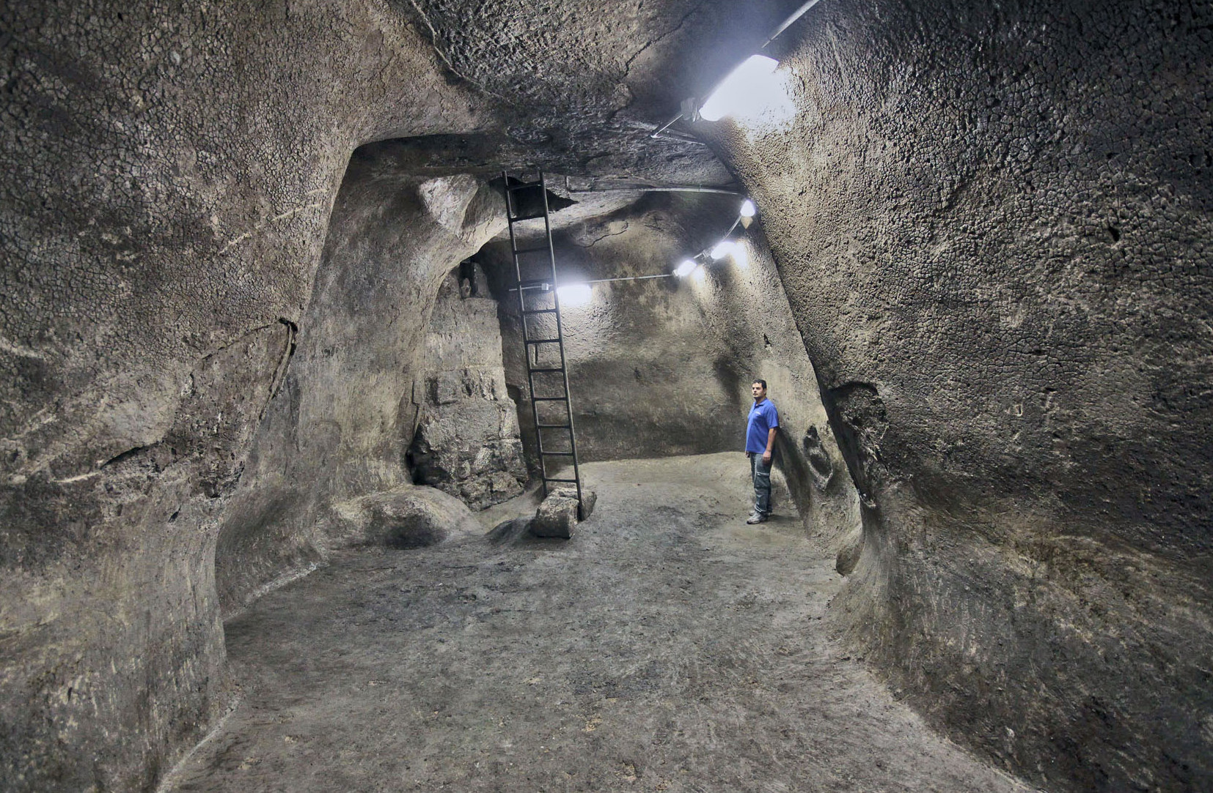
Thanks For Coming
A first century rock hewed reservoir recently discovered in Jerusalem. The reservoir has an approximate capacity of 66,043 U.S. Gallons.

