Slide 1
“Oh Be Careful”
O, be careful little eyes what you see
O, be careful little eyes what you see,
For the Father up above is looking down in love,
So be careful little eyes what you see.
Repeat…
Ears Hear
Mouth Say
Hands Do
Feet Go
Nose Stick It
Mind Think

Slide 2
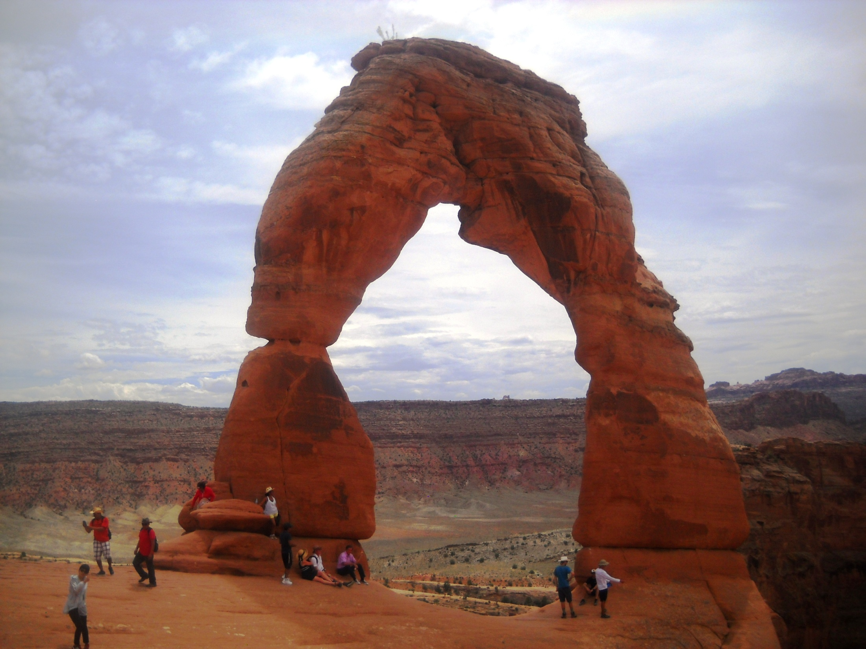
Arches National Park In Utah
Delicate Arch
65 ft.

Slide 3
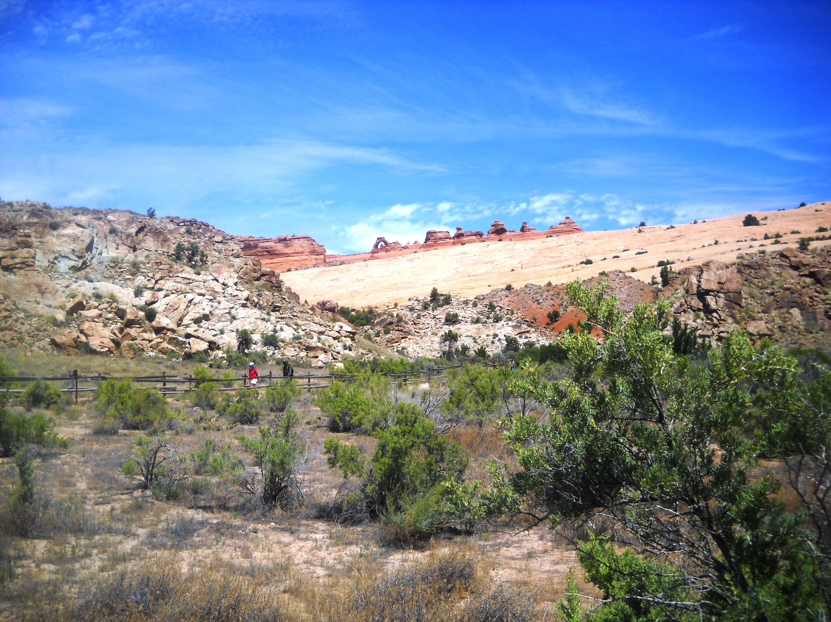

Slide 4
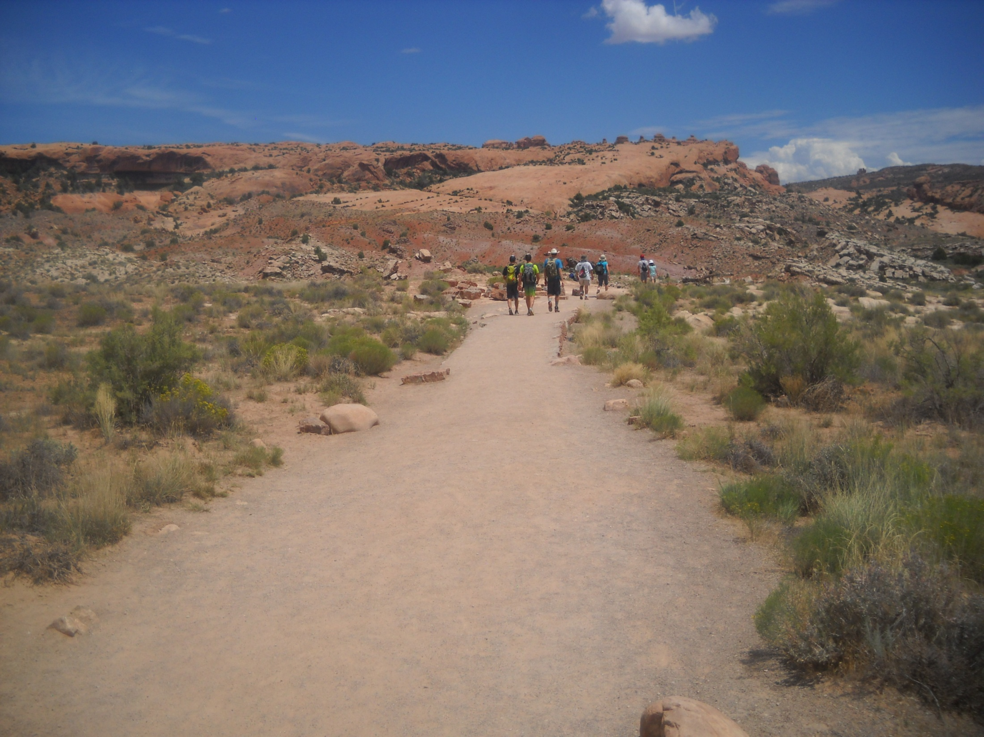
1.5 mile hike to Delicate Arch
Rise of 480 ft. from the parking lot
Lots of sun and plenty of heat

Slide 5
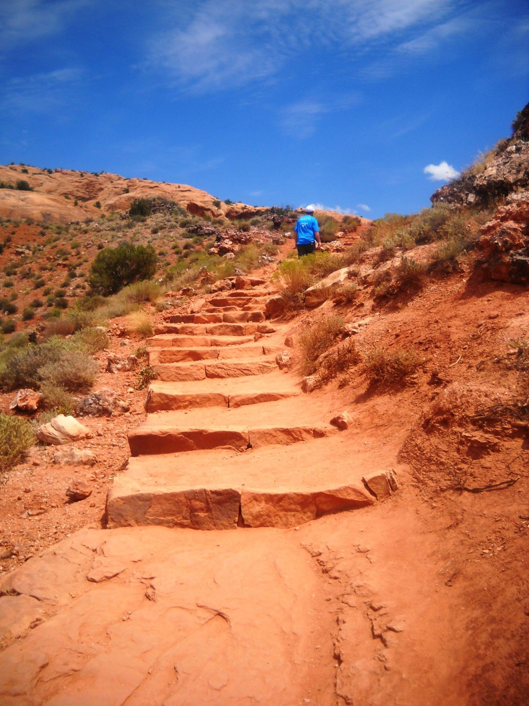

Slide 6
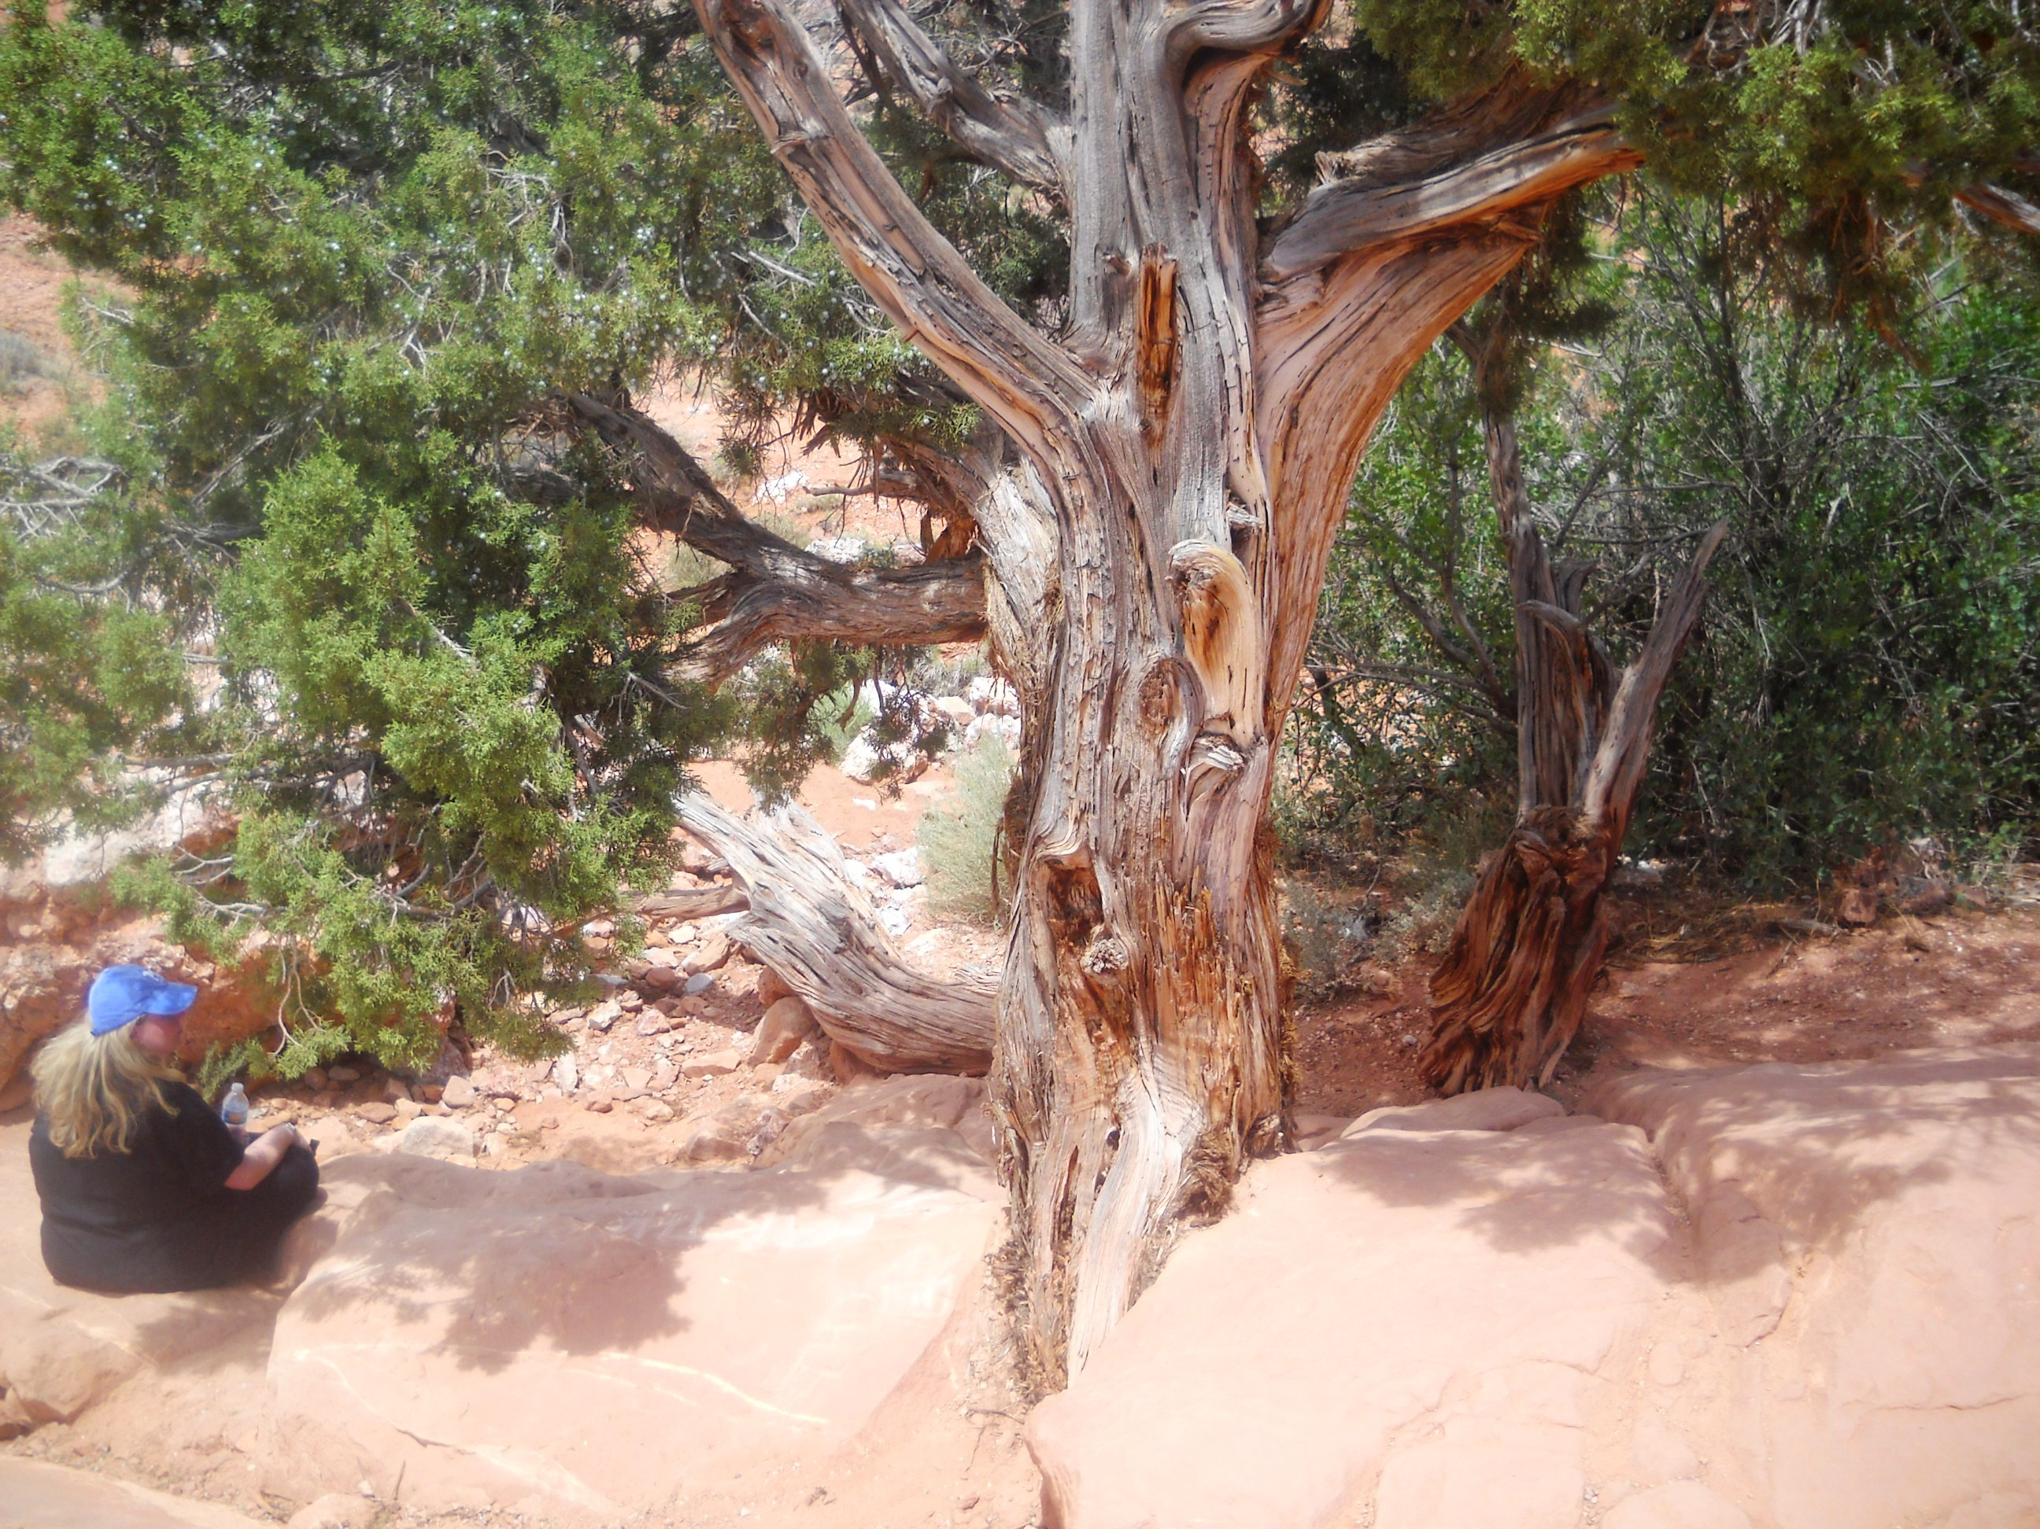

Slide 7
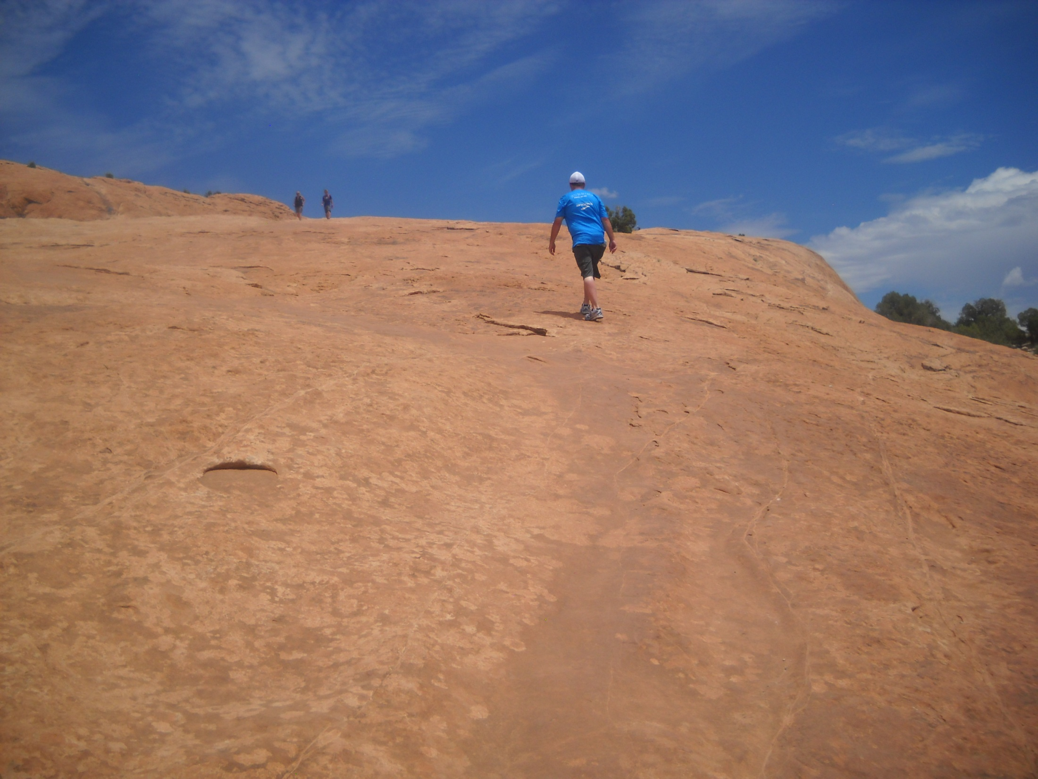

Slide 8
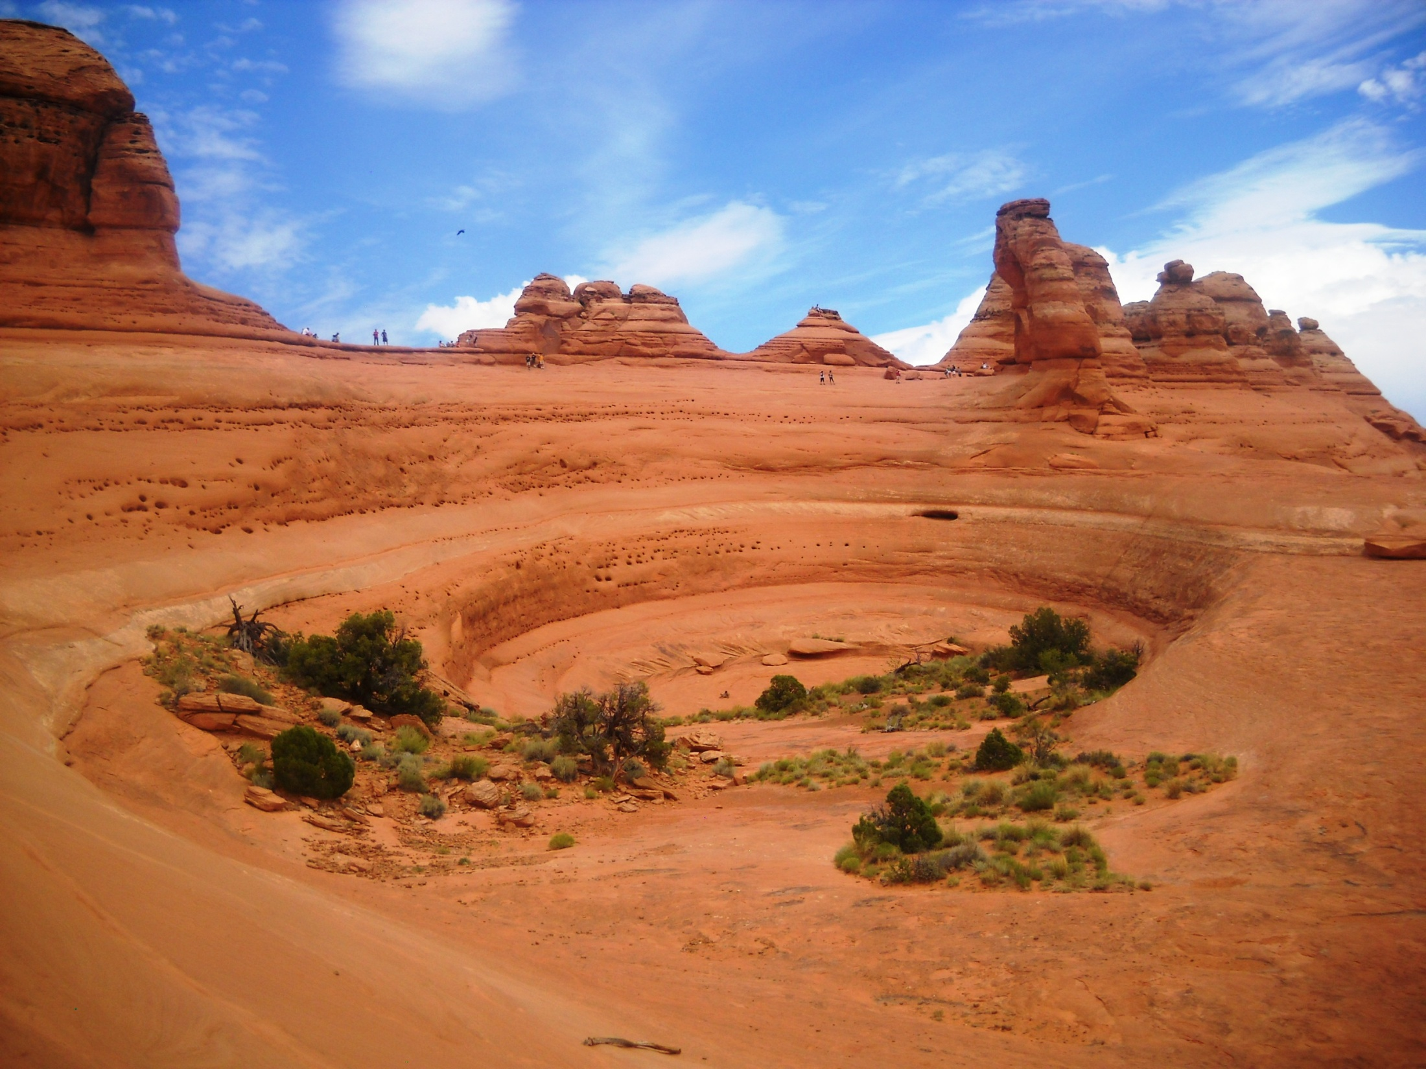
100 ft.

Slide 9
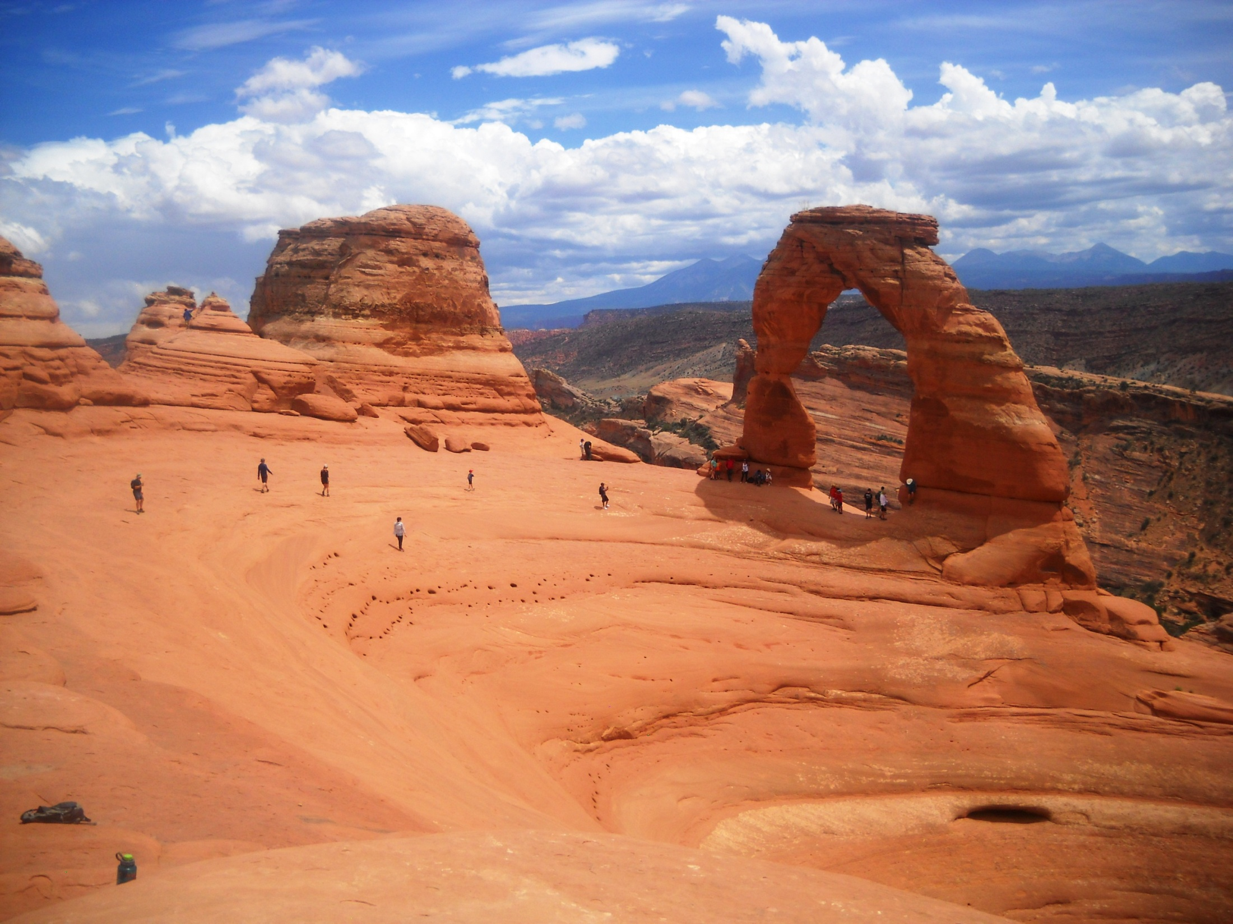
Walking Circumspectly
Eph.5:15

Slide 10
Walking Circumspectly – Eph.5:15
Define: “akribōs” exactly, accurately, diligently, carefully
Children’s Song – Oh Be Careful
Feet, Ps. 1:1-3, Is.65:2
Eyes, Job 31:1, Mt.4:8, 1 Jn.2:16
Mouth, Mt.12:34-37, Jm.3:1-12
Hands, Jm.4:8, 1 Tim.3:3, Pr.21:25
Ears, Mk.4:9, 24, Luke 8:18
Nose, 1 Pet.4:15, 1 Thes.4:11
Mind, Pr.4:23, 23:7, Phil.4:8
Applications in Many Areas:
Church, Home, Neighborhood
Work Place, School, Shopping

Slide 11
The Plan of Salvation
Hear the Gospel of Christ, Acts 18:8
Believe in Jesus Christ, Rom.5:1
Repent and Turn to God, Luke 24:47
Confess Jesus Before Men, Matt.10:32
Baptized Into Christ, Gal.3:26-27
-----------------------------
Grow And Be Faithful, 2 Pet.3:18
If An Erring Christian: Repent and Pray God, I Jn.1:9

